Slide 1
Economics for Leaders
Lesson 1: Economic Growth & Scarcity

Slide 2
Hypothesis for the Week
Human prosperity and social cooperation develop spontaneously in societies that protect private property rights and encourage voluntary trade.

Slide 3
Economic Reasoning Proposition #5
ERP-5: Understanding based on knowledge and evidence imparts value to opinions.
  Opinions matter and are of equal value at the ballot box. But on matters of rational deliberation the value of an opinion is determined by the knowledge and evidence on which it is based. Statements of opinion should initiate the quest for economic understanding, not end it.

Slide 4
3 sample slides follow. The third is linked to a video. Please use ONE of these or a similar video found on the EFL videos website, to set the context of world poverty and to introduce ERP #5.

Slide 5
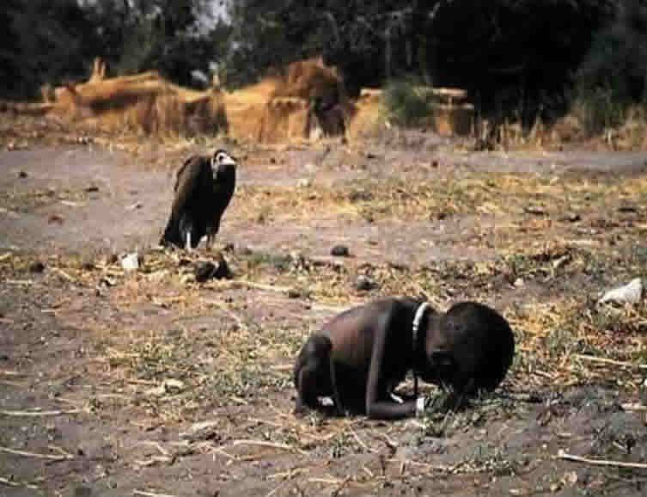

Why Should We Care?
http://www.flatrock.org.nz/topics/odds_and_oddities/ultimate_in_unfair.htm
Notes:
The story of Kevin Carter: he shot this in Sudan in 1993, during famine, then chased the vulture away but did not apparently help the girl (perhaps on instruction not to touch the locals due to fear of disease...?). He later committed suicide.
NYT published the picture and was overcome by an avalanche of inquiries from readers as to what happened to the girl but she was never found again.

Slide 6
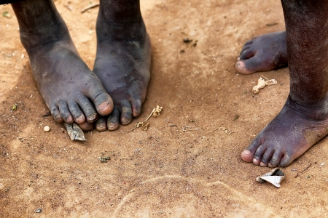
Why Should We Care?

Slide 7
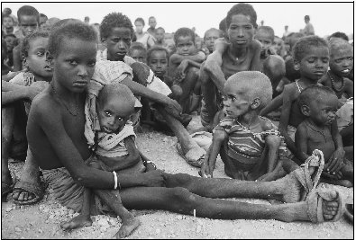
Why Should We Care?
Notes:
Picture is link to video. Play from beginning to 1:30. Possibly show without sound.
http://www.youtube.com/watch?v=cKjySRhVWbg

Slide 8
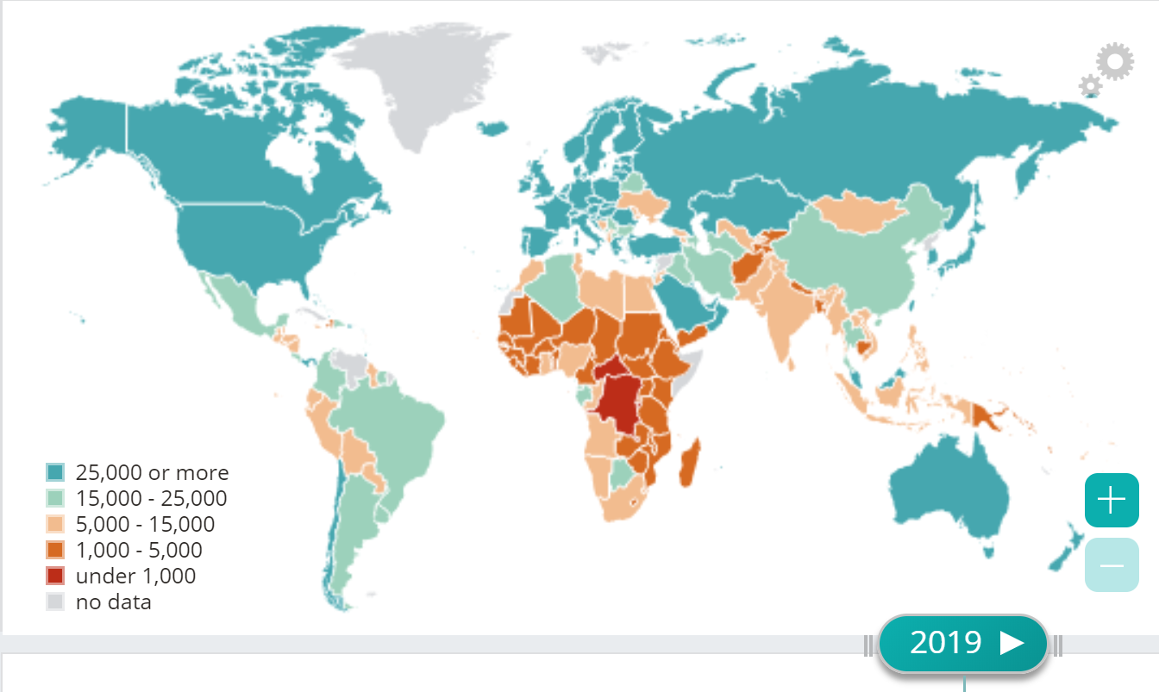
GDP Per Capita 2019 PPP
International Monetary Fund DataMapper
Low, Middle, & High Income Nations
Why are some countries rich and others poor?
Notes:
Economic reasoning tools developed this week will help us to answer this and other questions about world poverty
Interactive Map: http://www.imf.org/external/datamapper/PPPPC@WEO/THA/EGY

Slide 9
Economic Growth
Economic growth raises standards of living, even in the continuing face of scarcity
Notes:
What we will discover is that economic growth – not redistribution -- is the ultimate solution to poverty.

Slide 10
Economic Growth
Improves the lives of the poor by making the pie bigger
Bigger “slices” mean higher standards of living

Slide 11
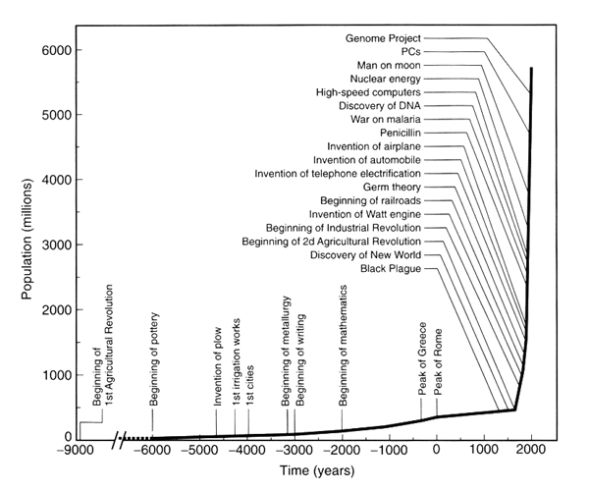
Population Growth and Important World Events
~1750

Slide 12
Economic Reasoning Proposition #1
ERP 1: People choose, and individual choices are the source of social outcomes.
  Scarcity necessitates choices: not all of our desires can be satisfied. People make these choices based on their perceptions of the expected costs and benefits of the alternatives.
Notes:
Make a transition from the general topic of world poverty – to economic reasoning tools

Slide 13
Scarcity Isn’t Optional
Fact: Resources ARE limited
  Land (natural resources)
  Labor (human effort)
  Capital (buildings, machines, & technology)
  Entrepreneurship (willingness to risk)
  Time
Fact: Human desires are boundless

Slide 14
Productivity
The output produced from a given set of resources in a given period of time.
Increasing productivity means that greater output is produced from a given set of resources in a given period of time.

Slide 15
Institutions
The formal and informal “rules of the game” that shape incentives and outline expected and acceptable forms of behavior in social interaction.

Slide 16
Incentives
The reward or penalties that influence people’s choices and behavior.

Slide 17
The “Big Ideas” from Lesson 1:
Scarcity forces us to choose among alternatives
Economic growth gives us more to choose from and raises standards of living by:
  reducing infant mortality,
  Increasing life expectancy,
  reducing hunger,
  improving environmental quality, and
  reducing the incidence of debilitating diseases.

Slide 18
The “Big Ideas” from Lesson 1:
Some institutions and institutional arrangements encourage economic growth and some do not.
The institutions that foster growth and economic development include:
  Open markets
  Property rights and the rule of law
  Entrepreneurship and innovation

Slide 19
Please use the slides before this one in your presentation.
The slides following this one are provided as options.

Slide 20
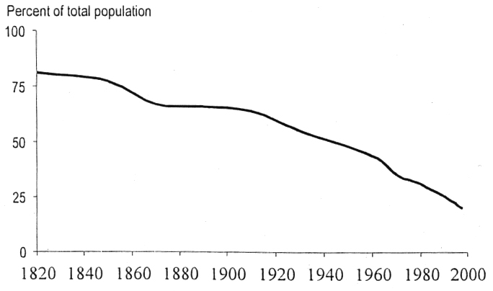
Share of World Population in Poverty,
1820 - 1998
Notes:
Visual from “A Long-term Economic Perspective on Recent Human Progress” by Gary Walton 2012

Slide 21
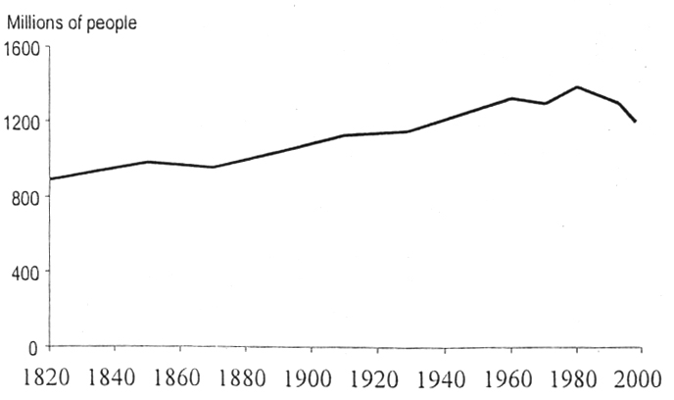
Number of People Living on Less Than $1 Per Day, 1820 - 1998
1980
Notes:
Visual from “A Long-term Economic Perspective on Recent Human Progress” by Gary Walton 2012

Slide 22
Why can’t we have all we want?
Available resources are limited
  Land (57,506,000 sq mi. & not even all habitable!)
  Labor (7 bil. souls x 24 hrs a day)
  Capital (less than ∞)
  Entrepreneurship (not everybody is Jeff Bezos)
Human desires are boundless : 7 billion & increasing
Notes:
We can never quite have it all, there is always a desire lurking in the back of our mind. We WILL be hungry again tomorrow, we will be thirsty this afternoon. We will salivate over that next chocolate bar even if we had eaten a thousand of them to this day.
It is our unfortunate predicament that the available resources will never quite match our desires and needs.
What do we call this? Scarcity.

Slide 23
Economic Growth
Economic growth raises standards of living, even in the continuing face of scarcity
Growth does not eliminate scarcity but may attenuate it (some things become less scarce)
Growth is
  Not even across times and countries
  Not automatic
  Not irreversible
BUT!
It is the most powerful weapon against poverty ever discovered!

Slide 24

Questions:
Why are some countries rich and others poor?
Why have some countries experienced economic growth and others have not? (What factors lead to economic growth?
Why are some countries growing rapidly today and others are not, even though they may have experienced significant growth in the past?
What can be done to promote economic growth and reduce poverty?

Slide 25
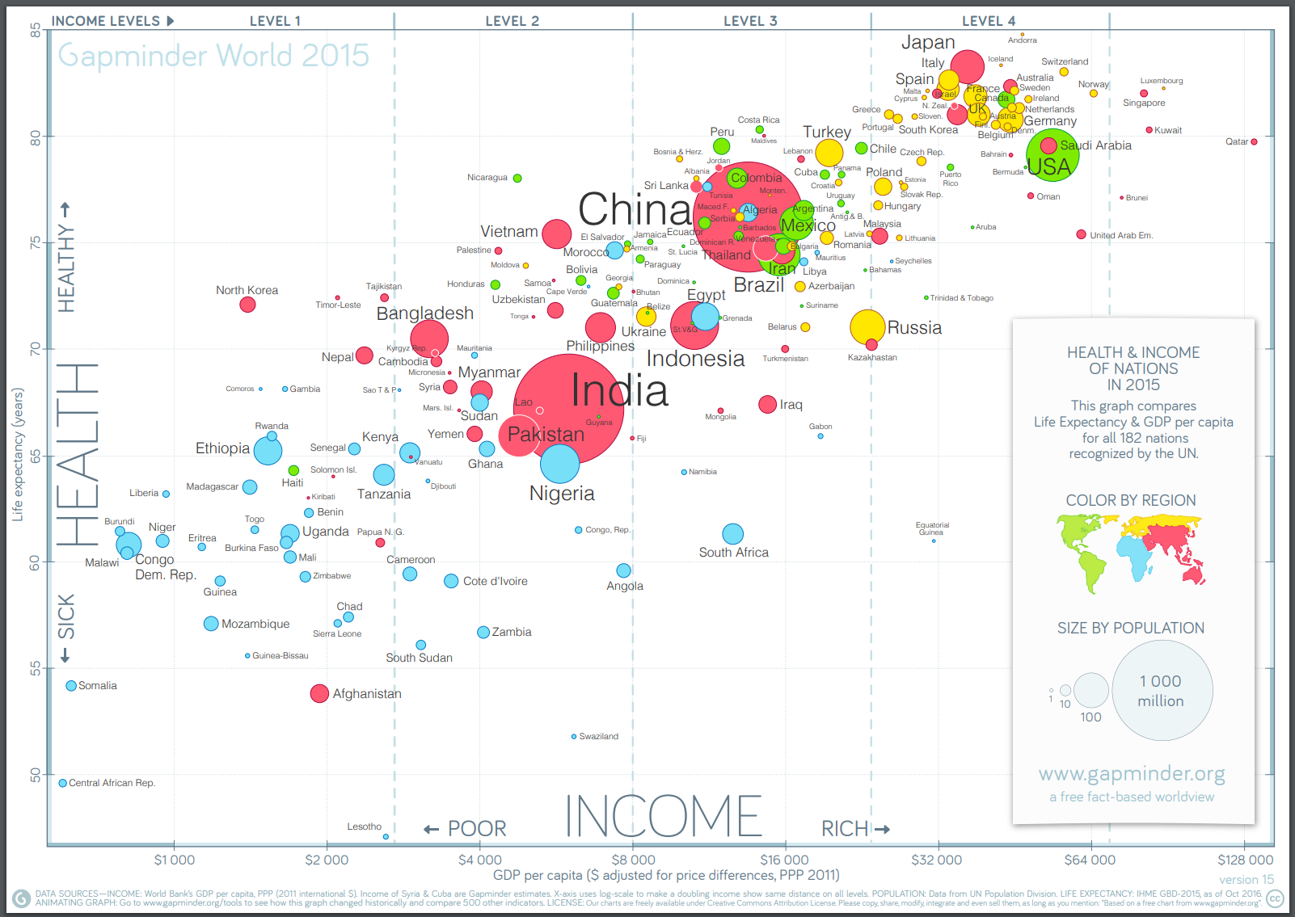
https://www.gapminder.org/news/updated-gapminder-world-poster-2015/
Notes:
Mapping the health and wealth of the world. Life expectancy and Income per person 2015. Size of the bubble = population. Color = region. Updated Dec. 2016
https://www.gapminder.org/downloads/updated-gapminder-world-poster-2015/

Slide 26
The Secret to Economic Growth: Productivity
The output produced from a given set of resources in a given period of time.
Increasing productivity means that greater output is produced from a given set of resources in a given period of time.
Hans Rosling and the Magic Washing Machine
http://www.youtube.com/watch?v=BZoKfap4g4w

Slide 27
Key to Productivity: Institutions
The formal and informal “rules of the game” that shape incentives and outline expected and acceptable forms of behavior in social interaction – our institutions help protect property rights.
Institutions in your life:

Slide 28
What are the “rules of the game” (the accepted and expected forms of social interaction) in:
Dating ?
Notes:
Ask students to define the “rules” for dating. Do you just call up a girl? Do you need “signals” to tell you what to do? How do your friends help you? Where does the Mall fit in?

Slide 29
Institutions shape Incentives
Incentives are the rewards or penalties that influence people’s choices and behavior.

Slide 30
The Institutions that matter for economic growth . . .
. . . are the institutions that shape the Incentives for choices about the uses of scarce resources.
Open markets
Property rights
The rule of law
Entrepreneurship and innovation

Slide 31
How Do You Know When Something is Scarce?
Scarcity Forces You to
CHOOSE
SCARCITY CHOICE

Slide 32
Economic Reasoning Proposition #2:
Choices impose costs; people receive benefits and incur costs when they make decisions.
  The cost of a choice is the value of the next-best alternative foregone, measurable in time or money or some alternative activity given up.

Slide 33
People’s Choices are always RATIONAL
Rational choice = choosing the alternative that has the greatest excess of benefits over costs.
If ALL choices are rational, then the challenge is to understand the decision-maker’s perception of costs and benefits.

