Slide 1
Economics for Leaders
Activity Slides

Slide 2
Economics for Leaders
Activity: Magic of Markets

Slide 3
5 Economic Reasoning Propositions
People Choose, and individual choices are the source of social outcomes.
Choices impose costs; people receive benefits and incur costs when they make decisions
People respond to incentives in predictable ways.

Slide 4
5 Economic Reasoning Propositions
Institutions are the “Rules of the Game” that influence choices
Understanding based on knowledge and evidence imparts value to opinions.

Slide 5
Institutions that foster growth and Economic Development:
Open Markets
Property Rights
Rule of Law
Entrepreneurship and Innovation

Slide 6
Why do people trade?

Slide 7
Round 1

Slide 8
Round 2

Slide 9
Why do people trade?

Slide 10
Was it possible to trade without bearing a cost?

Slide 11
What are the necessary conditions for wealth creating to take place?
Think INSTITUTIONS!
“Rules of the Game”
Property Rights
Voluntary Exchange

Slide 12
Does the creation of wealth make EVERYONE happy?

Slide 13
Assessment:
If we were to observe twenty people buying items at an outdoor Farmers market, what could we conclude about their gains and losses?
What could we conclude about their wealth?

Slide 14
Economics for Leaders
Activity: The Ultimatum Game

Slide 15
Proposal Selection Form
Proposer Identification Code __________________
Circle a proposal:
9/1 8/2 7/3 6/4 5/5 4/6 3/7 2/8 1/9
If the responder accepts this proposal,
I will receive ________ and the responder will receive ________ .
If the responder does not accept this proposal, both the responder and I will receive $0.
XyZpDQ
$$$$$
$$$$$

Slide 16
Proposer Identification Code __________________
Circle a proposal:
9/1 8/2 7/3 6/4 5/5 4/6 3/7 2/8 1/9
If the responder accepts this proposal,
I will receive ________ and the responder will receive ________ .
If the responder does not accept this proposal, both the responder and I will receive $0.
Responder Identification Code _________________
If I accept the proposal circled above,
I will receive ________ and the proposer will receive ________
If I reject this proposal , I will receive $0 and the proposer will receive $0.
Circle either accept or reject below.
ACCEPT REJECT
XyZpDQ
$$$$$
$$$$$
123LMNO
$$$$$
$$$$$

Slide 17
Debrief
What did the proposers offer? Why?
How did they decide how much to offer?
Notes:
Don’t reveal what you did…. But what do you THINK the proposers and responders did?

Slide 18
Debrief
Which offers did responders accept or reject? Why?
How did responders decide whether to accept or reject an offer?

Slide 19
Debrief
A fundamental assumption of economics is that economic man is a rational decision-maker who acts in his self-interest.
Are the results of this activity consistent with this theory of homo economicus (economic man)?
Why or Why not?

Slide 20
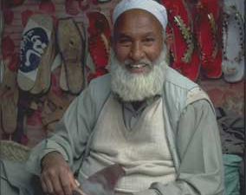
The Ultimatum Game
Notes:
Important Experiment that has been done many times, many places, etc…. In the field of Economics.

Slide 21
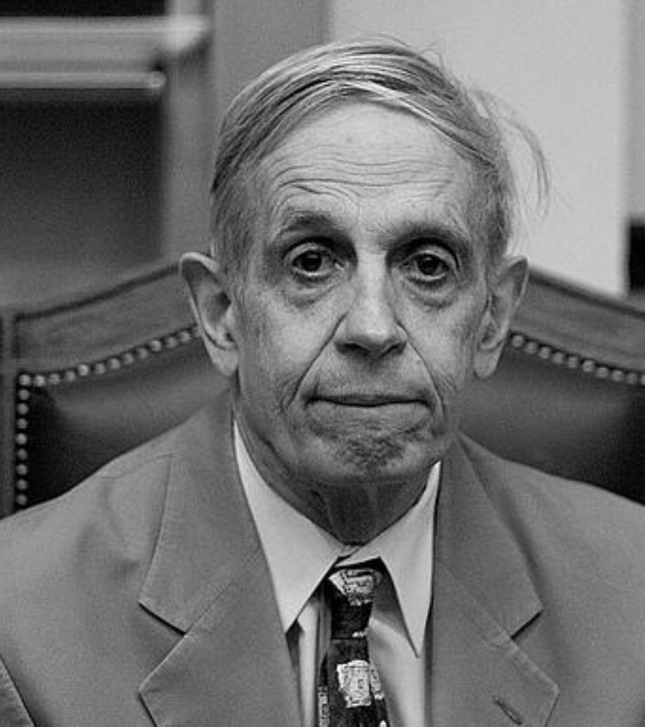
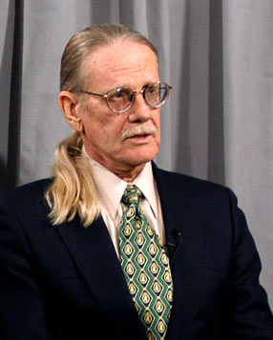
History
John Nash – 1994 Nobel Prize in Economics for his work in game theory
Game Theory – the study of interactions in which the results of one person’s choices depend not only on his own behavior, but also on the choices made by another person.
Vernon Smith – 2002 Nobel Prize in Economics for experimental economics, which builds on game theory.
Notes:
John Nash: Girls walk in… which would you approach? The prettiest… NO, she wouldn’t go out with you and all the rest of the girls would be mad because you went after the “pretty” one = consider other’s choices when making your own choice.
Vernon Smith: Experiments like this Ultimatum Game and Broadband Auction… etc.

Slide 22
“These experiments create an empirical challenge to what we call the
selfishness axiom—
the assumption that individuals seek to maximize their own material gains in these interactions and expect others to do the same.”
~Joseph Henrich, Emory University –Completed a 4-continent research project in which the Ultimatum Game was played in 15 indigenous societies.

Slide 23
Debrief
If individuals “seek to maximize their own material gains,” and assume that other people do, too, what will proposers do?
Why? (explain their thinking)
Notes:
EVERY offer should be 9:1

Slide 24
Debrief
If individuals “seek to maximize their own material gains,” and assume that other people do, too, how will responders react to proposals?
Why?

Slide 25
Results of Large Numbers of Ultimatum Game Experiments*:
the modal (most common) split is
50% - 50%
the mean (average) split is about
60% - 40%
about 20% of low offers are rejected
*Games conducted with college students in the U.S. and other developed countries. Students were paid to participate. Stake was the equivalent of $10 U.S. Results are considered to be “robust.”

Slide 26
Debrief
The results of ultimatum games are inconsistent with the model of economic man that predicts material self-interest (selfishness).
Note, especially, the rejection rate.

Slide 27
Proposed Explanations
“Other-regarding” Behavior
  We gain satisfaction not only from our lives (as the homo economicus model predicts), but also from the lives of others.
Notes:
Other-Regarding behaivor: Maybe but Research says this isn’t the biggest explanation
Fairnes: Rejected.

Slide 28
Proposed Explanations
Reciprocity? Vernon Smith’s variations on the Ultimatum Game suggest that reciprocity motivates people.
  Centipede Game: reward the other person for not being selfish, hoping for reciprocal generosity on their turn.

Slide 29
Proposed Explanations
More equal splits may be less the result of fearing punishment for being unfair than they are the result of individuals’ concern for their reputations
  This is consistent with the results of experiments comparing the behavior of people in market and non-market economies (also consistent with Adam Smith’s observations)
Notes:
Other-Regarding behaivor: Maybe but Research says this isn’t the biggest explanation
Fairnes: Rejected.

Slide 30
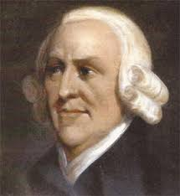
“A dealer is afraid of losing his character, and is scrupulous in observing every engagement. When a person makes perhaps 20 contracts in a day, he cannot gain so much by endeavoring to impose on his neighbors, as the very appearance of a cheat would make him lose.”
~Adam Smith – Wealth of Nations

Slide 31
“Markets require that even those persons who are not particularly other-regarding in their personal lives become so in their market behavior. Since market exchanges are voluntary, and since the objects the purchaser might acquire are many, entry into the market obliges sellers to become to an important degree other-regarding.”
~Michael Novak – Business as a Calling

Slide 32
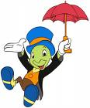
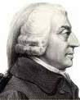
Proposed Explanations
Adam Smith’s “Impartial Spectator”
We view our behavior through the eyes of an impartial spectator.
- Theory of Moral Sentiments
Notes:
It’s about the INSTITUTIONS

Slide 33
Proposed Explanations
Players demand fairness, and punish unfair behavior on the part of proposers.
  Vernon Smith’s new “trust game” research supports this hypothesis. Hurtful actions (injustice) merit punishment, while justice (want of injustice) merits no reward.
Variations of the Ultimaturm Game
  Earned right to be the proposer
  Dictator Game
  Presented as “transaction” rather than “ultimatum”
  If innate sense of fairness is the motivator, why are offers different?
  So perhaps not innate fairness but “functional” fairness.
Notes:
Other-Regarding behaivor: Maybe but Research says this isn’t the biggest explanation
Fairnes: Rejected.

Slide 34
Conclusions Based on Continued Research
Behavior in none of the 15 less-developed societies was consistent with the selfishness axiom.
Size of the Stake matters – very high stakes yield lower offers and lower rejection rates.
Individual differences do not explain ultimatum game outcomes
  age
  gender
  socio-economic status
  risk-aversiveness
However . . .

Slide 35
Conclusions based on continued research:
Group Differences Matter
  in the routine degree of economic cooperation in everyday life (EX: Whaling Communities)
    And…
  in the degree to which markets are an integral part of society
Group differences are significant in explaining experimental outcomes
Notes:
Group differences DO MATTER
EX: Whaling societies – you don’t catch whales by yourself.
The degree to which markets are integrated in society and the more they interact in markets, the more “fair” the splits.

Slide 36
Thus, we return to INSTITUTIONS
PERHAPS…. The way people play the ultimatum game reflects the way they interact in everyday life.
  Splits are more equal in cultures where people commonly exchange products and labor in markets.
  Markets are institutions through which societies develop distinctive patterns of interaction, which may be internalized and reflected in ultimatum game behavior.

Slide 37
Food for Thought (or assessment…)
Suppose that someone argued that capitalism is not good for the poor because it makes people greedy and selfish and encourages them to ignore others and think only of themselves. How could you use the results of ultimatum game experiments to counter that argument?

Slide 38
Our Results…

Slide 39
Paul Heyne, The Senior Economist, April 1995
Perhaps the most common moral objection to market systems is the one that asserts they are based on universal selfishness. Is that true? . . .
Economic theory assumes self-interested behavior. Self-interested behavior is selfish behavior only if one’s interests are selfish. We could avoid confusion on this score by saying that economic theory assumes people act to further the projects that interest them. Whether those projects are entirely or primarily selfish depends on what kind of people they are. We should probably be slow to judge. What do we really know about other people’s motives? . . .

Slide 40
Paul Heyne, The Senior Economist, April 1995
The moral critics of capitalism . . . might reply, ‘people are motivated primarily by money.’ And that is certainly true. But what does it mean? Suppose you are a teacher who has been asked to sponsor the debate club. You don’t really want to do it, but you agree when you are offered an extra $200 a month in salary. Were you motivated in this case by the money? It would seem so. But what does it tell us? It does not tell us you are interested only or primarily in money, because money is always a means to some other end. Suppose Ms. Demosthenes wants the money in order to increase her contributions to the local children’s hospital, and she will be giving up her regular bowling nights in order to find the time. Mr. Cicero will use the extra money to ACCEPT himself a new set of golf clubs and will find the time by preparing less carefully for his classes. Both Ms. Demosthenes and Mr. Cicero did it for the money, but what a world of moral difference we find in why and how they really did it.

Slide 41
Economics for Leaders
Activity: In the Chips

Slide 42
How to Play “In the Chips”
Your Goal: Make as much profit as you can over the course of the game.

Slide 43
How to Play “In the Chips”: BUYERS
Buyers: Each buyer will have only one buyer card at a time. It will say, “You are authorized to buy a box of computer chips. Pay as little as possible. If you pay more than ______ per box, you lose money.”
To make a “profit,” buy at a lower price than the price shown on your card. If you buy at a higher price, you suffer a loss.
Record the buyer card price & transaction price on your student score sheet.

Slide 44
How to Play “In the Chips”: SELLERS
Sellers: Each seller will have only one seller card at a time. It will say, “You are authorized to sell one box of computer chips for as much as possible. If you accept less than ______ per box you lose money.”
To make profit, sell at a higher price than the price shown on your card. If you sell at a lower price, you suffer a loss.
Record the seller card price & transaction price on your student score sheet.
REPORT TRANSACTION PRICE TO TEACHER

Slide 45
How to Play “In the Chips”: EVERYONE
When I say “GO,” sellers and buyers are free to move around the room and to make transactions with one another. Any seller may talk with any buyer.
Both buyers and sellers are free to make as many transactions as they want in a round
Remember to trade in your card after each transaction.
During the game, keep track of your progress on the student score sheet.
In between rounds, compute your gains and losses by taking the difference between the price on your buyer or seller card and the price of the transaction.

Slide 46
Let’s Play!

Slide 47
Debriefing
Who made money?
Who made the most money?
  Strategies?
Who lost money?
  Why?

Slide 48
Debriefing
What conditions made the market work well?
  Equal number of buyers and sellers
  like products for sale
  equal or full knowledge about the products
  clear rules concerning what you could/could not do in market

Slide 49
Debrief
What can you tell me about price in the various rounds?
In which round was there the greatest spread in transaction prices? Why?
Why did the transaction prices become more concentrated in the final rounds?

Slide 50
Debrief
Who determined the “market price” for computer chips?
Buyers? Where would they have set the price if they'd had the power to do so?
Sellers? Where would they have set the price if they'd had the power to do so?
Would you describe this as a competitive market?
Who was in competition with whom?

Slide 51
Debrief
How does opportunity cost explain a high price on a seller card? A low price on a buyer card?

Slide 52
Economics for Leaders
Activity: Market for Thingamajigs

Slide 53
How to Play - BUYERS
Goal: PROFIT
Each buyer will have only one buyer card at a time. The card will allow you to buy ONE thingamajig and will tell you how much you value it. To make a “profit,” buy at a lower price than the price shown on your card. If you buy at a higher price, you suffer a loss.
Record the buyer card price on your student score sheet.
When the round starts, try to buy below your buyer-card price – the lower, the better. (You may buy at a price higher than that on your buyer card, but note that this will reduce your “profit” for the round.)

Slide 54
How to Play - SELLERS
Goal: PROFIT
At the beginning of each round, each seller will be given an inventory of 10 Thingamajigs and a role card with the cost per thingamajig.
To make profit, sell at a higher price than the cost. If you sell at a lower price, you suffer a loss.
Record the transaction prices as you sell on your seller score sheet.
In between rounds calculate your profits.

Slide 55
How to Play - EVERYONE
All stores are open to all buyers.
When a buyer and seller agree on a price, they record the transaction on their transaction records, and the seller gives the Thingamajig to the buyer.
The BUYER must then report the transaction by turning in the Thingamajig card to the person keeping the Market Tally in the front of the room. The buyer may then exchange his buyer card for another and try to make another purchase.

Slide 56
How to Play - EVERYONE
When the teacher says “Start,” sellers and buyers are free to move around the room and to make transactions with one another. Any seller may talk with any buyer.
Both buyers and sellers are free to make as many transactions as they want in a round. Buyers, remember to turn in your Thingamajig card to the tally keeper and get a new buyer card after each transaction.
During the game, keep track of your progress on the student score sheet. Compute your gains and losses by taking the difference between the price on your buyer or seller card and the price of the transaction.

Slide 57
Let’s Play!
ROUND 1

Slide 58
Let’s Play!
ROUND 1
ROUND 2
ROUND 3
ROUND 4
Notes:
Round 1: Regular (don’t run out of inventory)
Round 2: Higher Value cards (disaster)
Round 3: Opportunity for Buyers to get more
Round 4: Price Ceiling

Slide 59
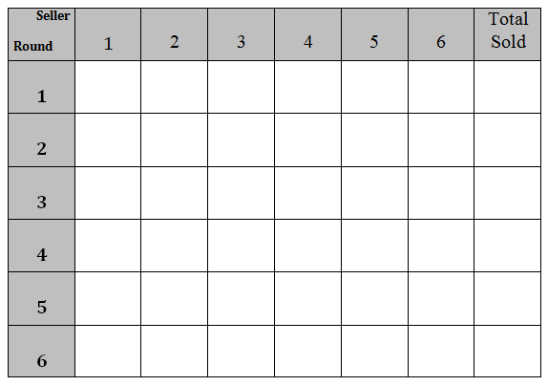
Transaction Tally

Slide 60
Economics for Leaders
Activity: Job Jungle
Job Jungle, Copyright 1988 - Raymond P. H. Fishe, all rights reserved.

Slide 61
1 Kitchen - How Many Cooks?
# cooks | #pizzas made | # additional pizzas from hiring this cook? | What happened?
0 | 0 | 0
1
2
3
4
5
6
No Cook – No Pizza !
10
10
Good cook – does everything himself
25
15
1 baker, 1 prep and waiter
45
20
1 baker+1 prep+1 waiter – what a system!
55
10
Extra guy – helps who ever is behind
55
0
Things aren’t so hectic
40
-15
Get her out of the way !
Would you hire 6 cooks?
What's the most you'd be willing to pay cook #4?
Notes:
After you go through all the numbers, then say: “What if… pizzas sell for $10?” Then what’s the most I’d be willing to pay the 4th worker? What’s the marginal benefit of a worker? A: The value of the additional pizzas they make.

Slide 62
Two Types of Jobs
Unskilled or low-skill jobs
Skilled Jobs
Taking orders
Cutting Patterns
Sewing
Printing
Labeling
Packing
Delivery
Bookkeeping
Marketing
Design
Advertising
Shipping & Ordering

Slide 63
JOB JUNGLE: Output, Marginal Product, and Marginal Revenue
Price of Kites (P) = $_________
$10
YELLOW CARD WORKERS (unskilled) |  |  |  |  | Pink Card Workers (skilled)
# Hired | Kites Made | Added Product (MP) | P xMP |  | # Hired | Kites Made | Added Product (MP) | P x MP
1st | 5 | 5 | $50 |  | 1st | 8 | 8 | $80
2nd | 8 | 3 | $30 |  | 2nd | 14 | 6 | $60
3rd | 10 | 2 | $20 |  | 3rd | 19 | 5 | $50
4th | 11 | 1 | $10 |  | 4th | 22 | 3 | $30
5th | 12 | 1 | $10 |  | 5th | 24 | 2 | $20
6th | 12 | 0 | $0 |  | 6th | 25 | 1 | $10

Slide 64
If You Are a Worker . . .
Your goal is to make an income – the more the better! (You'll use this income to purchase the goods and services you want and need. The more income you have, the higher your standard of living.) The worker with the most income at the end of the game wins a prize.
A worker earns income by finding an employer who will hire her at a mutually acceptable wage.
All workers start with some money – as indicated on the top of the card. Workers start with different amounts of money because that's the way things are.

Slide 65
If You Are a Worker . . .
All workers begin with YELLOW cards and are unskilled. You may not negotiate for a PINK card job when you have a yellow card.
A job lasts for only one round. At the beginning of each round, you are unemployed.
The wage is for the round and you may only be hired once each round.

Slide 66
If You Are a Worker . . .
If you agree to be hired by an employer, have the employer enter the wage on your card and initial it. Once you make a deal, you may not back out or look for a better offer.
After you get a job, return to your seat and total your income.

Slide 67
If You Are a Worker . . .
At the end of a round, you may buy an education from the teacher for $25.
To buy an education, you must have $25 on your yellow card. No loans allowed.
The teacher will take your YELLOW card, subtract $25, and enter any remaining $ on a PINK card. When you have a PINK card, you may try to get high skilled jobs.

Slide 68
If You Are an Employer. . .
The employer's goal is to make profit – the more, the better! To make profit, you have to produce KITES. To do that, you have to hire workers:
You hire low-skilled (YELLOW card) workers to act as cutters, sewers, and printers.
You hire high-skilled (PINK card) workers as designers, marketing specialists, accountants, etc.

Slide 69
If You Are an Employer. . .
Refer to the "Output" charts in making your hiring decisions. Not all workers are of the same value to you.
The output scales are independent. If you hire 2 YELLOW card workers and then hire a PINK card worker, the PINK card worker's wage goes on the "1st" line of the PINK card worker chart.

Slide 70
If You Are an Employer. . .
The wage is for one round only. At the beginning of each round, you start over hiring workers.
When you hire a worker, write the wage on his card with your colored pen and initial it. You may not back out on a deal to hire a worker once you've made an agreement.
Also record the hire in the “wage paid” column of your profit calculation sheet.
At the end of each round, figure profit for that round.

Slide 71
Round #2 – Wages Paid |  |  |  |  |  | Round #2 – Profit Calculation
YELLOW Card |  | PINK Card |  |  |  | # Kites produced (pink+yellow) |  |  | (from chart)
Worker | Wage | Worker | Wage
Hired | Paid | Hired | Paid |  |  | X Price of kites |  |  | X $ 10
1st |  | 1st |  |  |  |  |  |  | = $
2nd |  | 2nd |  |  |  | = TOTAL REVENUE
3rd |  | 3rd
4th |  | 4th |  |  |  |  |  |  | — $
5th |  | 5th |  |  |  | — TOTAL COST
6th |  | 6th |  |  |  |  |  |  | $
 |  |  |  |  |  | = PROFIT Round #2
Sub-total |  | +Sub-total |  |  | = | Total cost

Slide 72
JOB JUNGLE: Output, Marginal Product, and Marginal Revenue
Price of Kites (P) = $_________
$15
YELLOW CARD WORKERS (unskilled) |  |  |  |  | Pink Card Workers (skilled)
# Hired | Kites Made | Added Product (MP) | P xMP |  | # Hired | Kites Made | Added Product (MP) | P x MP
1st | 5 | 5 | $75 |  | 1st | 8 | 8 | $120
2nd | 8 | 3 | $45 |  | 2nd | 14 | 6 | $90
3rd | 10 | 2 | $30 |  | 3rd | 19 | 5 | $75
4th | 11 | 1 | $15 |  | 4th | 22 | 3 | $45
5th | 12 | 1 | $15 |  | 5th | 24 | 2 | $30
6th | 12 | 0 | $0 |  | 6th | 25 | 1 | $15

Slide 73
Minimum Wage?

Slide 74
Unemployment Insurance?

Slide 75
Economics for Leaders
Activity: Cartels & Competition

Slide 76
The Producers…
6 companies…
do 98% of the business in this industry.

Slide 77
The Producers
Your goal: make as much profit as possible
Prizes for ALL companies that earn MORE than $200 profit!
Additional prize for company that earns the MOST profit!

Slide 78
Demand Forecast
PRICE
MARKET DEMAND (QD)
$125
$100
$75
$50
$30
$25
$20
0 – 6
7 – 13
14 – 19
20 – 26
27 – 32
33 – 40
41 – 50

Slide 79
Production Decision Worksheet
Let’s Practice…

Slide 80
Demand Forecast
PRICE
MARKET DEMAND (QD)
$125
$100
$75
$50
$30
$25
$20
0 – 6
7 – 13
14 – 19
20 – 26
27 – 32
33 – 40
41 – 50

Slide 81
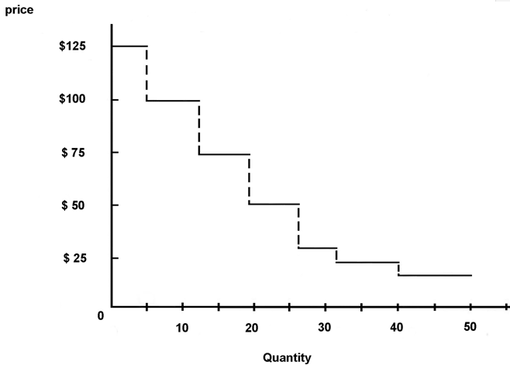
Market Demand
Price
$125
$100
$75
$50
$30
$25
$20
QD
6
13
19
26
32
40
50

Slide 82
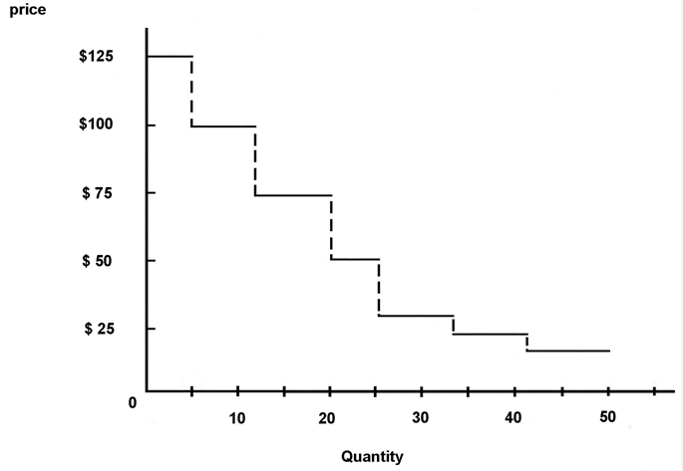
Market Demand
Price
$125
$100
$75
$50
$30
$25
$20
QD
5
12
20
25
34
42
50

Slide 84
Activity: Fish Game

Slide 85

The Fish Game
Rules:
  0 to 10 seconds: $0.25 per fish
  10 to 20 seconds: $0.50 per fish
  Game ends when all fish taken.

Slide 89
Economics for Leaders
Activity: Farmers & Fishers

Slide 90
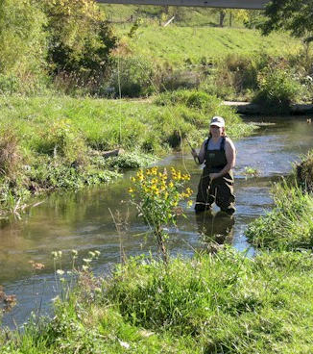
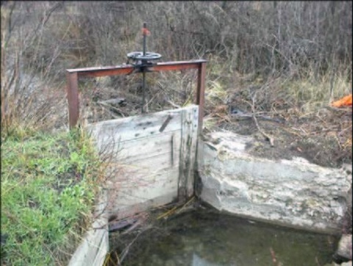

United States
(surface) Water Law
Riparian (roots in English common law)
  Typical in the East
  People who own land along streams, lakes, springs, etc., have a right to reasonable use of the water.
  Historical use protected by law from new uses

Slide 91
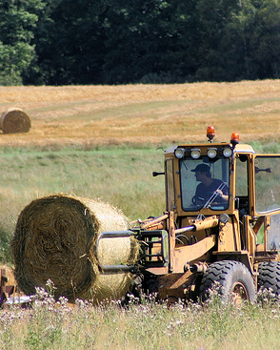
United States
(surface) Water Law
Prior appropriation (spontaneous response to conditions)
Typical in the West
The first person to divert water (take it out of the stream) and use it, has the first right.
People who come after may claim water that is left after the first user has fulfilled his right.
“Ownership” of water rests with the state
Water right is a use right only, and is measured in cubic feet/second

Slide 92
Water Law - Terminology
Use-It-or-Lose-It: If rights-holder doesn’t use all of the water claimed, the right is lost and the water right reverts back to the state
Salvaged Water Rule: If a person saves water (e.g., with better irrigation), he cannot sell the extra water or even keep his right to it. (Ownership reverts to the state.)
Beneficial Use: People may not establish water rights unless they are using the water for “beneficial use”, as determined by state law. For example, agriculture is considered a beneficial use in all states, but only some states recognize recreation or fishing as beneficial uses.
Public Interest: Water rights ― especially the right to transfer ― are limited by the “public interest,” which may include protecting an economic area or the environment, or public health and safety.

Slide 93
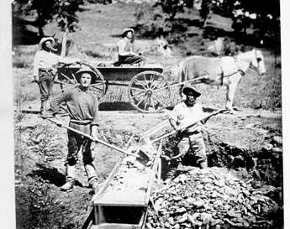
The “rules of the game” make a difference in the level of conflict over water.
Example:
Joe and Frank are gold miners. Joe sets up his camp on a stream, builds a sluice, and diverts 10cfs (cubic feet per second) of water through the sluice. Frank arrives one month later and builds his camp upstream from Joe. His sluice only uses 5 cfs of water, but in August when Frank takes out water, only 6 cfs are left for Joe.
Suppose the property rights rule is riparian common law. What happens?
Suppose the rule is prior appropriation (first-come, first-served). What happens?

Slide 94
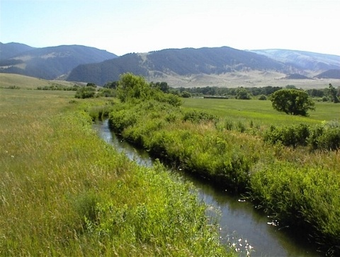
Scenario
A small town lies at the lower end of a valley in which five farmers raise some market crops and hay to feed their livestock. The farmers, whose families settled the area in the 19th century, irrigate their fields in dry years with water from a stream that flows from the snowfields of the mountains at the head of the valley.
Most of the people in the town work for the farmers or supply goods and services related to farming. The exception is the Outfitter, a family-owned business that serves big game hunters during the fall hunting season and bird hunters throughout the winter.

Slide 95
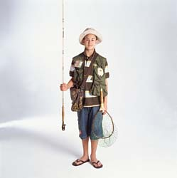
When Orley Outfitter came back from college in the city, he convinced his father that “city dudes would pay big bucks to fish in our stream.”
Turned out, Orley was right! Boom town! Orley began hiring local kids to work as guides and their moms to work in the fishing supply shop. The local diner stays open all week and the gas station gets several deliveries a month instead of one.
Everything was great . . . until

Slide 96
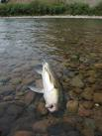
After a beautiful, dry winter (which everybody loved – not a single football game was canceled at the high school!), the river was low.
When the farmers opened up the headgates to irrigate their hay fields, the river below town all but dried up, and the water got very warm. Soon, more fish were floating belly-up than swimming.

Slide 97
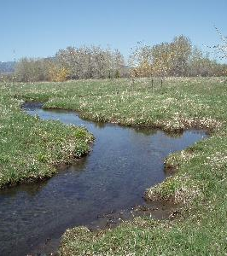
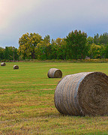
Word spread and fishermen began to cancel their vacations. The Outfitters were panicky; it looked like they would lose most of their yearly income!
And then they got mad. The farmers didn’t have to irrigate; their hay would still grow. True, they would only get 2 cuttings instead of 3, but that wouldn’t hurt them as much as the low water was hurting the Outfitters! It didn’t seem fair for the farmers to hog all the water.

Slide 98
A Town Meeting Has Been Called
Roles: You will be either a farmer or an outfitter. (It is up to you whether or not to share the information on your role card.)
The challenge to your group is to solve the problem that is threatening to disrupt your community.
If you come up with a solution that I cannot improve upon, you get to keep the prize I’ve put on your table. If I can improve on your solution, your group forfeits the prize.
The problem is immediate – now, this summer, here, in this town! Don’t waste time with pie-in-the-sky solutions to fix the world for all time

Slide 99
“Rules of the Game”
The farmers have the water rights under prior appropriation.
There is NO use-or-lose it provision in the law.
There is NO salvaged water provision in the law.
Beneficial uses include: diversion for agriculture, industrial, mining, and domestic water supplies; and in-stream use for recreation and conservation

Slide 100
A “Better” Solution Is One That:
Makes the farmers better off without hurting the fishermen
Makes the fishermen better off without hurting the farmers, or
Makes both the farmers and the fishermen better off

Slide 101
Stop here – solution slide follows

Slide 102
The range of possibilities
 |  | Farmers $75,000
 | HIGH Water yrs.
 |  | Outfitters $100,000
WATER |  |  | Farmers $75,000
 |  | Farmers irrigate
 |  |  | Outfitters $20,000
 | LOW Water yrs.
 |  |  | Farmers $50,000
 |  | irrigate
 |  |  | Outfitters $100,000
Farmers DON’T

Slide 103
The Range of Mutually Beneficial Solutions
WATER |  |  | Farmers $75,000
 |  | Farmers irrigate
 |  |  | Outfitters $20,000
 | LOW Water yrs. |  | $50,000
 |  | irrigate
 |  |  | Outfitters $100,000
$25,000
difference
$80,000
difference
Farmers DON’T

Slide 104
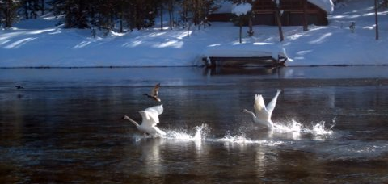
Trumpeter Swans and Idaho Farmers – A “willing seller, willing buyer” exchange based on clearly defined property rights to water.

Slide 105
It's not the people;
it's the system.
Notes:
It’s not about good guys and bad guys. It’s the Institutions and Incentives.

Slide 107
Economics for Leaders
Foreign Currencies & Foreign Exchange

Slide 108
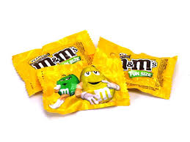
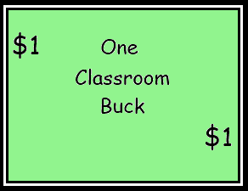
For Sale

Slide 109
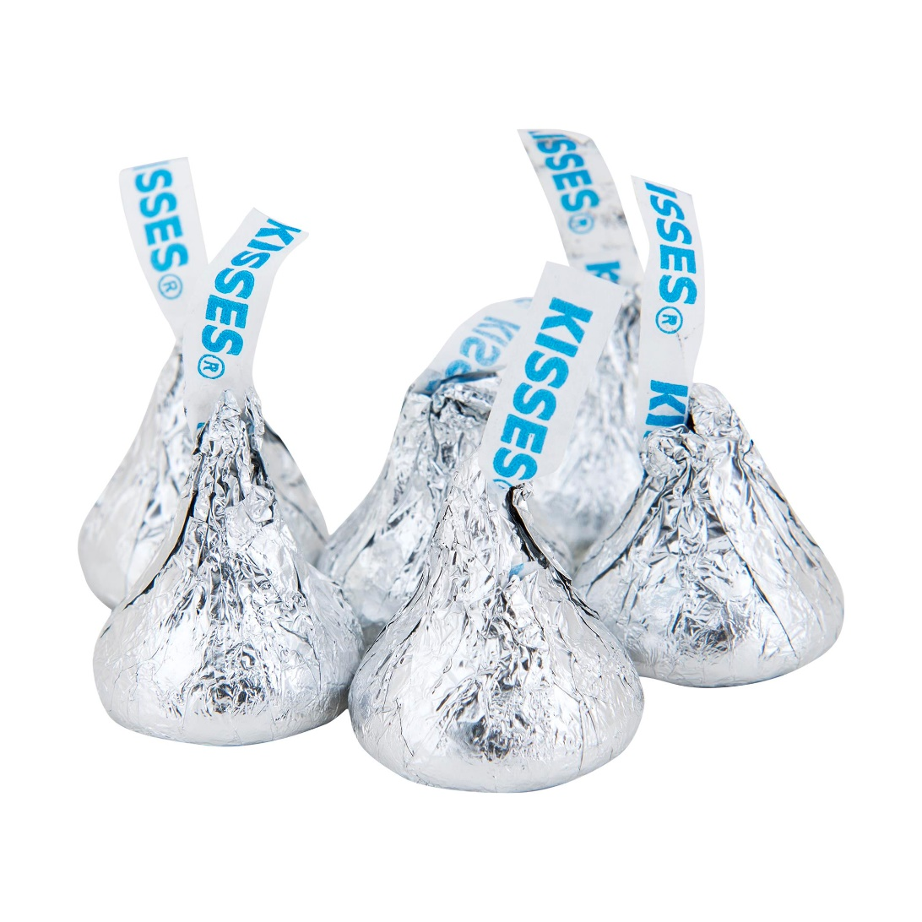
For Sale

Slide 111
Riyals for Bucks?
 | 1 | 1 | 1 | 1 | 1 | 1 | 1 | 1 | 1 | 1 | 1 | 1 | 1 | 1 | 1

Slide 112
Debrief
What happened to the price of candy?
What happened to the price of a buck?
Why?

Slide 113
What is money?
Medium of Exchange
Store of Value
Measure of Value
Foreign currencies serve all of these functions too!

Slide 114
How much is money worth
Whatever people are willing to exchange for it!
Supply and Demand
Less demand for a country’s currency?
Greater supply?

Slide 116
Economics for Leaders
Tic-Tac-Toe Tariff!

Slide 117
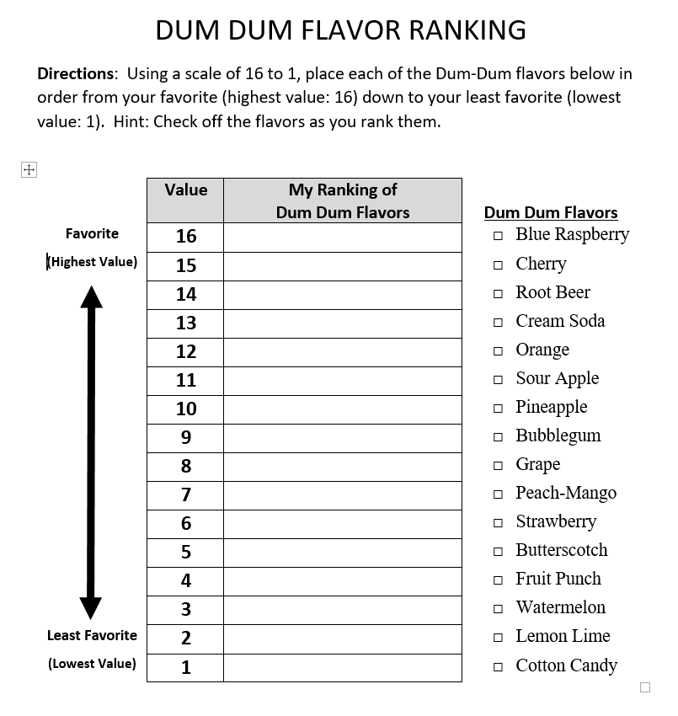
Rank the Flavors
Favorite (16) to Least Favorite (1)

Slide 118
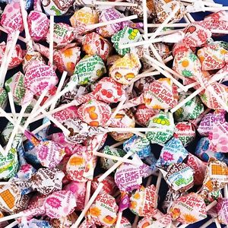

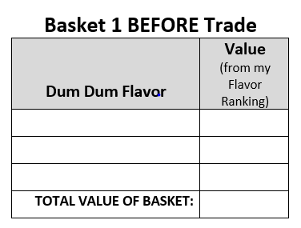
Two Countries:
X and O
X

Slide 119
ROUND 1
GOAL: Trade Dum Dums to get a higher valued basket.
RULES:
The Dum Dums belong to you and you will get to keep them and even eat them at the end of class, but for now, please do not unwrap or eat the lollipops.
You are free to trade with people in your own country. When you make a trade with someone from your country, record the trade on your trading record, indicating what flavor you gave up and what flavor you gained in the trade.

Slide 120
ROUND 1
GOAL: Trade Dum Dums to get a higher valued basket.
RULES:
People from Country X may trade with people from “Country O,” however, the person from Country O must pay a tariff (tax) to country X in the form of a completed game of tic-tac-toe with the person from Country X they wish to trade with.
  The citizen of Country O must provide the Tic-Tac-Toe Tariff card for the game.
  The citizen from Country X always makes the first move.

Slide 121
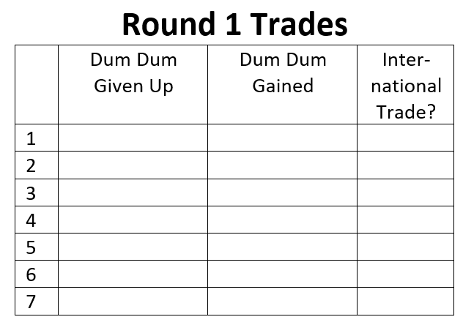
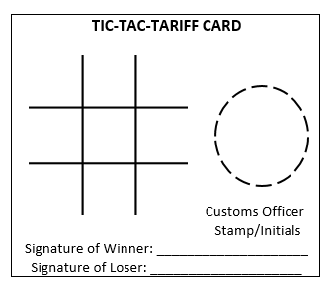
Trading and Paying the Tariff

Slide 122
ROUND 1
GOAL: Trade Dum Dums to get a higher valued basket.
RULES:
At the completion of the game, the winner signs in the winner space, the loser signs in the loser space, then the two shake hands and turn the completed tic-tac-toe tariff card into the customs official (Teacher) at the front of the room.
Once the customs official has stamped the Tic-Tac-Toe Tariff card, the two parties are free to exchange Dum Dums and the citizen from Country O will be given a new blank Tic-Tac-Toe Tariff card.

Slide 123
ROUND 1
GOAL: Trade Dum Dums to get a higher valued basket.
RULES:
Both people will record the trade on their record and put a check mark in the “International Trade” column.
In the event there is a tie game, the citizen from Country O should get in line to exchange the tie-game card for a new clean Tic-Tac-Toe Tariff card so the two can play again and repeat the process until there is a winner.

Slide 124
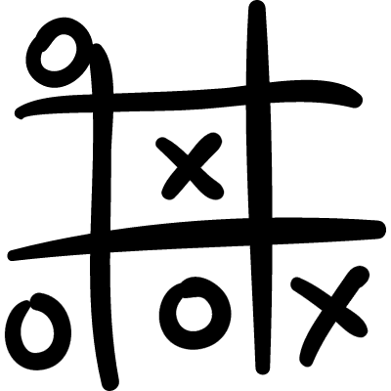
On your marks…. Trade!

Slide 125
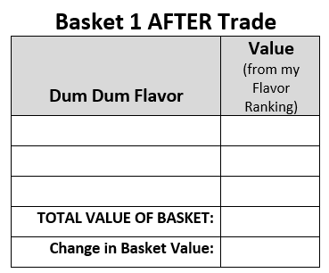
End Round 1

Slide 126
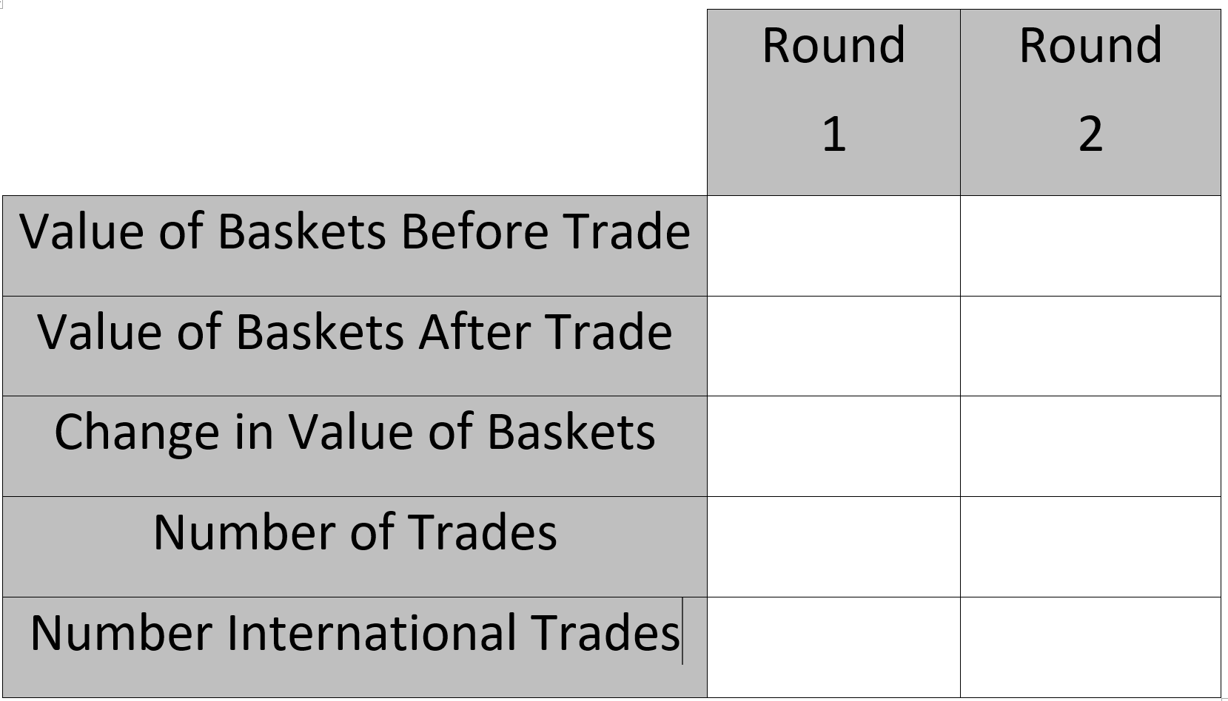
Trading Results

Slide 127
Debrief
How did you do?
Raise your hand if the value of your basket increased?
Raise your hand if you participated in an international trade?
How did it compare to trades you did within your own country?
Did anyone participate in an international trade for which they did not pay a tariff? Or did anyone change the outcome of a tie game just so they wouldn’t have to go through the hassle of playing again?

Slide 128
ROUND 2
GOAL: Trade Dum Dums to get a higher valued basket.
RULE CHANGE:
You are free to trade with anyone regardless of what country they are from. No tariff is required in order to trade with someone from another country.
Continue to track international trades.

Slide 129
On your marks…. Trade!

Slide 130
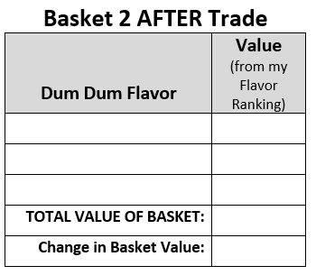
End Round 2

Slide 131
Trading Results

Slide 132
Debrief
How was round 2 different? (Number of trades, value of baskets, trades with people from other country?)
How did the tariff impact trade?
Does the tariff eliminate international trade?
Who benefits from a tariff?
Who is hurt by a tariff?
Who paid the tariff?
Who bore the cost of the tariff? What are the costs of the tariff?
How does the tariff in this activity compare to tariffs in the real world?

Slide 134
Videos Used at EFL
Monday Afternoon/Evening: World Poverty and Economic Growth
Hans Rosling and The Magic Washing Machine http://www.youtube.com/watch?v=BZoKfap4g4w
Hans Rosling’s 200 Countries, 200 Years, 4 minutes http://www.youtube.com/watch?v=jbkSRLYSojo
Lesson 1
from minute 1:00 thru 2:30 of http://www.youtube.com/watch?v=Nt4aWojF9Rg Poverty in Africa – In Your Eyes
Fire Department Auction: http://www.youtube.com/watch?v=bnjQ3cV4×1I
Greed http://www.youtube.com/watch?v=RWsx1X8PV_A Milton Friedman interview by Phil Donahue
Lesson 2
“Gridlock” http://reason.tv/video/show/6.html – Drew Carey – Section 4:15 – 6:10 opportunity cost analysis as a father compare the several hundred dollar monthly bill for access to the private toll lanes in Orange County to the $5/min/child he and his wife pay when they’re late to pick up their three kids from daycare.
Marginal Analysis – Negotiating with the Dentist: http://www.youtube.com/watch?v=7_qwjcxwUqw
Lesson 3
Ethanol – Silly Senator, Corn Is for Food http://reason.tv/video/show/462.html – Reason TV
Organ Transplants – Kidneys for Sale? http://reason.tv/video/show/333.html Drew Carey start at about 5 min – good overview of for and against (also lesson 2 opp cost and 4)
Prisoners’ dilemma: http://www.youtube.com/watch?v=p3Uos2fzIJ0 – British game show – Golden Balls – Split or Steal?
Hudsucker Proxy http://www.youtube.com/watch?v=D2QlitH4nYY

Slide 135
Videos Used at EFL
Lesson 4
Throw-Pillow Fight- Is your interior designer really putting your life at risk? http://reason.tv/video/show/741.html – using licensing restrictions to reduce competition.
Lesson 5 – entrepreneurship
Food Fight – Battle of the Bacon Dogs http://reason.tv/video/show/392.html – Drew Carey – government licensing of street vendors – “People just want the bacon” (would also work well in lessons 3, 4 & 8.)
Lesson 6 – Labor
Mexicans and Machines – Why it’s time to lay off NAFTA http://reason.tv/video/show/451.html Drew Carey –
Lesson 8 – Actions of government
http://reason.tv/video/show/392.html Food Fight – Battle of the Bacon Dogs – Drew Carey – government licensing of street vendors – “People just want the bacon”
http://reason.tv/video/show/741.html Throw-Pillow Fight – Is your interior designer really putting your life at risk? – using licensing restrictions to reduce competition.
http://www.youtube.com/watch?v=cWt8hTayupE&NR=1 Obama Budget Cuts Visualization – start at 0.10 (We humans have a problem with big numbers – takes out the first 10 seconds which is criticism of Obama) Piles of pennies used to show how big the federal budget is, what portion of the budget is discretionary, etc.
Lesson 9
http://www.pncchristmaspriceindex.com/CPI/index.html PNC Christmas index, 2009
Lesson 10
Drew Carey http://reason.tv/video/show/451.html Mexicans and Machines – Why it’s time to lay off NAFTA – (See notes in lesson 6 above.)

