Slide 1
Economics for Leaders
Lesson 10: International Markets

Slide 2

Countries don’t trade
People Do !

Slide 3
Voluntary Trade Creates Wealth - ALWAYS
International trade
National trade
Regional trade
Local trade

Slide 4
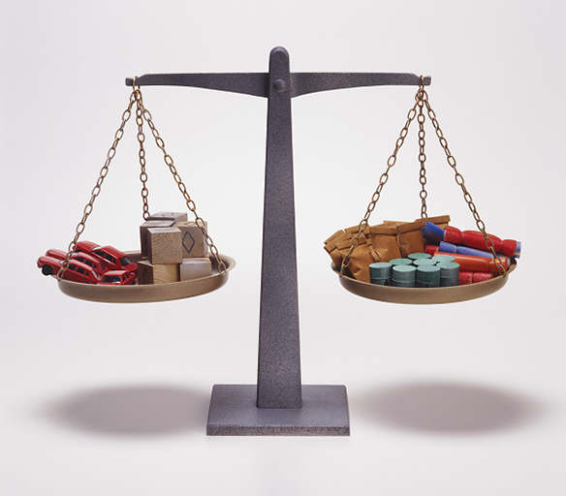
Balance of Payments
Current
Account
Capital account
Goods &
Services
Financial flows

Slide 5
Please use the slides before this one in your presentation.
The slides following this one are provided as options.

Slide 6

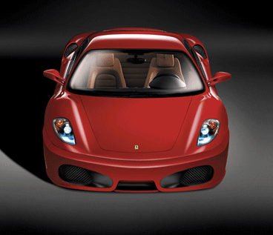
Fundamentally the same decision

Slide 7
Economic Reasoning Proposition #5
ERP-5: Understanding based on knowledge and evidence imparts value to opinions.
  Opinions matter and are of equal value at the ballot box. But on matters of rational deliberation the value of an opinion is determined by the knowledge and evidence on which it is based. Statements of opinion should initiate the quest for economic understanding, not end it.

Slide 8
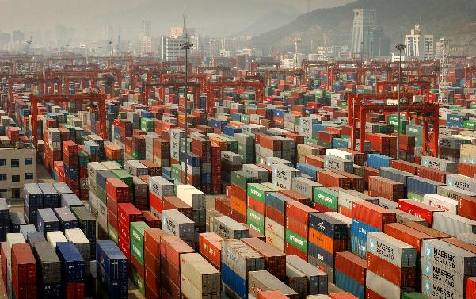
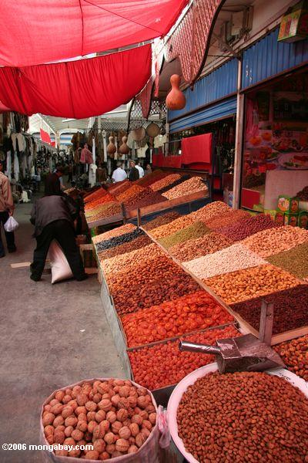
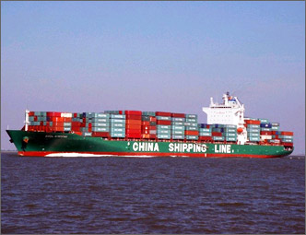
Opening Markets Is Creating Wealth

Slide 9
Who should produce what?
The Law of Comparative Advantage
  Through specialization and exchange, both parties can gain from lower costs and greater output – even if one party does both things better.
What is your lowest opportunity cost alternative?

Slide 10

Comparative Advantage
Producing a Meal
Barbie
Ken
Cooking
10 min
40 min
Cleaning
20 min
30 min
Totals
30 min
70 min

Slide 11

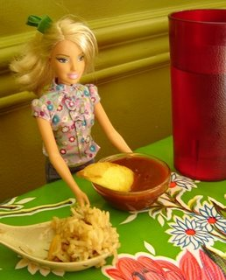
Opportunity Costs
Barbie
Ken
1/2 cleaning
4/3 cleaning
Cooking
Cleaning
2/1 cooking
3/4 cooking

Slide 12

What Will Ken & Barbie Do?
Working Independently
  Barbie Produces a Meal in 30 Minutes
  Ken Produces a Meal in 70 Minutes
Barbie Has An Absolute Advantage
Would Barbie Produce Two Meals?
With Trade/Cooperation
  Barbie Spends 20 Minutes Cooking
  Ken Spends 60 Minutes Cleaning
  They Both Gain!

Slide 13
Remember
Nations Are Not Different
Goods are Produced at Least Cost When People Specialize According to the Principle of Comparative Advantage
Lesson - Don’t Try to Do Everything; It is Not Efficient
Trade Between Countries Creates Wealth
Examples
  Ken and Barbie Have Time for Other Activities

Slide 14
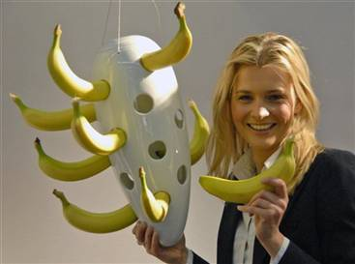
Banana size regulations

Slide 15
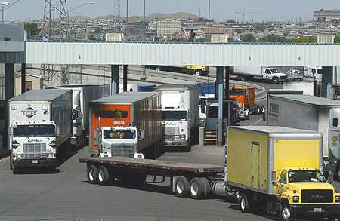
Mexican Truck Now Allowed on US Highways

Slide 16


Slide 17
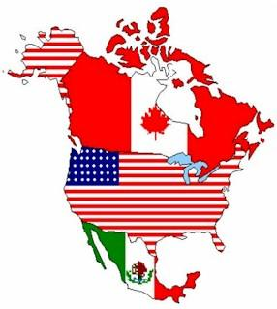
USMCA
Replaces NAFTA
Signed but not yet ratified by legislatures in each country
Notes:
Significant changes include:
Automobiles must have 75% of their components manufactured in Mexico, the U.S. or Canada to qualify for zero tariffs (up from 62% with NAFTA)
40-45% of automobile parts have to be made by workers who earn at least $16/hour by 2023.
Mexico has also agreed to additional labor rules including union representation, labor protection to migrant workers, and ending discrimination to women.
Extended copyright to 70 years beyond the life of the author (originally 50 under NAFTA).
Extending the period that a pharmaceutical drug can be protected from generic competition, and includes new provisions to deal with the digital economy, including prohibiting duties on things like music and e-books, and protections for internet companies so they’re not liable for content their users produce. (https://ustr.gov/about-us/policy-offices/press-office/fact-sheets/2018/october/united-states%E2%80%93mexico%E2%80%93canada-trade-fa-1)
Protection for Canada and Mexico from the Section 232 loophole which was used by the Trump administration to impose steel and aluminum tariffs on Canada, Mexico, and the European Union. Canada and Mexico wanted protections from these tariffs as part of the NAFTA negotiations. Canada and Mexico did get a side agreement that protected them from possible auto tariffs under Section 232.
This agreement sunsets (or expires) after 16 years and is required to be reviewed every 6 years.

Slide 18
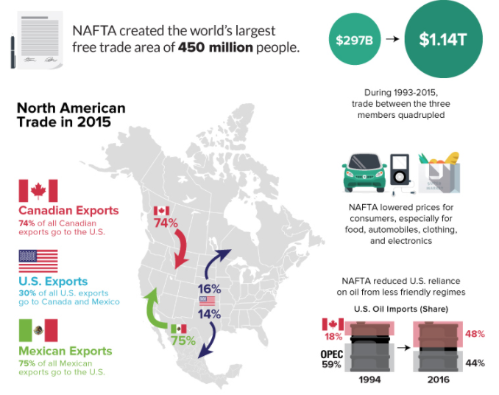
NAFTA
1994 - 2018
Notes:
https://www.visualcapitalist.com/nafta-mixed-track-record/

Slide 19
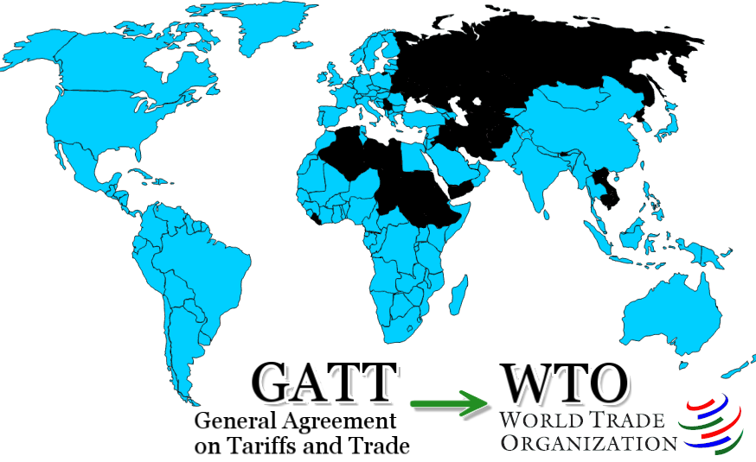
WTO (formerly GATT)

Slide 20
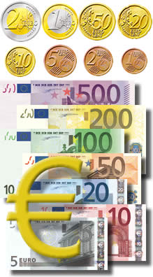
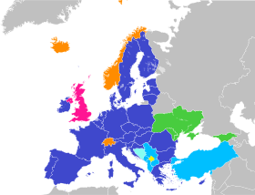
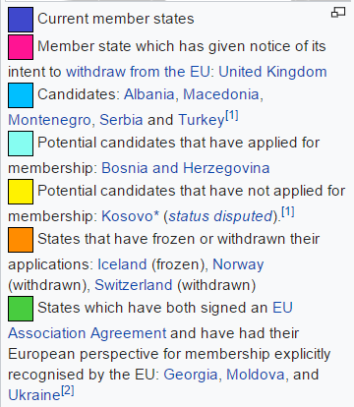
European Monetary Union

Slide 21
Exploring International Trade
http://atlas.cid.harvard.edu/
http://wits.worldbank.org/trade-visualization.aspx
http://www.visualcapitalist.com/interactive-mapping-flow-international-trade/

Slide 22
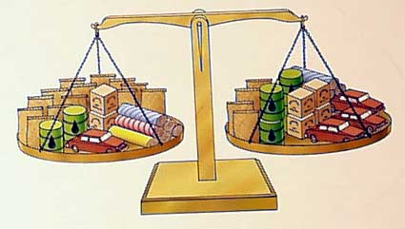
Trade Balance
Imports
Exports

Slide 23
Pierre Sells (Exports) Bread . . .
Then What?

Slide 24
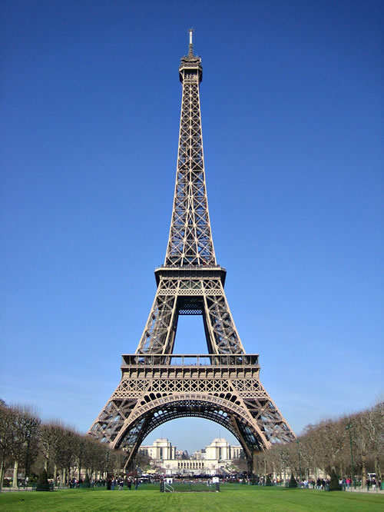



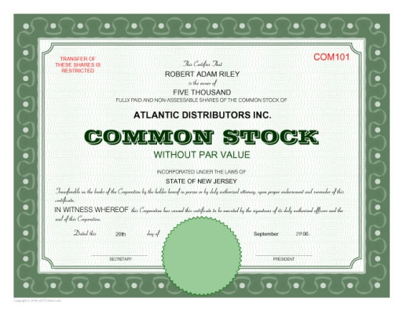
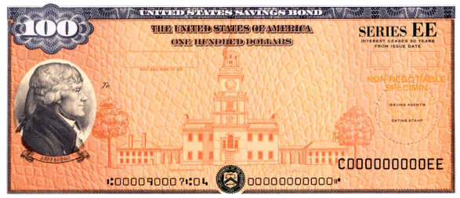
What Can Pierre Do with $$US?
Take his Cheri to his favorite bistro at the Eiffel Tower?
Mais NON!
Buy U.S goods & services
OR
U.S. assets ?
Oui! Oui!

