Slide 1
Lesson 2: Opportunity Cost & Incentives

Slide 2
Economic Reasoning Proposition #1
ERP 1: People choose, and individual choices are the source of social outcomes.
Scarcity necessitates choices: not all of our desires can be satisfied. People make these choices based on their perceptions of the expected costs and benefits of the alternatives.
Notes:
Make a transition from the general topic of world poverty – to economic reasoning tools

Slide 3
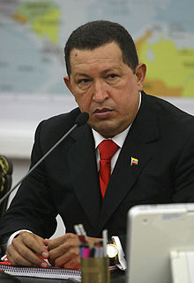
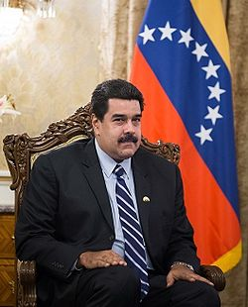
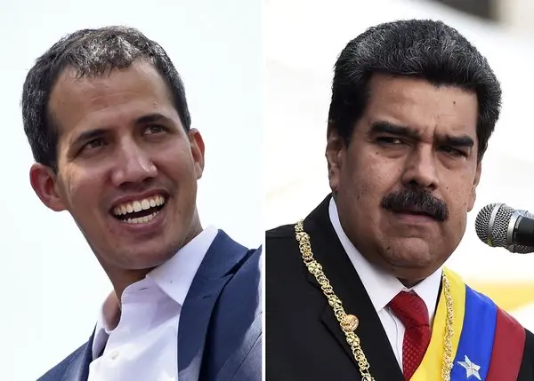
The poverty of some nations and the wealth of others is not an accident; it is the result of choices
Economic Freedom Ranking 1980: 16/104
Economic Freedom Ranking 2018: 162/162
Economic Freedom of the World Report 2018
Hugo Chavez, Venezuelan President 1999-2013
Nicolas Maduro, Venezuelan President 2013-2019
Next Leader: ???
Juan Guaidó or Nicolas Maduro
Notes:
Pictured, former Venezuelan Presidents Hugo Chavez (1999-2013), Nicolas Maduro (2013-2019).
2019 Presidential Election is still contested: Incumbent, Nicolas Maduro or Juan Guaidó (left)
http://www.npr.org/2016/05/29/479913331/coca-cola-halts-production-in-venezuela-due-to-nation-s-sugar-shortage

Slide 4
Economic Reasoning Proposition #2:
Choices impose costs; people receive benefits and incur costs when they make decisions.
The cost of a choice is the value of the next-best alternative foregone, measurable in time or money or some alternative activity given up.

Slide 5
Opportunity Cost:
the value of the next-best alternative

Slide 6
Characteristics of Cost:
Costs are “to” someone.
Costs are the results of actions.
Costs relevant to decision making lie in the future.
Past costs (also known as “sunk” costs) are not important to decisions
Example: Do you consider the cost of a movie ticket in whether you sit though to the end of a really bad movie?

Slide 7
Economic Reasoning Proposition # 3:
People respond to incentives in predictable ways.
Choices are influenced by incentives, the rewards that encourage and the punishments that discourage actions. When incentives change, behavior changes in predictable ways.

Slide 8
Incentives:
the rewards or penalties that shape people’s behavior
Incentives may be negative or positive.
Incentives may be monetary or non-montary

Slide 9
Should we ration?
Wrong Question!
Given that we MUST ration…
What is the best mechanism?

Slide 10
Choices are made at the Margin
Marginal: additional, next, a little more or a little less

Slide 11
Ideas to Take Away from Lesson 2:
Scarcity forces us to choose and every choice has an opportunity cost.
Changing opportunity costs affect incentives and choices.
Because costs lie in the future, the relevant costs and benefits occur at the margin.
Open markets are a key institution for fostering economic growth and improving standards of living.

Slide 12
Ideas to Take Away from Lesson 2:
Price is a powerful incentive. The law of supply and the law of demand describe producers’ and consumers’ predictable reactions to changes in price.
Buyers’ and sellers’ decisions about quantity demanded and quantity supplied are affected by opportunity costs.

Slide 14
Please use the slides before this one in your presentation.
The slides following this one are provided as options.

Slide 15
Paper Auction
Rules:
You are bidding for the right to DISPOSE of the contents of the bag.
Winning bidder must dispose of the CONTENTS by first removing it from the bag and then
Putting it in the landfill (trashcan) OR
Reusing it (put in pocket for later) OR
Recycling it (eat it)
The same options apply to the baggie AFTER contents removed
Notes:
See Lesson Outline for materials and instructions for auctioning three types of paper.

Slide 17
Missed Flight?

Slide 18
Push Up Challenge

Slide 19
Negotiating with the dentist?
Negotiating with the Dentist
Notes:
http://www.youtube.com/watch?v=7_qwjcxwUqw
Video starts on click during presentation.

Slide 20
Negotiating with the dentist?
Negotiating with the Dentist
Notes:
http://www.youtube.com/watch?v=7_qwjcxwUqw
Video starts on click during presentation.

Slide 21
Methods of Rationing Scarce Goods and Services
prices
command (someone decides)
majority rule
contests
by force
voting
first-come-first-served
sharing equally
lottery
personal characteristics
need
merit

Slide 22
Economic Reasoning Proposition # 4:
Institutions are the “rules of the game” that influence choices.
Laws, customs, moral principles, superstitions, and cultural values influence people’s choices. These basic institutions controlling behavior set out and establish the incentive structure and the basic design of the economic system.

Slide 23
Economic Reasoning Proposition #5
ERP-5: Understanding based on knowledge and evidence imparts value to opinions.
Opinions matter and are of equal value at the ballot box. But on matters of rational deliberation the value of an opinion is determined by the knowledge and evidence on which it is based. Statements of opinion should initiate the quest for economic understanding, not end it.

