Slide 1
Economics for Leaders
Lesson 3: Open Markets

Slide 2
Economic Reasoning Proposition # 3:
People respond to incentives in predictable ways.
  Choices are influenced by incentives, the rewards that encourage and the punishments that discourage actions. When incentives change, behavior changes in predictable ways.

Slide 3
Economic Reasoning Proposition # 4:
Institutions are the “rules of the game” that influence choices.
  Laws, customs, moral principles, superstitions, and cultural values influence people’s choices. These basic institutions controlling behavior set out and establish the incentive structure and the basic design of the economic system.

Slide 4
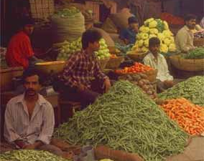
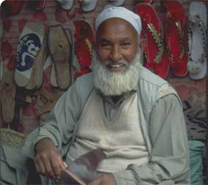

How Market Competition Benefits the Poor
It makes more goods and services available at lower prices.
The presence of other competitors (actual or potential) provides incentives for innovation
It provides opportunities for the poor as workers.
It provides opportunities for the poor as entrepreneurs.

Slide 6
Please use the slides before this one in your presentation.
The slides following this one are provided as options.

Slide 7
Buyers DON’T Compete With Sellers . . .

Slide 8
Buyers Compete with Buyers

Slide 9
Sellers Compete with Sellers

Slide 10
Market Competition: Win-Win Outcomes
Both buyers and sellers value what they received more than what they gave up.

Slide 11

Hudsucker Proxy (3 min)
Notes:
picture is link to YouTube video clip or see https://youtu.be/Ng3XHPdexNM

Slide 12

Hudsucker Proxy (8 min)
Notes:
picture is link to YouTube video clip or see https://youtu.be/D2QlitH4nYY

Slide 13
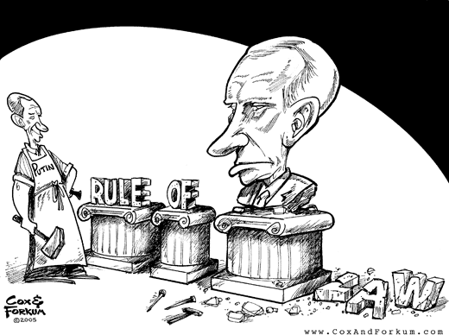


Institutions necessary for well-functioning markets:
Property rights
Rule of law

Slide 14
Ideas to Take Away from Lesson 3:
Open markets benefit both buyers and sellers by providing a low cost mechanism for trade.
Open entry and exit and competition are necessary for markets to function effectively.
Clearly defined property rights and stable rule of law are necessary for markets to function at low cost to participants.
Open markets encourage economic growth.

