Slide 1
Economics for Leaders
Lesson 4: Markets in Action

Slide 2

1 vs 100 EFL Style

Slide 3
Choose several problems you like from the lecture outline or the slides that follow. Please make sure that students practice at least 3 different analysis problems.

Slide 4
Rules for 1 vs. 100
Sit with a partner. Your team will start with $3 to play 3 rounds.
Each question is worth $1. If you answer the question correctly, you keep your $. If you answer is incorrect, you forfeit your $.
Answers must be in written form and complete when time is called.
Decisions of the judges are final re: whether your answer is correct.
Every team must play every round. There are no drop-outs, only forfeiture of $1.
Notes:
Choose questions/rounds from those provided in the following slides, or make some of your own. The examples should give students the opportunity to identify the market dynamics in action.

Slide 5


Slide 6
Got Hummus?
Insufficient rains in India have resulted in several years of poor harvests of chickpeas, the main ingredient in hummus. The country, by far the world’s largest producer of chickpeas, mostly grows the legume for domestic consumption. But worse-than-expected harvests mean that it has had to buy more chickpeas from growers elsewhere, putting pressure on supplies worldwide.
Notes:
Rising Hummus Prices? Blame a drought a half a world away. New York Times, 2/8/2018
https://www.nytimes.com/2018/02/08/business/hummus-chickpeas-prices.html?rref=collection%2Ftimestopic%2FFood%20Prices%20and%20Supply&action=click&contentCollection=timestopics&region=stream&module=stream_unit&version=latest&contentPlacement=4&pgtype=collection

Slide 7
Use supply and demand to explain what happened to price and quantity of chickpeas.
Supply increased, price and quantity both increased
Supply decreased, price increased, quantity decreased
Demand decreased, price increased, quantity decreased
Demand decreased, price and quantity both decreased.

Slide 8
Use supply and demand to explain what happened to price and quantity of chickpeas
Supply increased, price and quantity both increased
Supply decreased, price increased, quantity decreased
Demand decreased, price increased, quantity decreased
Demand decreased, price and quantity both decreased.

Slide 9
Hummus has grown in popularity in the U.K. Chickpeas are the major ingredient for Hummus. Predict what subsequently happened in the British market for hummus?
The supply of hummus decreased because the cost of production increased.
The supply of hummus increased because chickpea prices increased.
Trade agreements between India and the UK set a high price on hummus in both countries.
The demand for hummus by British consumers decreased in response to higher prices of chickpeas.

Slide 10
Hummus has grown in popularity in the U.K. Chickpeas are the major ingredient for Hummus. Predict what subsequently happened in the British market for hummus?
The supply of hummus decreased because the cost of production increased.
The supply of hummus increased because chickpea prices increased.
Trade agreements between India and the UK set a high price on hummus in both countries.
The demand for hummus by British consumers decreased in response to higher prices of chickpeas.

Slide 11
Which is not a predictable response to the drought in India.
Consumers of chickpeas will look for substitutes
Anticipating higher future prices, U.S. farmers plant more chickpeas.
Scientists from Scotland and Ethiopia jointly explore the development of drought-resistant chickpeas.
Indians import less chickpeas.

Slide 12
Which is not a predictable response to the drought in India.
Consumers of chickpeas will look for substitutes
Anticipating higher future prices, U.S. farmers plant more chickpeas.
Scientists from Scotland and Ethiopia jointly explore the development of drought-resistant chickpeas.
Indians import less chickpeas.

Slide 13
ROUND
2

Slide 14

What will happen to the supply, the demand and the price of gasoline in the U. S. if congress passes a law that sets a maximum price of $1.75 per gallon?
D
Price
S
$3.50
$1.75
QS
QD
Quantity
QP

Slide 15
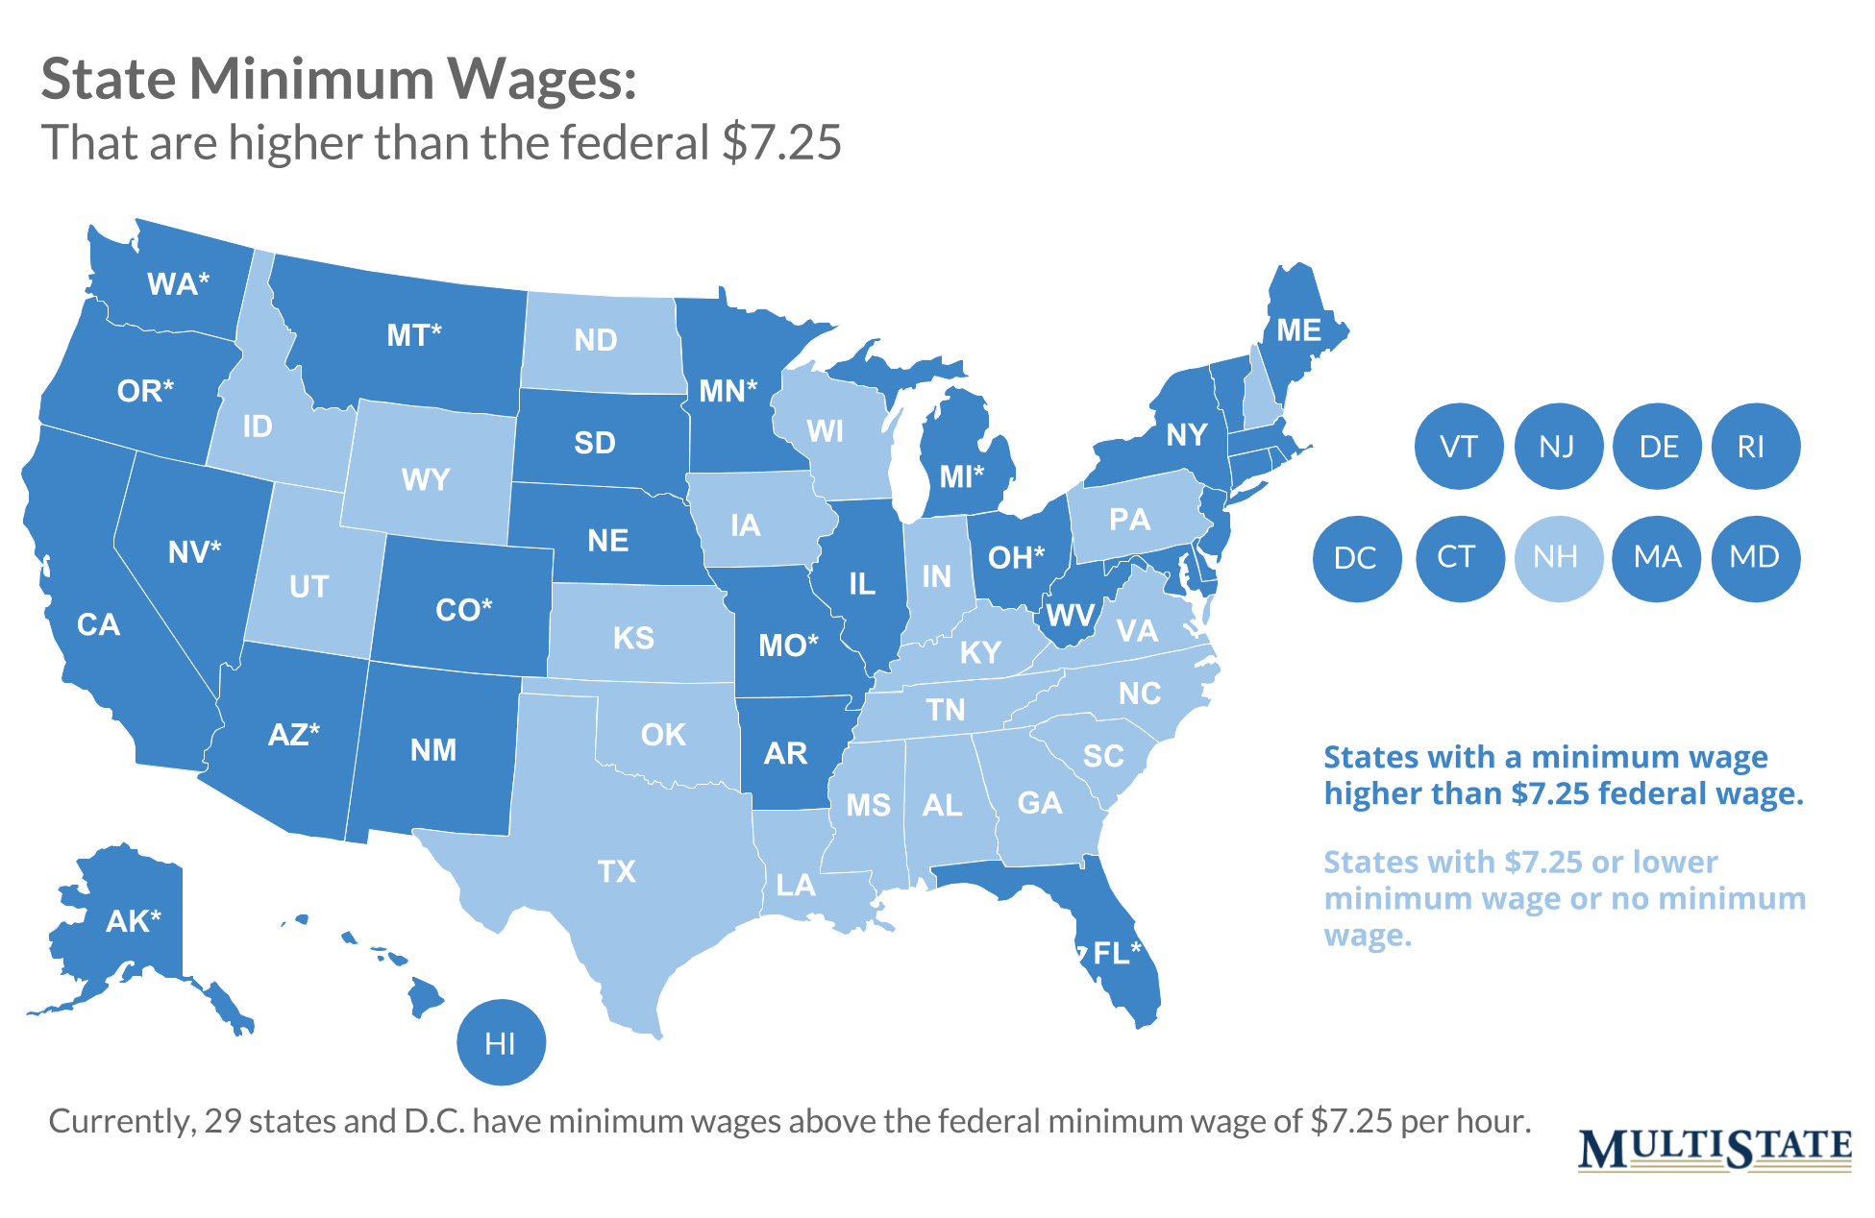
States’ Minimum Wages
As of May, 2019, 29 states have minimum wages higher than the federal minimum wage of $7.25/hr. Massachusetts and Washington currently have the highest minimum wages at $11/hr and NYC has a $15/hr min wage for employers with 11 or more employees.
Notes:
https://en.wikipedia.org/wiki/Minimum_wage_in_the_United_States

Slide 16
The purpose of minimum wage legislation is to make employers pay more than they would otherwise – that is, more than they would in an open market. Which of the following should we expect to happen when the minimum wage is set above the “prevailing wage” that occurs in a labor market?
There will be higher incomes as everyone will be paid more.
The increase in minimum wage encourages people to find a better balance between work and home life.
The quantity supplied of labor increases as more people move into the labor market seeking higher paying jobs.
Businesses will raise prices as this is just a cost to be passed on to consumers.

Slide 17
Suppose that the minimum wage is increased but it is below the “prevailing wage” in the labor market. What would you expect to happen in this situation?
The quantity of labor demanded will increase.
Many new firms will succeed in hiring new employees at the minimum wage instead of the “prevailing” wage.
The higher minimum wage will cause more workers to seek jobs overseas.
The higher minimum wage will attract more low-paid, unskilled workers to the United States seeking lawful employment.

Slide 18
If raising the minimum wage to $7.25/hour is a good idea, why doesn’t Congress make it a better idea and raise it to $20 or even $100?
We should. A $20 minimum wage would add more money to the economy.
Too many people would enter the labor market and find jobs at these higher wages, so that households would fall apart.
At these wage rates, people wouldn’t go to college and there would be shortages of skilled labor.
Higher wages will eventually increase unemployment and business failure.

Slide 19


Slide 20

Ghana and EU Banana Imports
http://www.youtube.com/watch?v=blvxPshCDe4 (play from 6:31 – 10:00)
Notes:
Picture is link to video http://www.youtube.com/watch?v=blvxPshCDe4 watch 6:31 – 10:00

Slide 21
7. What is the effect of restrictions on banana length and weight (i.e., bananas must be long and heavy) on the market for bananas in the European Union?
--- Short Answer Question
The equilibrium (market) price rises and consumers’ choices are restricted.
(The restrictions keep out particularly desirable varieties, such as the apple banana, which tastes like apple, and the Lady’s Finger, which is sweet and creamy. Both of these are small in size and weight.)

Slide 22
8. Since EU member countries don’t have commercial banana growers, why does the EU place such restrictions on its own consumers? (Who benefits?)
European growers of other kinds of fruits.
(The EU countries do not grow bananas, but they grow other fruits which are substitutes for bananas. Making imports conform to size and weight restrictions not only raises the cost, but also means that the bananas coming in are less sweet, which also encourages consumers to substitute other fruits for bananas.)

Slide 23

The bananas shown in the video bear the Fairtrade certification mark, meaning that they have been produced by small farmer organizations or in plantations that meet very high social and environmental standards. Farmers who produce Fairtrade Certified Bananas are guaranteed a floor price (Fairtrade Minimum Price) to cover the average cost of production, and a Fairtrade Premium of 1US$ per box of bananas to invest in social and economic initiatives in their communities.

Slide 24
9. What effect does FairTrade labeling have on the demand for Fair Trade labeled bananas?
It depends. Either:
Enough consumers who value socially conscious consumption will seek out such products and be willing to pay more, (Increase in Demand, more will be sold).
Or
Consumers may not value such labels and will be unwilling to pay the higher price, resulting in a decreased quantity demanded (sales will fall).

Slide 25
What principle of economics is illustrated in this video?

Slide 26

What principle of economics is illustrated in this video?
Negotiating with the Dentist
Notes:
http://www.youtube.com/watch?v=7_qwjcxwUqw
Video starts on click during presentation.

