Slide 1
Economics for Leaders
Lesson 5: Labor Markets

Slide 2
Economic Reasoning Proposition # 4:
Institutions are the “rules of the game” that influence choices.
Laws, customs, moral principles, superstitions, and cultural values influence people’s choices. These basic institutions controlling behavior set out and establish the incentive structure and the basic design of the economic system.

Slide 3
Economic Reasoning Proposition #2:
Choices impose costs; people receive benefits and incur costs when they make decisions.
The cost of a choice is the value of the next-best alternative foregone, measurable in time or money or some alternative activity given up.

Slide 4
Please use the slides before this one in your presentation.
The slides following this one are provided as options.

Slide 7
Historical Example of Excess Supply: Migrant Workers
Until effective legislation to stem the flow of illegals, large and growing demand for crop workers could be satisfied without raising wages because of the excess supply of illegal immigrants.

Slide 8
Historical Example of Excess Demand: Rosie the Riveter:
Excess demand in WWII pulled women into the factory work force at higher wages than they could make in traditional “women’s occupations.”

Slide 9
The Fastest-growing occupations, 2016-2026
Wind turbine service technicians
Home Health aides
Physician Assistants
Nurse Practitioners
Statisticians
Software Developers, applications
Mathematicians
Genetic Counselors
Physical Therapists
Massage Therapists
Derrick Operators, oil and gas
Nonfarm animal caretakers
Nursing instructors and teachers, postsecondary
Bureau Labor Statistics, Updated April 2018, www.bls.gov
Notes:
Growth rates for fasted growing occupations: https://www.bls.gov/emp/tables/fastest-growing-occupations.htm

Slide 10
Occupations with largest employment declines, 2016-2026
Executive secretaries and executive administrative assistants
Inspectors, testers, sorters, samplers, and weighers
Tellers
Postal Service mail carriers
Correctional officers and jailers
Cooks, fast food
Sewing machine operators
Bookkeeping, accounting and auditing clerks
Word Processors and typists
Computer Programmers
Cutting, punching, and press machine setters, operators and tenders, metal and plastic.
Chief executives
Computer operators
Structural metal fabricators
Bureau Labor Statistics, Updated April 2018, www.bls.gov
Notes:
From Bureau of Labor and Statistics Table 1.6 Occupations with largest job declines. https://www.bls.gov/emp/tables/occupations-largest-job-declines.htm

Slide 11
Industries w/ Largest wage & Salary Employment Growth, 2016 - 2026
Food services and drinking places
Construction
Home health care services
Offices of Physicians
Nursing and residential care facilities
Computer Systems design and related services
Hospitals
Local government educational services compensation
Management, scientific, and technical consulting services
Motor vehicle and parts dealers
Bureau Labor Statistics, Updated Online October 2017, www.bls.gov
Notes:
From Bureau of Labor and Statistics Table 2.4 Industries with largest wage and salary employment growth and declines. https://www.bls.gov/emp/tables/industries-large-grow-decline-employment.htm

Slide 12
Industries w/ Largest wage & Salary Employment Declines, 2016-2026
Wired Telecommunications Carriers
Newspaper, Periodical, book and directory publishers
Postal Service
Apparel, leather, and allied manufacturing
Textile mills and textile product mills
Plastics product manufacturing
Pulp, paper, and paperboard mills
Travel arrangement and reservation services.
Civic, social, professional, and similar organizations
Radio and television broadcasting
Notes:
From BLS table 2.4 “Industries with Largest wage and Salary employment growth and declines.” http://www.bls.gov/emp/ep_table_204.htm

Slide 13
Technology & Productivity
Notes:
Video comparison of horses and various tractors. Click on Bottom Line button for showing time reductions to plow same size field. Note that this is also linked to ppt for lesson 6 – decide where you want to use it. http://www.livinghistoryfarm.org/farminginthe50s/machines_plowing.html

Slide 14
Superstar Phenomenon
Floyd Mayweather $275 Million
(Earnings 2018)
Notes:
Floyd Mayweather, annual earnings 2018, $275 million.
Boxer. Highest paid athlete in the world, 2018.
https://www.forbes.com/sites/forbespr/2018/06/05/forbes-2018-list-of-the-worlds-100-highest-paid-athletes-sees-floyd-mayweather-reclaiming-the-top-spot/#503a7517173d

Slide 15
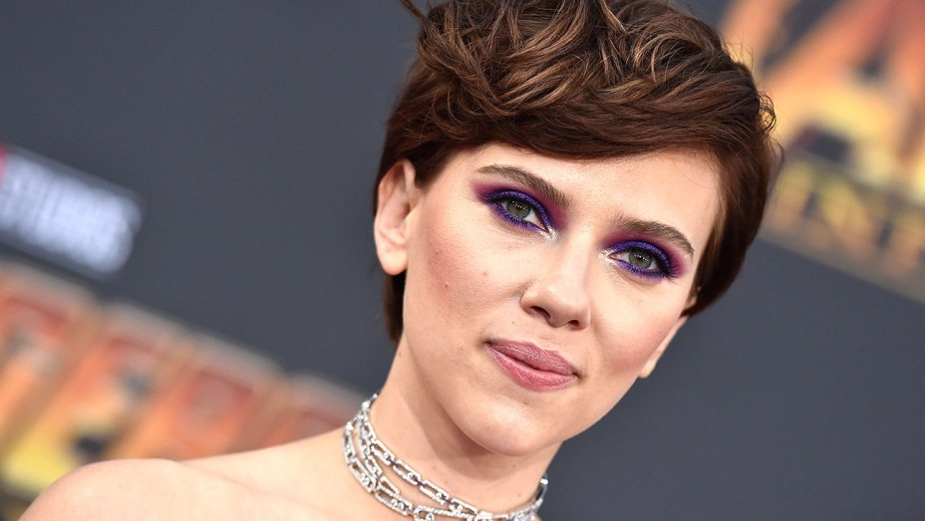
Scarlett Johansson $40.5 Million 2018
Superstar Phenomenon
Notes:
Scarlett Johansson, $40.5 million annual income 2018
Highest paid actress, Avengers star, Black Widow

Slide 16
Chris Hemsworth $64.5 Million 2018
Superstar Phenomenon
Notes:
Chris Hemsworth, 4th highest paid actor 2018, $64.5 million
https://www.businessinsider.com/10-highest-paid-actors-in-the-world-2018-8#4-chris-hemsworth-645-million-7

Slide 17
Superstar Phenomenon
Ellen Degeneres $87.5 Million
(Earnings 2018)
Notes:
Ellen Degeneres, annual earnings 2018, $87.5 million.
Celebrity Personality, talk show host
#2 Highest Paid TV Host, behind #1 Judge Judy ($147 million)
https://www.forbes.com/sites/maddieberg/2017/11/07/the-worlds-highest-paid-tv-hosts-dr-phil-ellen-degeneres-and-ryan-seacrest-lead/#4a529f55bf6a

Slide 18
“Ryan ToysReview” 7-year-old YouTube Star $22 Million
Superstar Phenomenon
Notes:
7 Year-old boy named Ryan is the top paid YouTube Star, 2018, $22 Million. Reviews toys for kids.
https://youtu.be/jjd-BeTX6U0
https://www.forbes.com/sites/natalierobehmed/2018/12/03/highest-paid-youtube-stars-2018-markiplier-jake-paul-pewdiepie-and-more/#2927bb4909ac

Slide 19
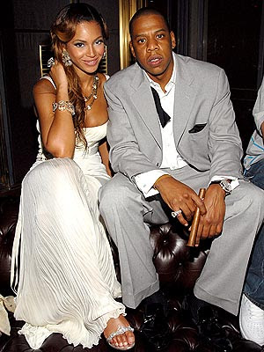
Beyoncé $60 Million 2018
Superstar Phenomenon
Jay Z
$76.5 Million 2018
Notes:
Beyonce & Jay Z highest paid celebrity couple 2018
https://www.forbes.com/celebrities/list/#tab:overall

Slide 20
LeBron $85.5 Million 2018
Superstar Phenomenon
Notes:
LeBron James –annual income 2017 (highest paid in NBA)
http://www.forbes.com/profile/lebron-james/

Slide 21
Jeff Kinney $18.5 Million 2018
Superstar Phenomenon
Notes:
Jeff Kinney Annual income 2018. 5th highest paid author.
https://www.forbes.com/sites/hayleycuccinello/2018/12/11/worlds-highest-paid-authors-2018-michael-wolff/#356f15662517

Slide 22
SUPERSTARS
What do these people have in common?
How does technology allow them to leverage their labor time and raise their income?

Slide 23
Sweatshops

Slide 24
What is their opportunity cost?

Slide 25
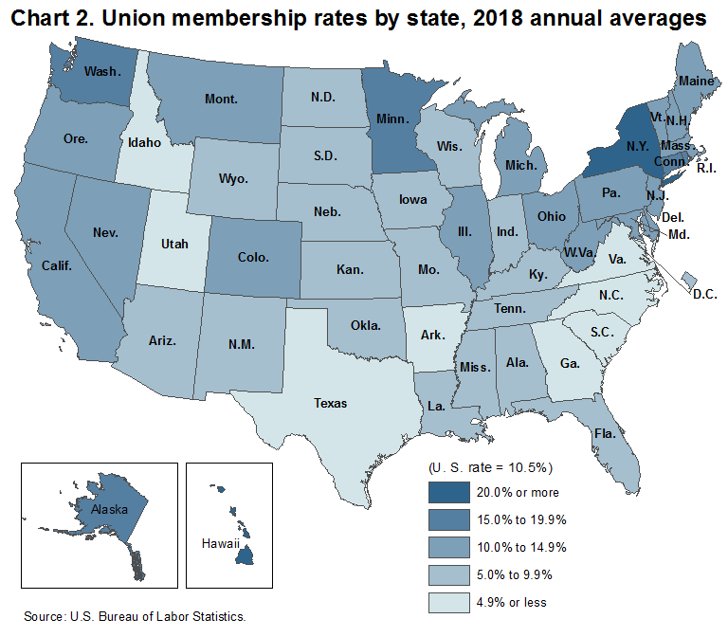
Notes:
https://www.bls.gov/regions/mountain-plains/news-release/unionmembership_missouri.htm

Slide 26
Does the minimum wage hurt workers?

Slide 27
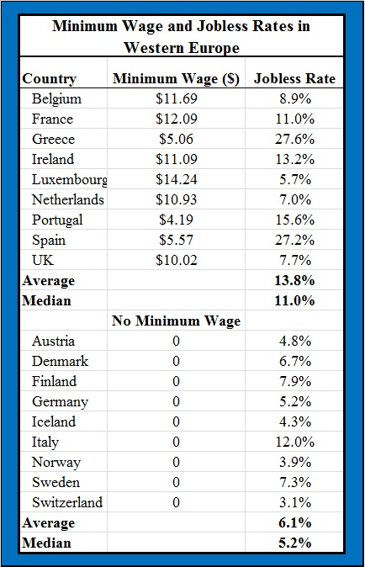
Minimum Wage and Jobless Rates in Western Europe
Notes:
http://www.aei-ideas.org/2013/11/in-western-europe-the-average-jobless-rate-is-twice-as-high-in-countries-with-a-minimum-wage-vs-those-with-no-minimum/

Slide 28
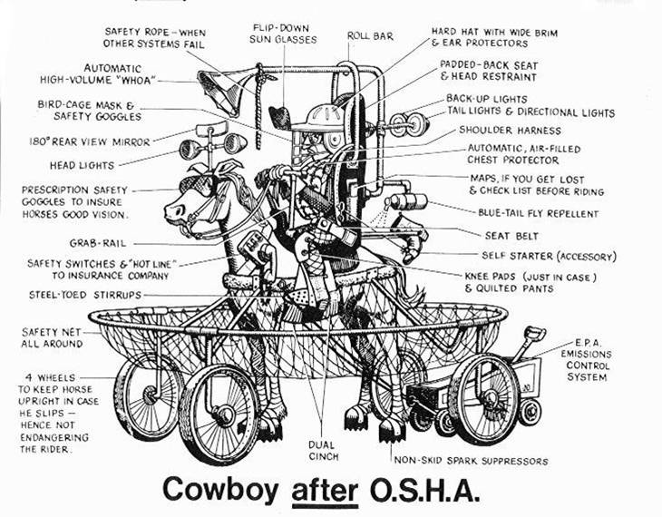

Slide 29
Child Labor Laws

