Slide 1

Economics for Leaders
Lesson 6: Incentives, Innovation &
the Role of Institutions

Slide 2
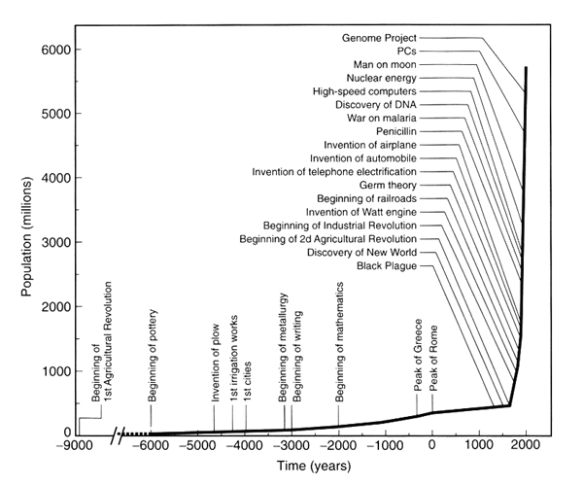
What drives innovation?
~1750
Notes:
Note that 1750 is beginning of industrial revolution and productivity takes off.

Slide 3
Economic Reasoning Proposition # 3:
People respond to incentives in predictable ways.
  Choices are influenced by incentives, the rewards that encourage and the punishments that discourage actions. When incentives change, behavior changes in predictable ways.

Slide 4
Economic Reasoning Proposition # 4:
Institutions are the “rules of the game” that influence choices.
  Laws, customs, moral principles, superstitions, and cultural values influence people’s choices. These basic institutions controlling behavior set out and establish the incentive structure and the basic design of the economic system.

Slide 5
Mini-Activity: Money for Sale!
In this envelope is a piece of U.S. currency
  $1, $2, $5, $10, $20, $50, or $100
I will sell to highest bidder at absolute auction
  I keep winner’s cash, winner keeps mine
  Winner opens envelope & reveals contents to us all

Slide 6
Questions for Money Auction Winner
Did you earn a profit?
What motivated you to accept the risk of today’s sale?
Suppose I repeated the sale, hour after hour, putting a $10 bill in the envelope every time
  To what would the winning bid tend to gravitate?
    Winning bid would approach $10 . . .
      Driving profit toward zero

Slide 7
Please use the slides before this one in your presentation.
The slides following this one are provided as options.

Slide 8

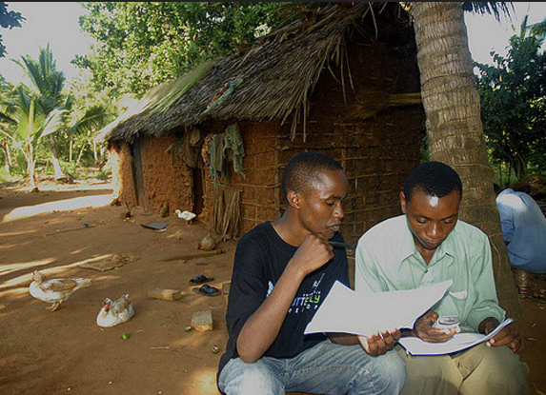
Mobile Planet
Photos taken during various travels, mostly Africa, of mobile phones and their impact on and in the developing world
Notes:
Community cell phones
http://www.kiwanja.net/mobilegallery/

Slide 9
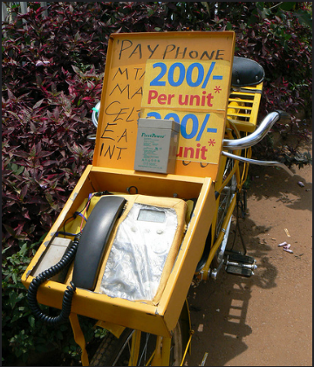
Mobile Planet
Photos taken of mobile phones and their impact on and in the developing world
Notes:
Community cell phones
http://www.kiwanja.net/mobilegallery/

Slide 10
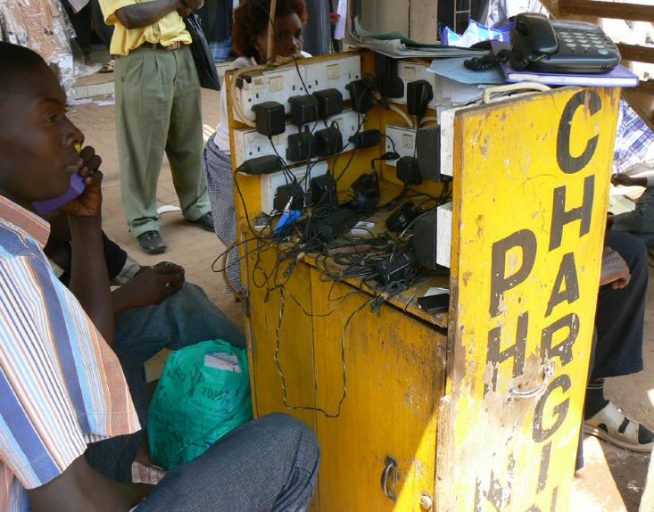
Cell Charging Kiosk, Uganda
Mobile Planet
Photos taken of mobile phones and their impact on and in the developing world
Notes:
https://textually.org/textually/archives/cat_mobile_phone_projects_third_world.htm?p=14

Slide 11
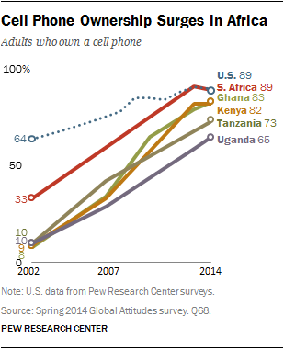
Cell Phones in Africa: Communication Lifeline
In a few short years, the proliferation of mobile phone networks has transformed communications in sub-Saharan Africa. It has also allowed Africans to skip the landline stage of development and jump right to the digital age.
-Pew Research Center, April 2015
Notes:
http://www.pewglobal.org/2015/04/15/cell-phones-in-africa-communication-lifeline/

Slide 12

Solar lightbulb to shine on developing world
Here's a bright idea for the planet. A Hong Kong-based company has introduced what it bills as the world's only solar-powered lightbulb with the hope of reaching millions of people with little or no access to electricity.
http://www.engadget.com/2010/06/09/nokero-debuts-rugged-rainproof-n100-solar-light-bulb-for-develo/

Slide 13

Technology & Productivity
http://www.livinghistoryfarm.org/farminginthe50s/machines_plowing.html
Notes:
Video comparison of horses and various tractors. Click on Bottom Line button for showing time reductions to plow same size field. Note that this is also linked to ppt for lesson 5 http://www.livinghistoryfarm.org/farminginthe50s/machines_plowing.html
Alternate series of videos:
https://youtu.be/QGj-KkjwXJY (concrete throwing with shovels)
https://youtu.be/EYg-cHe79hI (scaling concrete throwing
https://youtu.be/YwzelMxVkr0 (adding cement truck and buckets)

Slide 14
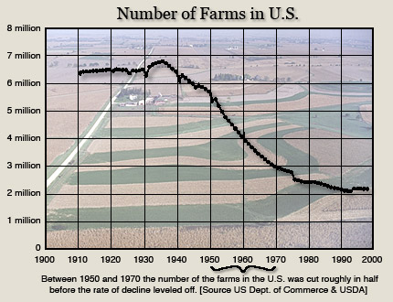
http://www.livinghistoryfarm.org/farminginthe50s/life_11.html

Slide 15
Soviet Social Indicators, 1990
Acute shortages of medical supplies;
Fewer than one-half of draft age men were fit for military duty;
Illness kept an average of 4,000,000 workers from their jobs each day (as opposed to 287,000 in the US);
Infant mortality rates had risen from 22.9 deaths per thousand in 1971 to 33 deaths per thousand in 1989;
In rural areas, where one-third of Soviets lived, half the hospitals had no sewer connections, and eighty percent had no hot water.

Slide 16
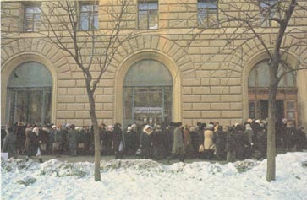
Soviet Line for Shoes

Slide 17
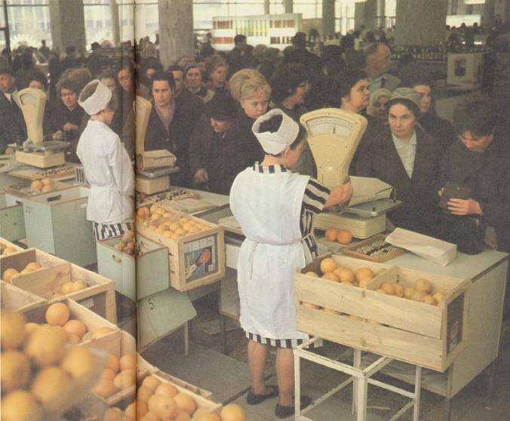
Soviet Line for Oranges

Slide 18
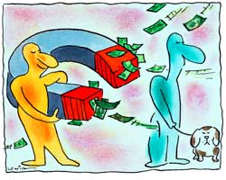
Profit attracts resources

Slide 19

One Key to Innovation
Unless potential innovators (risk-takers)
  get to keep the profits . . .
  they won’t be willing to accept the losses
Result: less risk-taking, less innovation

Slide 20

Case Study: Napster
Lars Ulrich, Metalica Drummer, testified on Napster case.
(9 min video on property rights and incentives.)
VIDEO: http://www.econedlink.org/interactives/index.php?iid=193&type=educator
Notes:
Lars Ulrich (Metalica Drummer) testified on Napster case… 9 min video on property rights and incentives.

Slide 21

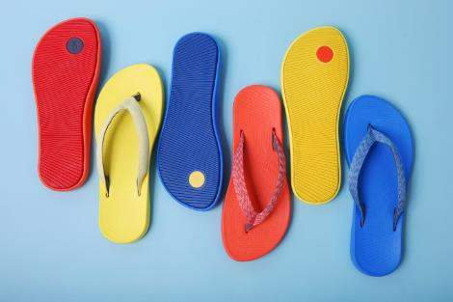



Best inventions of 2018
(From Time’s Top 50 list)
On-demand eyes for the blind
Gravity Jet Suit (Iron Man!)
TV Art – TV That blends into wall
3-D printed home (builds tiny house in 48 hours)
Allbirds SweetFoam shoes (made from discarded sugarcane)
Notes:
http://time.com/collection/best-inventions-2018/

Slide 22


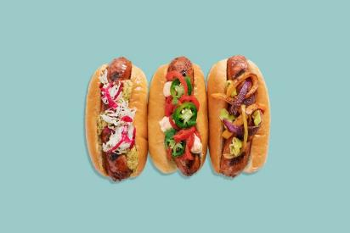
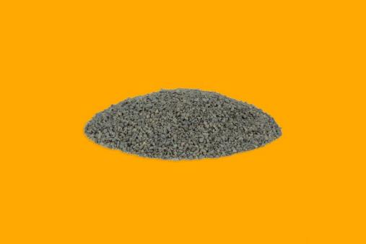
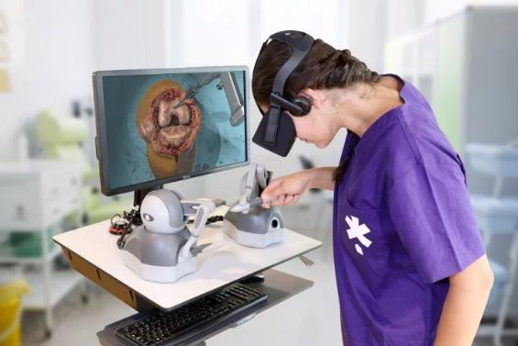
Best inventions of 2018
(From Time’s Top 50 list)
Sustainable Diamonds (lab-grown, forged in plasma)
Custom-fit clothes (body-suit and app creates 3-D scan of body to order affordable custom-fit clothes)
Beyond Sausage (plant-based sustainable protein)
Roofing that fights smog pollution (absorbs pollution to wash away in rain)
VR Training for Surgeons
Notes:
http://time.com/collection/best-inventions-2018/

Slide 23

What makes a successful invention?
Notes:
Jimmy Kimmel makes a pitch on Shark Tank. https://youtu.be/7S6k7tt-d6U

Slide 24
Interactive: “Adaptation of Technological Innovation – US Households and US Farms”
http://www.livinghistoryfarm.org/farminginthe70s/farminginthe1970s.html

Slide 25
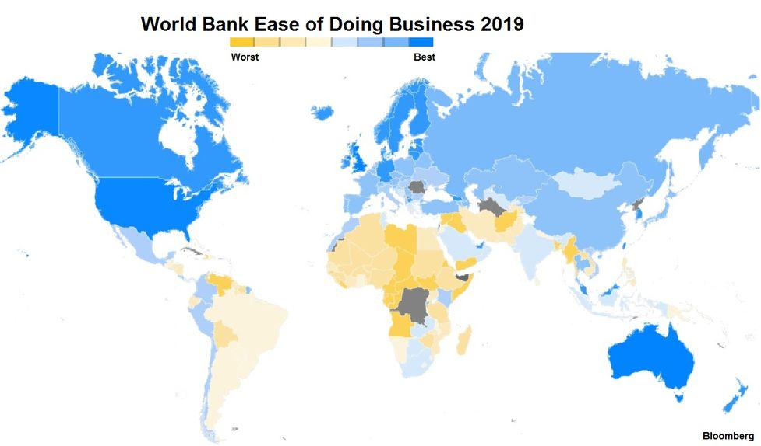
World Map Showing the Ease of Doing Business 2019
Notes:
Ease of Doing Business Rankings: http://www.doingbusiness.org/rankings
https://knoema.com/atlas/maps/Ease-of-doing-business-index

Slide 26
The Ease of Doing Business
2019 Report
Most Difficult:
  Somalia
  Eritrea
  Venezuela
  Yemen
  Libya
  South Sudan
  Central African Republic
  Haiti
  Chad
Easiest to Do Business:
  New Zealand
  Singapore
  Denmark
  Hong Kong SAR, China
  Korea, Rep.
  Georgia
  Norway
  United States
  United Kingdom
http://www.doingbusiness.org/rankings
Notes:
http://www.doingbusiness.org/rankings

