Slide 1
Economics for Leaders
Lesson 7: Property Rights
Is the Environment Different?

Slide 2
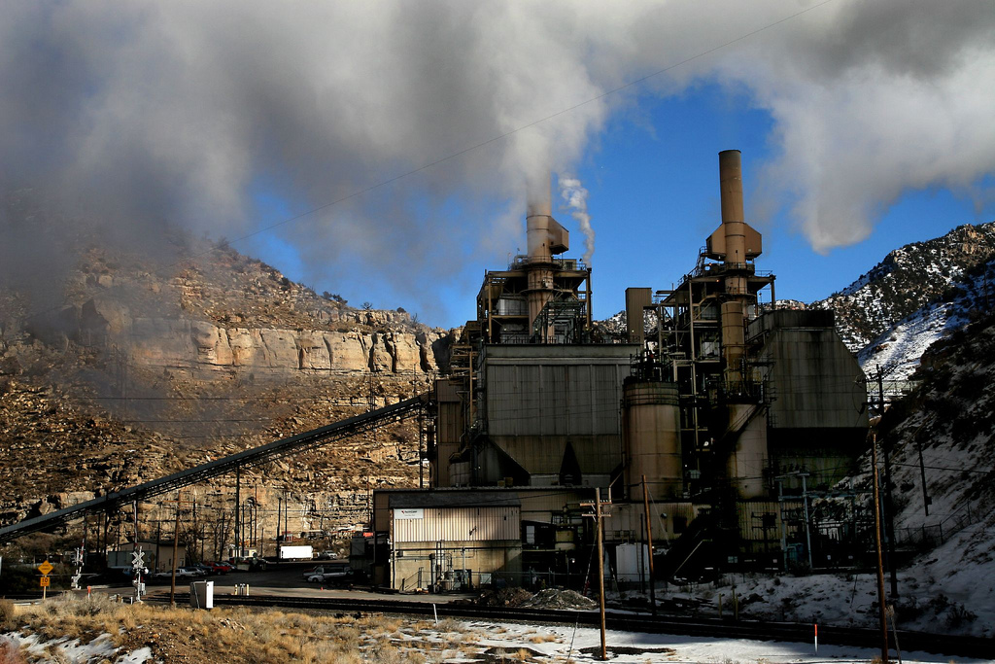
Coal-Fired Power Plant

Slide 3
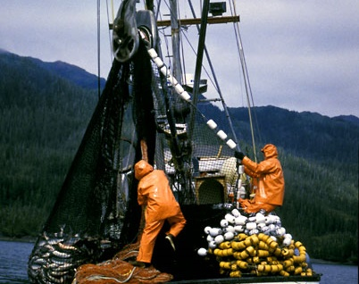
Commercial Salmon Fishing

Slide 4
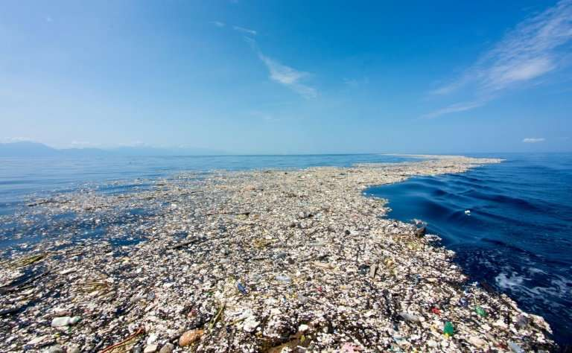

QUESTION:
Is environmental quality different, or is it like other goods and services?

Slide 5
Economic Reasoning Proposition #1
ERP 1: People choose, and individual choices are the source of social outcomes.
Is environmental quality scarce? (Does it use resources?)
Notes:
Make a transition from the general topic of world poverty – to economic reasoning tools

Slide 6
Economic Reasoning Proposition #2:
Choices impose costs; people receive benefits and incur costs when they make decisions.
Do decisions about the environment have opportunity costs?

Slide 7
Economic Reasoning Proposition # 3:
People respond to incentives in predictable ways.
Do people’s choices about environmental quality respond to incentives in predictable ways?

Slide 8
Economic Reasoning Proposition # 4:
Institutions are the “rules of the game” that influence choices.
Are the incentives that influence people’s choices about environmental quality shaped by the “rules of the game?

Slide 9
Economic Reasoning Proposition #5
ERP-5: Understanding based on knowledge and evidence imparts value to opinions.
Is this true of opinions about the environment?

Slide 10

QUESTION
Is environmental quality different, or is it like other goods and services?
YES!
Let’s use our economic way of thinking to investigate environmental problems

Slide 11
Property Rights
The formal and informal rules governing the ownership, use, and transfer of goods, services, and resources.
Property rights may be:
  Private
  Common
  Collective

Slide 12
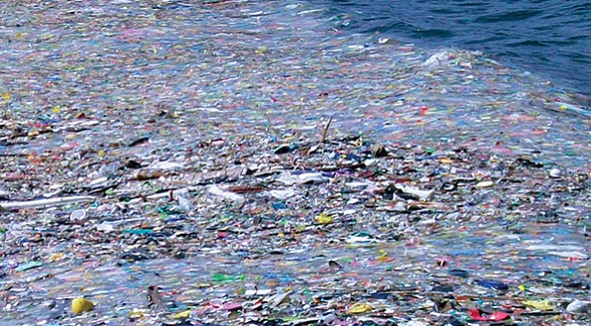
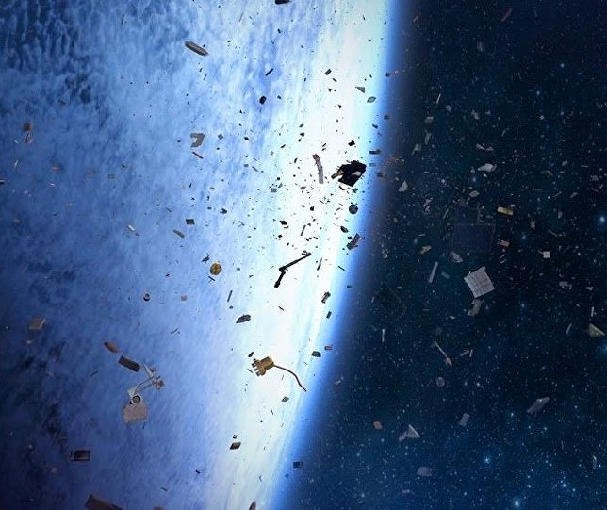
Property Rights Solutions?
Pollution Permits?
IFQs (Fishing Quotas)?
Others?
Whales
Great Pacific Garbage Trash
Space Trash
Climate Change
Notes:
Top Photo: Great Pacific Garbage Patch
Bottom Photo: Space Trash

Slide 13
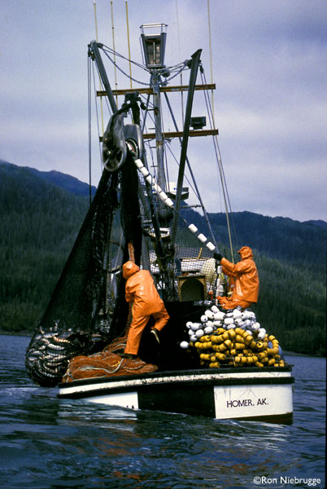
Commercial
Salmon Fishing
  Fishermen pay for the boats and gear
    don’t pay for reduction to the stocks of fish (future fish available)
  One potential solution: use fishing quotas (IFQ)
  Video: Saving Ocean Fisheries with Property Rights
  https://www.youtube.com/watch?v=B0Aql1re0FY

Slide 14
Economic Reasoning Proposition # 3:
People respond to incentives in predictable ways.
  Choices are influenced by incentives, the rewards that encourage and the punishments that discourage actions. When incentives change, behavior changes in predictable ways.

Slide 15

When Markets Work Well
There is an exchange of Benefits and Costs
P
S
Pe
Costs
D
Qe
Q
But . . .
Benefits

Slide 16
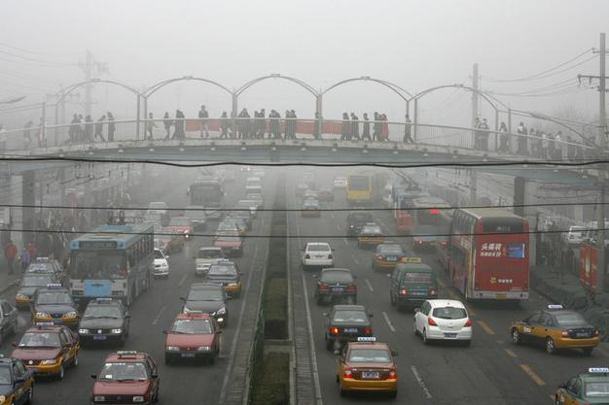
Negative Externalities

Slide 17
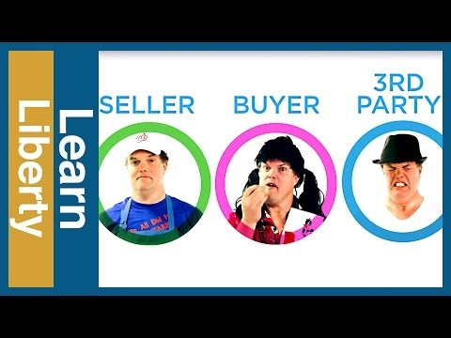
When is a potato chip not just a potato chip?
Notes:
http://www.learnliberty.org/videos/externalities-when-is-a-potato-chip-not-just-a-potato-chip

Slide 18

Positive Externalities

Slide 19
Please use the slides before this one in your presentation.
The slides following this one are provided as options.

Slide 20
Show FTE “jay-walking” video on environment
http://www.fte.org/staff-members/eflvids/

Slide 21
The Fish Activity:
The range of possibilities
Farmers
$75,000
HIGH Water yrs.
Outfitters
$100,000
WATER
Farmers $75,000
Farmers irrigate
Outfitters $20,000
LOW
Water
yrs.
Farmers
$50,000
Farmers DON’T
irrigate
Outfitters $100,000

Slide 22
The Fish Activity:
The Range of Mutually Beneficial Solutions
WATER
Farmers $75,000
Farmers irrigate
$25,000
difference
Outfitters $20,000
LOW
Water yrs.
$50,000
$80,000
difference
Farmers DON’T
irrigate
Outfitters $100,000

Slide 23
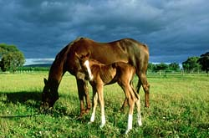

Positive ? Negative ?
Might depend which way the wind blows !

Slide 24
Externalities ?
Suppose that you show up at the Prom and another girl is wearing the same dress. Is this a positive or negative externality? Why?
Your brother or sister just finished a big homework assignment and is relaxing by watching TV. However, the sound is rather loud. Is this a positive or negative externality? How are such disputes settled in your family?
A smoker lights up a cigar as you wait for a bus. Is this a positive or negative externality? Why? Ask about the present and future costs (smelly clothes now and possible health effects later in life).
In John Grisham’s novel, “The Appeal,” a chemical company pollutes the town drinking water by improperly disposing of chemical waste. Cancer rates in the town soar after several years of dumping. Is this a positive or negative externality? Explain that the “rule of law” in our legal system has established liability laws that attempt to sort out responsibility in these types of situations. This is not true in many less developed countries.
Notes:
Questions from teaching suggestions #5

Slide 25
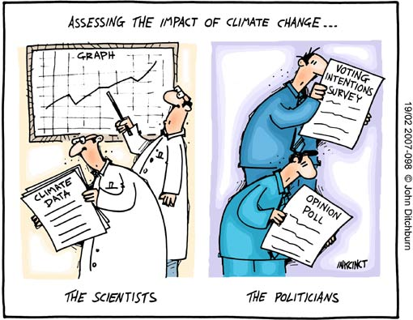
Climate Change

Slide 26


Captain Planet
Captain Planet, he's our hero
Gonna take pollution down to zero
He's our powers magnified
And he's fighting on the planet's side
Captain Planet, he's our hero
Gonna take pollution down to zero
Notes:
Play small video for audio of Captain Planet Theme Song: https://youtu.be/ZGegECwSiGY
Capt Planet doesn’t understand marginal analysis

Slide 27

Marginal Analysis
“EPA cleanups of superfund sites
cost an average of $12 billion
for every cancer case prevented.”
“Super Fund Follies” Dec., 1999

Slide 28
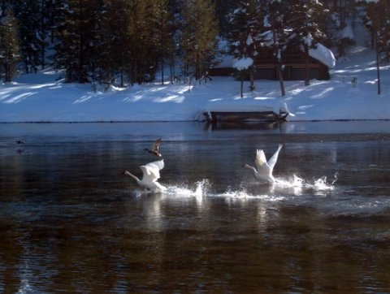
Trumpeter Swans and Idaho Farmers
A “willing seller, willing buyer” exchange based on clearly defined property rights to water.
Notes:
Trumpeter swans on the Henry’s Fork river in Idaho. A contract between the environmentalists and the Idaho farmers’ water bank allows release of water from farm ponds if the river threatens to freeze and reimbursement of the farmers for lost crops if the ponds don’t refill in time to irrigate.

Slide 29
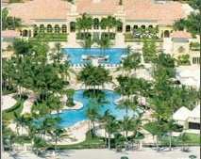
The Ocean Club, Key Biscayne
Additional Cost:
Turn lanes and media landscaping
$3million to renovate local elementary school
Contribute land for new beach access path and park
Total additional cost = $12 million
Benefits:
600 condos
Avg price = >$1 million
Notes:
Zoning in Miami example from teaching suggestions #8

