Slide 1
Economics for Leaders
Lesson 8: Setting the Rules
Costs and Benefits of Government Action

Slide 2
Economic Reasoning Proposition # 4:
Institutions are the “rules of the game” that influence choices.
  Laws, customs, moral principles, superstitions, and cultural values influence people’s choices. These basic institutions controlling behavior set out and establish the incentive structure and the basic design of the economic system.

Slide 3
The Rule of Law
Rule of Law exists when rules that govern behavior and interactions among individuals and groups of individuals apply to both the governed and the governing.
Rule of Man exists when laws are applied at the discretion of the governing.
Under the Rule of Force, people own what they can defend.

Slide 4
Please use the slides before this one in your presentation.
The slides following this one are provided as options.

Slide 5
Freedom House: Rule of Law
Is there an independent judiciary?
Does the rule of law prevail in civil and criminal matters? Are police under direct civilian control?
Is there protection from political terror, unjustified imprisonment, exile, or torture, whether by groups that support or oppose the system? Is there freedom from war and insurgencies?
Do laws, policies, and practices guarantee equal treatment of various segments of the population?

Slide 6
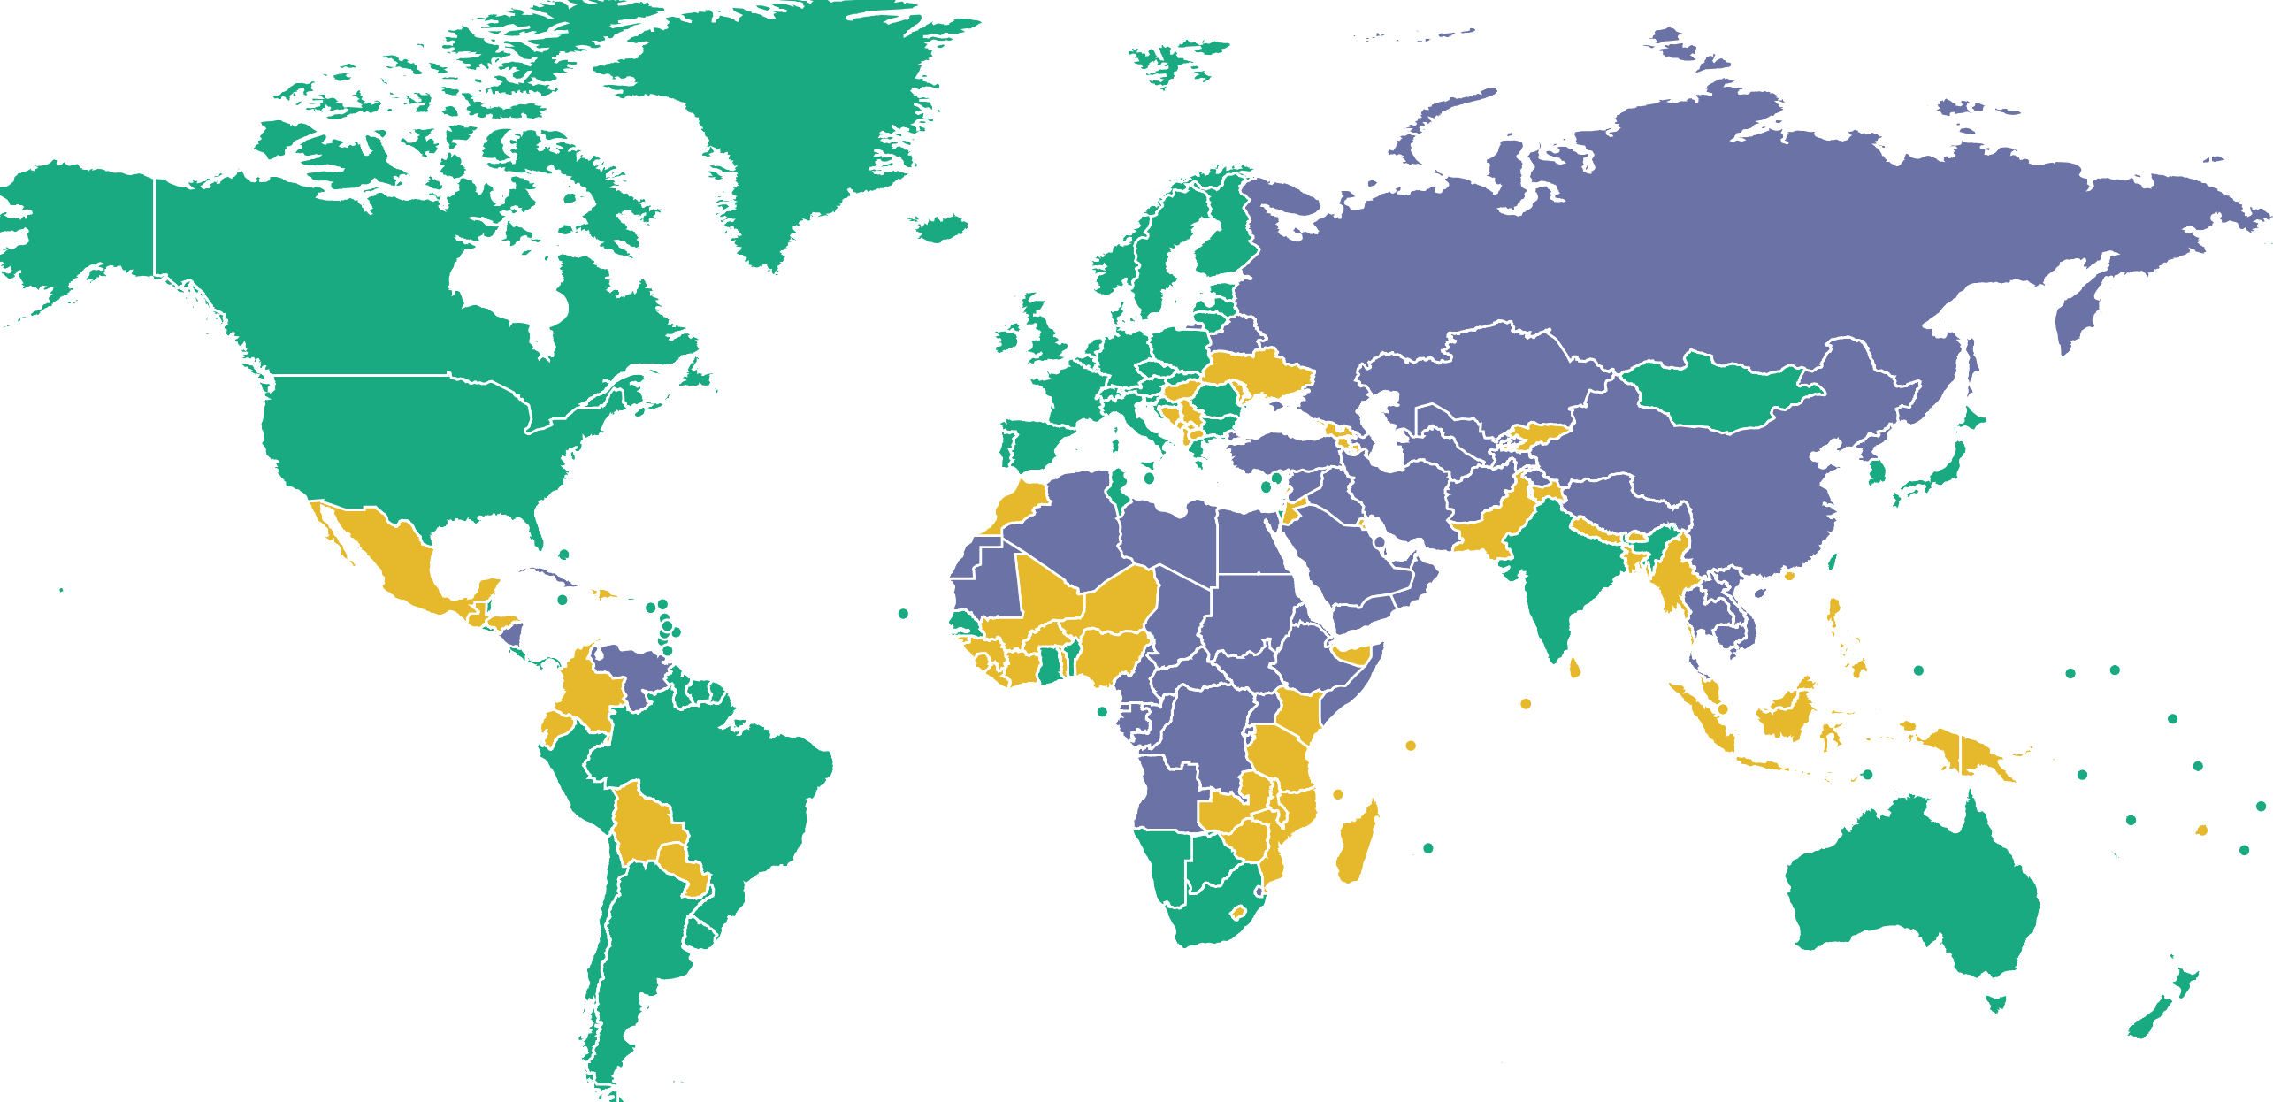


Freedom House: Freedom of the World 2019
(current state of political and civil rights)
Free Partly Free Not Free

Slide 7
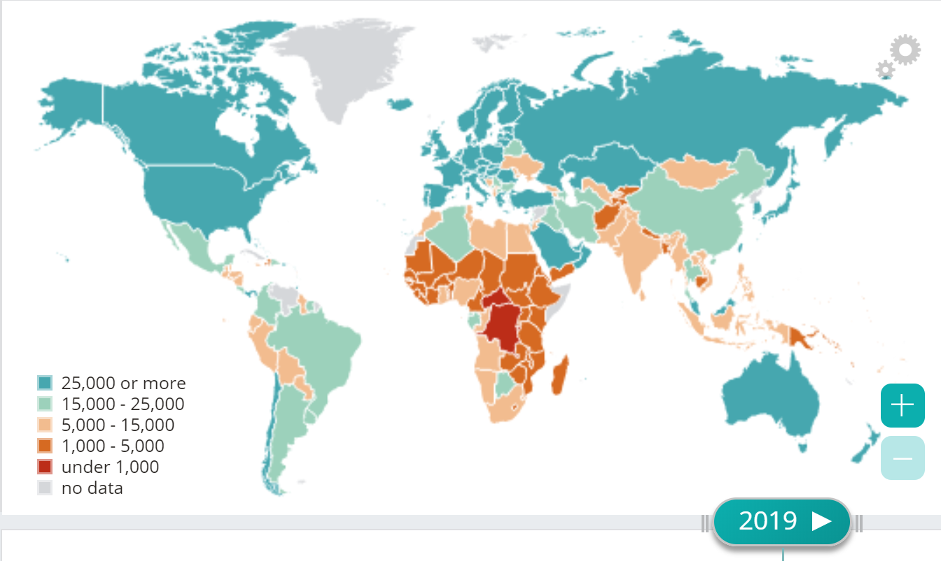
GDP Per Capita 2019 PPP
International Monetary Fund DataMapper
Low, Middle, & High Income Nations
Notes:
Economic reasoning tools developed this week will help us to answer this and other questions about world poverty
Interactive Map: http://www.imf.org/external/datamapper/PPPPC@WEO/THA/EGY

Slide 8
The Guideline Is the Same
Private Production should take place when the marginal benefit exceeds the marginal cost
Government Production should take place when the marginal benefit exceeds the marginal cost.
MB ≥ MC

Slide 9
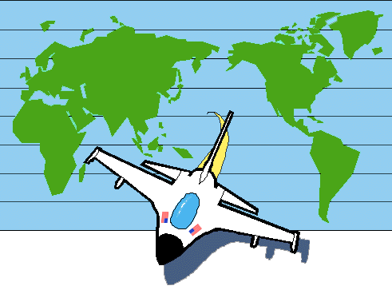
Public Goods
Non-rivalrous in consumption
Non-exclusive in production

Slide 10
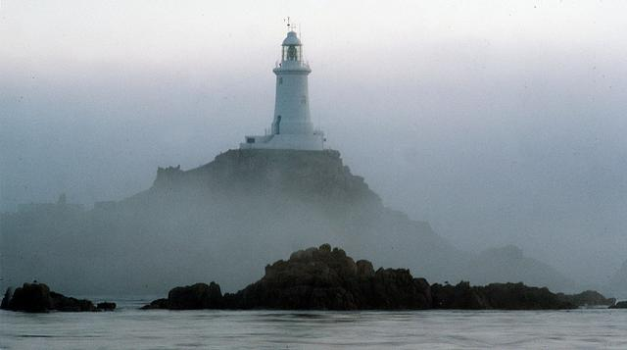
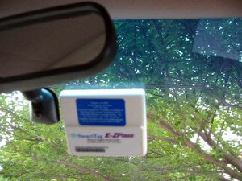
Technology & Public Goods

Slide 11

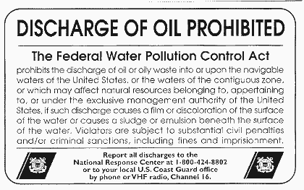
Addressing Externalities

Slide 12

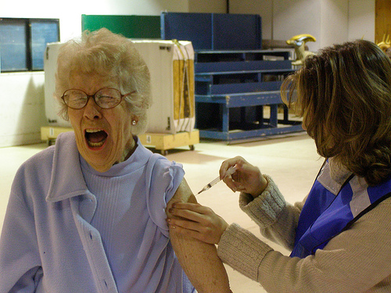
Addressing Externalities

Slide 13
Government Spending as Percentage of Total Federal Outlays
Year | Defense | Health & Medicare | Inc. & Soc. Security | Net Interest on Debt
1940 | 16% |  | 15% | 10%
1950 | 31% |  | 11% | 11%
1960 | 50% | 2% | 20% | 8%
1970 | 42% | 4% | 23% | 7%
1980 | 23% | 8% | 33% | 9%
1990 | 24% | 11% | 30% | 15%
2000 | 16% | 18% | 35% | 12%
2010 | 20% | 21% | 37% | 6%
2015 | 16% | 25% | 36% | 6%
2016 | 15% | 26% | 36% | 6%
2017 | 15% | 26% | 35% | 7%
Source: Office of Management and Budget www.cbo.gov/publication/53651
Notes:
The mix of government services – for teaching suggestion #3
www.cbo.gov/publication/53651
NOTE: “Inc & Social Security” consists of Social Security and Income Security (includes federal employee retirement and disability, unemployment compensations, food and housing assistance, and other federal income security programs).
“Health & Medicare” consists of spending for Medicare (net of premiums and other offsetting receipts), Medicaid, and the Children's Health Insurance Program as well as outlays to subsidize health insurance purchased through the marketplaces established under the Affordable Care Act and related spending.

Slide 14
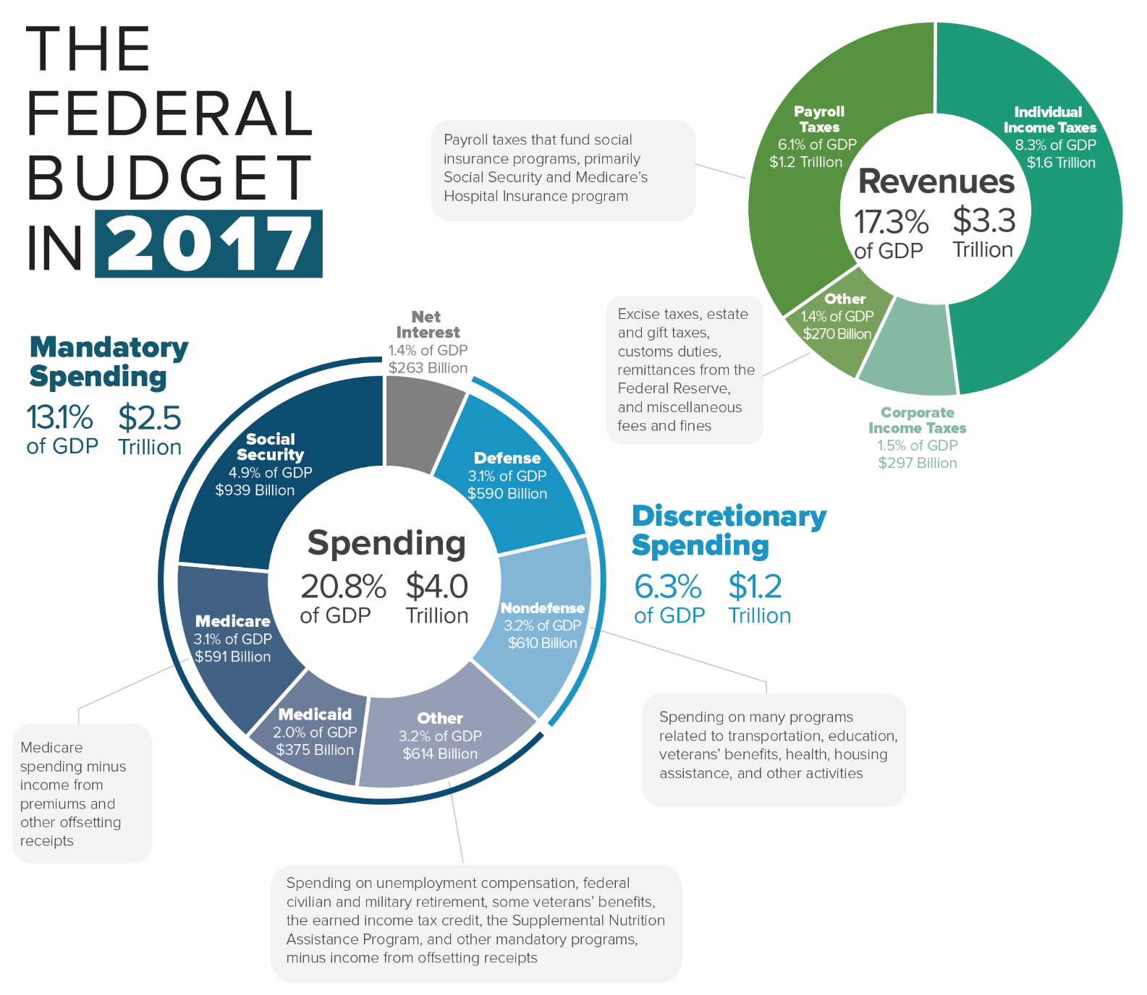
Where does government get & spend their money?
Notes:
Infographics for 2018 budget not available yet. 2018 Revenue $3.33 trillion. 2018 Spending $4.11 trillion
2017 https://www.cbo.gov/publication/53624

Slide 15
How do we pay for government?
Taxes

Slide 16
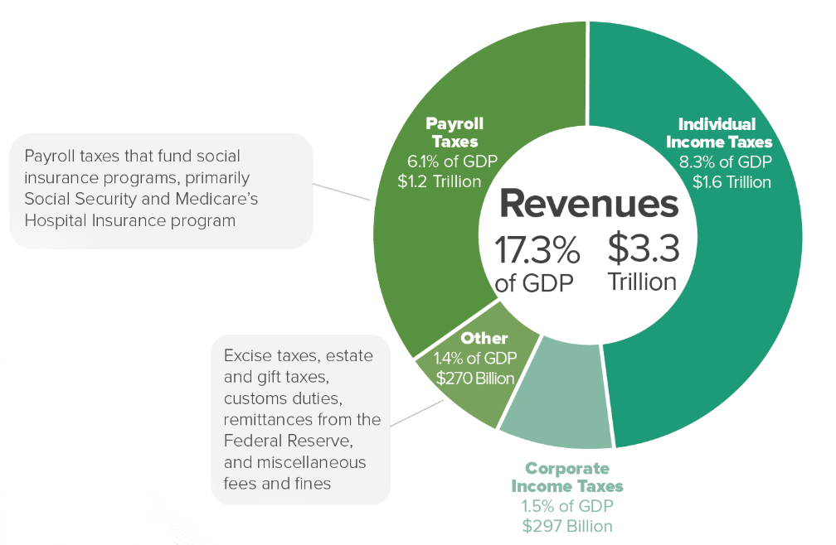
U.S.
Federal Revenues (Fiscal Year 2017)

Slide 17
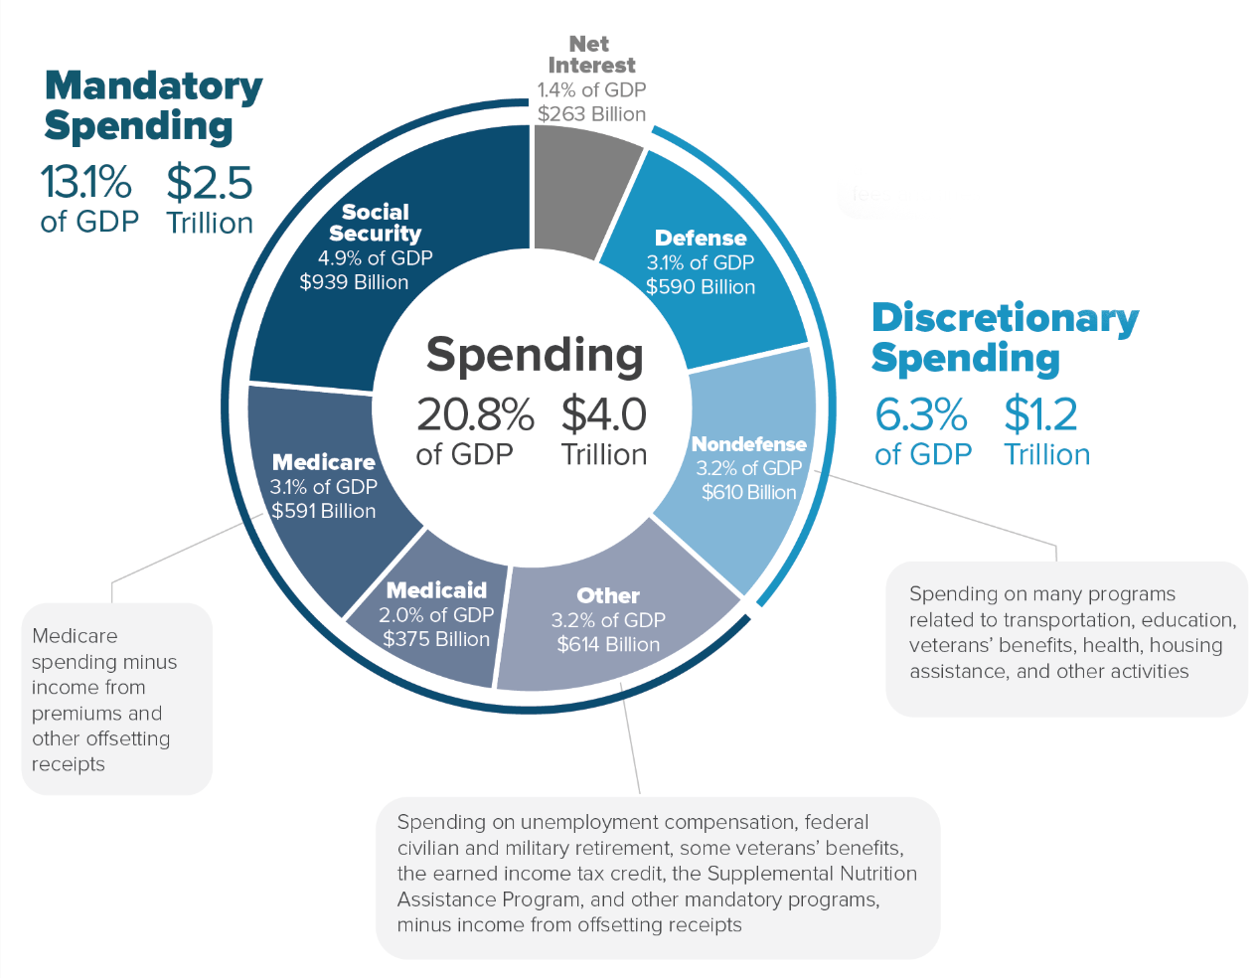
U.S.
Federal Spending (Fiscal Year 2017)

Slide 18
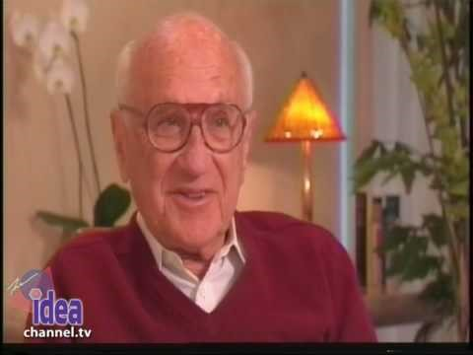
4 Ways to Spend Money
Notes:
Milton Friedman on spending money. How government spending is different than private spending.
https://www.youtube.com/watch?v=5RDMdc5r5z8

Slide 19
Public Choice Theory:
Like private individuals, elected officials act in their best interests.
Elected officials’ abilities to accomplish their goals depend on being elected (and re-elected).
Elected officials have an incentive to pay more attention to those constituents who are able and likely to influence the election.
The power of Special Interest Groups derives from the distribution of benefits and costs

Slide 20
Concentrated Benefits and Diffuse Costs? Vote “For!”
Big benefit to a small but organized group of voters
Small cost to a large number of unorganized, sometime voters

Slide 21
Legislators tend to vote:
FOR
AGAINST
legislation that confers significant benefits on relatively small (but organized and active) groups and imposes small costs on the public at large
legislation that imposes costs on small (but organized and active) groups and deprives the public at large of relatively small benefits

Slide 22
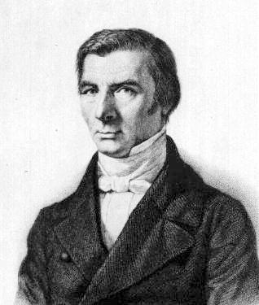
“Government is the great fiction through which everybody endeavors to live at the expense of everybody else.”
Frédéric Bastiat (1801 – 1850).

