Slide 1
Economics for Leaders
Lesson 9: Money & Inflation

Slide 2
What is Money?
ANYTHING generally accepted in payment for goods & services
IS money

Slide 3
Money is what money does
If it performs the functions of money,
then it is money!

Slide 4
Functions of Money
measure of value
  Values expressed in money prices (helps comparisons)
store of value
  a way to store wealth over time
medium of exchange
  accepted in buying & selling (reduces transactions cost)

Slide 5
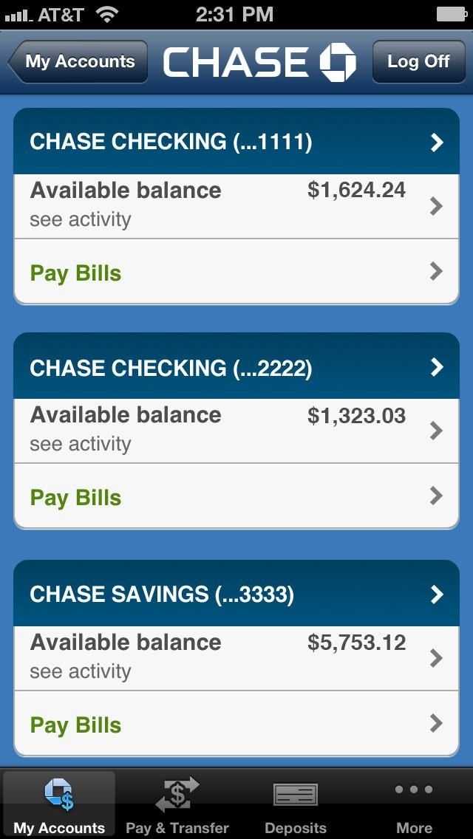

What Performs These Functions in the U.S. Economy?
checking account balances
currency
coins

Slide 6
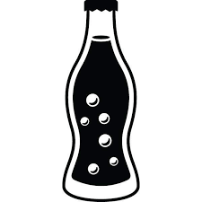

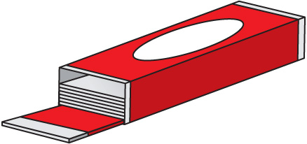
For Sale!
Notes:
Conduct three rounds of auction with identical candies for sale each time.

Slide 7
Inflation
A general, sustained increase in the price level.
The erosion or decline of purchasing power.
The best-known measure of inflation is the CPI, or Consumer Price Index
Market Basket of Goods and Services

Slide 8
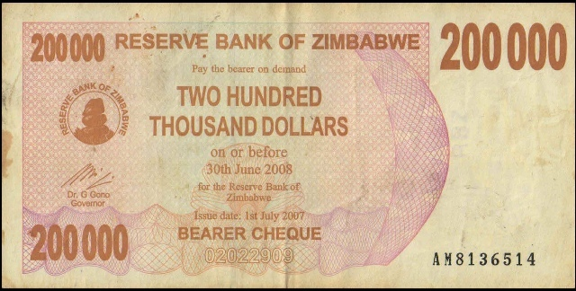
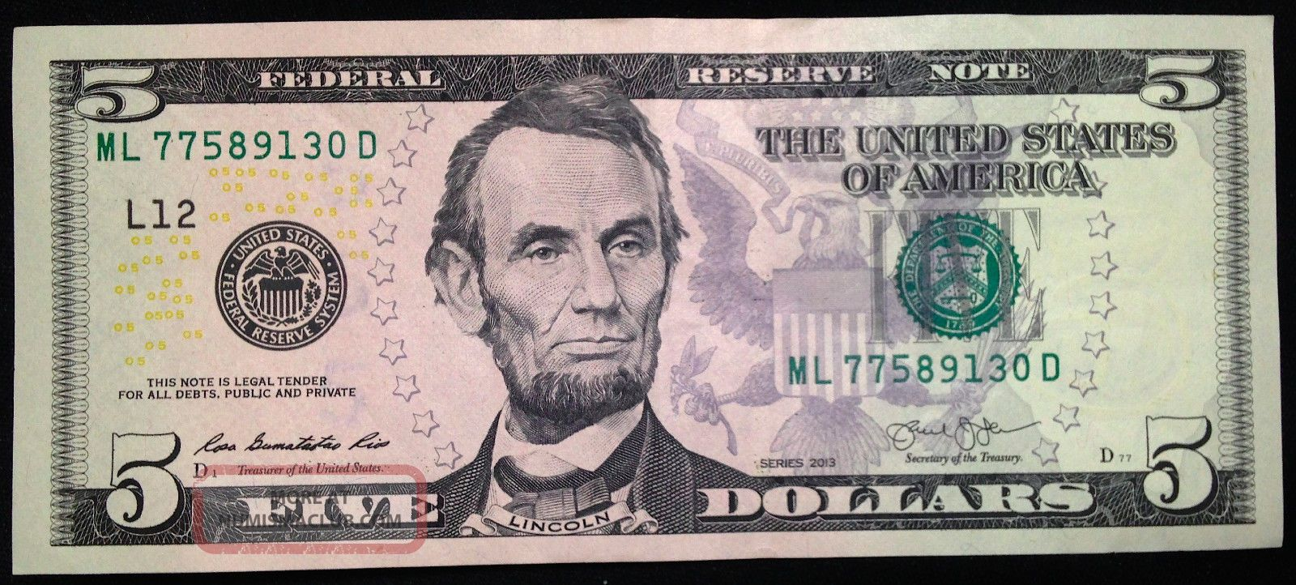
Which would you rather have?

Slide 9
Inflation Reduces the Value of the Dollar
Price Level

Slide 10
Same Products – Higher Prices

Slide 11
What Causes Inflation ?
All periods of significant sustained inflation have been accompanied by increases in the money supply

Slide 12
Why do we worry about the money supply?
Experience has shown us that the money supply is the most important factor affecting general price levels, that is -
Inflation
Inflation must be taken seriously it alters incentives and people’s economic behavior, and consequently, it negatively impacts the economy as a whole.

Slide 13
Open Market Operations
The most important tool of the Fed in controlling the money supply
Can be, and is, used on a daily basis
Its effect is immediate
Can be used to target interest rates

Slide 14
Please use the slides before this one in your presentation.
The slides following this one are provided as options.

Slide 15
Interest Rates
Mortgage:
New car:
Credit card:
Savings account:
Treasury notes:

Slide 16
How do Banks Create Money?
Money Supply = $100
$100
John

Slide 17
Lending creates additional purchasing power
$50
$100
Money Supply =
$100 + $50 = $150
John
Sue

Slide 18
More lending creates more money
$50
$50
$25
$100
John
Bill
Sue
Money Supply increases = $100 + $50 + $25 = $175

Slide 19
Paying off loans contracts the money supply
$50
$50
$25
$100
John
Bill
Sue
Money Supply decreases = 175 – $25 = $150

Slide 20
Open Market Operations:
When the Fed Sells Bonds
Who ends up with the money?
Who ends up with the bond?
What happened to the money supply?
$$$$
bond
Fed Bond Sales
Notes:
Money Supply Decreases

Slide 21
Fed purchases of government securities increase the availability of money to the public.
When the Federal Reserve buys government securities, reserves in the banking system increase.
Increased reserves means increased ability to lend, which increases the money supply.
$1000
$1000
Fed
bond
Bill’s Bank
Bill

Slide 22
Open Market Operations:
When the Fed Buys Bonds
Who ends up with the money?
Who ends up with the bond?
What happened to the money supply?
bond
$$$$
Fed Bond Sales

Slide 23
Open Market Operations allows the Fed to manage interest rates
If Open Market Operations reduce the money supply:
      If Open Market Operations increase the money supply:
Bank deposits increase
Bank reserves increase
The supply of money to lend increases
Interest rates fall
Bank deposits decrease
Bank reserves decrease
The supply of money to lend decreases
Interest rates rise

Slide 24
Measuring Inflation – the Consumer Price Index
The Department of Labor’s Bureau of Statistics:
  Determines the items in the market basket
  Gathers the prices of the items in the basket during a base year
  Gathers the prices of the items in the current year.
  Calculates the CPI:
=
X 100
CPI
Price of basket in current year
Price of basket in base year

Slide 25
Suppose CPI_{this year} = 125
What does it mean?
  25% increase in prices between the base year and this year
The change in the index is referred to as
      the Inflation Rate

Slide 26

PNC Christmas Price Index, 2018
Video/Interactive Website: http://www.pncchristmaspriceindex.com/

Slide 27
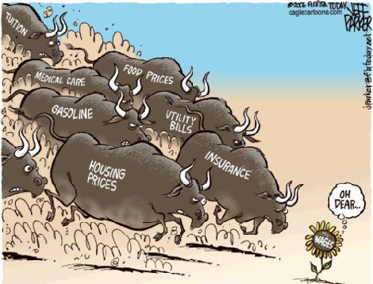
Inflation

Slide 28
Hyperinflation in Zimbabwe
This kind of hyperinflation is rare in history, but we are seeing it once again, in Zimbabwe. Government officials claim an inflation rate of 66,212 percent (most months they refuse to release inflation figures at all). The International Monetary Fund believes the rate is closer to 150,000% — about the level reached by Weimar Germany. By some estimates, about 50% of Zimbabwe’s government revenue comes from the printing of money. At independence in 1980, the Zimbabwean dollar was worth more than one U.S. dollar. Recently, the state-controlled newspaper raised its cover price to 3 million Zimbabwean dollars. Two pounds of chicken were recently reported to cost about 15 million Zimbabwean dollars.
A Zimbabwean friend who runs a business recently told me, “If you don’t get a bill collected in 48 hours, it isn’t worth collecting, because it is worthless. Whenever we get money, we must immediately spend it, just go and buy what we can. Our pension was destroyed ages ago. None of us have any savings left.” http://davidcoltart.com/archive/2008/376 “Dying Silently in Zimbabwe,” by Michael Gerson, Washington Post, Feb 20, 2008

Slide 29
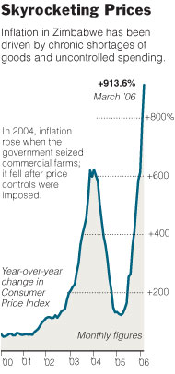
Hyperinflation in Zimbabwe
HARARE, April 25,2006 — How bad is inflation in Zimbabwe? Well, consider this: at a supermarket near the center of this tatterdemalion capital, toilet paper costs $417.
No, not per roll. Four hundred seventeen Zimbabwean dollars is the value of a single two-ply sheet. A roll costs $145,750 — in American currency, about 69 cents.
The price of toilet paper, like everything else here, soars almost daily, spawning jokes about an impending better use for Zimbabwe's $500 bill, now the smallest in circulation.
http://www.nytimes.com/2006/05/02/world/africa/02zimbabwe.html

Slide 30
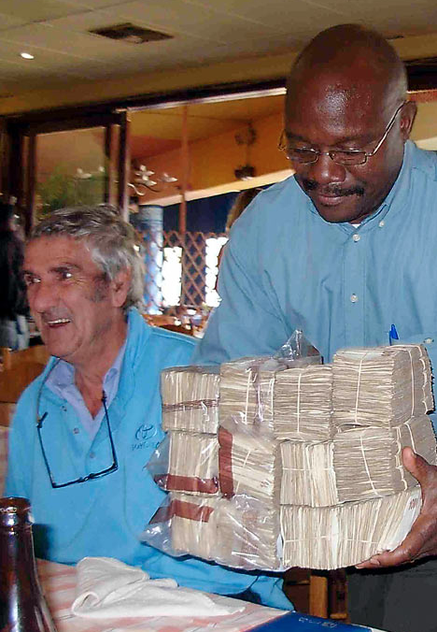
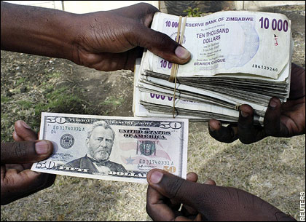
Lunch for 8 people costs a diner 6 million Zimbabwean dollars (about $18 U.S.)

