Slide 1
Government Budgets
and Expenditures
are Rarely the Same
Bill Bergman
/TruthinAccounting
@truthinacct
@truthinacct
Truth in Accounting

Slide 2
Intro / Appetizers
Accounting is about numbers, but it is also about words.
What do the words mean? Do they mean what they say?
Importance of simple questions. What is cash?
Accounting is about words, but it’s also about symbols.
Like a $. What is a $?

Slide 3
Some interesting reads …
Edwin Vieira, “What is a Dollar?”
Seth Lipski, “What is a Dollar?”
Notes:
“… This history demonstrates that official Washington, D.C., has no conception of what a “dollar” really is. The reason for this self-imposed ignorance is obvious. By reducing the “dollar” to a political abstraction, the government has empowered itself to engage in limitless debasement (depreciation in purchasing power) of our money.”

Slide 4
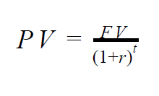
What’s Better, a Dollar Today or Tomorrow?
Depends on if it is an asset or a liability
A bird in the hand is worth two in the bush

Slide 5
Three Roles for Money
Medium of exchange
Store of value
Unit of account

Slide 6
Intro / Appetizers (cont.)
What are “expenses?” Are they equal to “expenditures?”
Accrual-basis vs. cash-basis accounting
Budgets vs. financial statements
“There are words, and there are deeds.”

Slide 7
Is cash always cash?
Our government has established a variety of insurance-like schemes advertised to stabilize our financial system, and the integrity of cash and cash equivalents.
Pretending that risky things aren’t risky a formula for subsidies, instability, and bailouts
These schemes have exposed the public purse, and taxpayers, to the risk of loss. Accounting and reporting for that risk isn’t easy.

Slide 8
Tracking cash is important, but …
Economic performance can go up when cash is going down, and economic performance can go down when cash is going up
So, accounting systems are based on ACCRUAL as well as cash basis
Cash-basis systems help governments claim “balanced budgets” even as debt accumulates – bonded debt, or other forms of debt

Slide 9
Accrual-basis accounting
Record revenues when earned, expenses when incurred.
The City of Chicago “balances its budget, as required by state law.”
Chicago City Council fellow response, when asked “how do you balance the budget every year, when your expenses exceed your revenue every year?”

Slide 10
State of Illinois Constitution
“The Governor shall prepare and submit to the General Assembly, at a time prescribed by law, a State budget for the ensuing fiscal year. The budget shall set forth the estimated balance of funds available for appropriation at the beginning of the fiscal year, the estimated receipts, and a plan for expenditures and obligations …”
“Proposed expenditures shall not exceed funds estimated to be available for the fiscal year as shown in the budget.”

Slide 11
Who Sets Accounting Standards?
There are lots of different accounting “standards”
FASB
IASB
GASB
FASAB
IPSASB
The Mystery Guest

Slide 12
Types of Audit Opinions
Unmodified
Modified
Adverse
Disclaimer
Which type of opinion has the U.S. Government received?

Slide 13
Budgets and Financial Reports
Budgets are planning documents – forward-looking.
Government budgets are linked to appropriations process, grounded in legislatures, with executive responsibility as well.
Financial statements are prepared after a period ends, give you information about financial condition at a past point in time, and over a past period of time.

Slide 14
Why Do Budgets Get So Much Attention?
They are important control/accountability devices, to be sure, but …

Slide 15
Why Do Budgets Get So Much Attention?
They are important control/accountability devices, to be sure, but …
Budgets are where the action is

Slide 16
Why Do Budgets Get So Much Attention?
They are important control/accountability devices, to be sure, but …
Budgets are where the action is
People care more about spending other people’s money than they do about accounting for it

Slide 17
Paul Douglas, Economy in the National Government (1952)
“Witnesses Urge Expenditures, Not Economy”
“Subcommittees of each house hold hearings on all regular appropriations bills. These are very helpful in developing information about particular expenditures and programs. But, almost invariably, witnesses … represent agencies defending the budget requests or pressure groups demanding larger expenditures.”

Slide 18
Paul Douglas, Economy in the National Government (1952)
Chapter X – “The Budget Must Be Balanced”
“The Public Interest is Diffused”
“Special Interests are Concentrated”
“Left Hand Saves, Right Hand Spends”
“Special Interests are Organized on Many Fronts”
“Powerful Combinations Win Battles and Lose War”

Slide 19
Douglas on Winning Battles, and Losing Wars
“The further result is a fine paradox. Everybody is for economy as a general principle, but no one can get his special privilege unless he consents to special privileges for others.”
“As groups win their battle for special expenditures, they lose the more important war for general economy.”

Slide 20
Jerry Tempelman, “James M. Buchanan on Public Debt Finance” (2007)
Public debt delays paying the piper for benefits today
Government feeds well-organized special interest groups today, shifting burden to tomorrow’s unorganized general citizenry
Need constitutional amendment enforcing balanced budgets

Slide 21
Financial Report U.S. Government
Report for FY 2018 (September) released late March, 2019. Delayed by longest federal government shutdown in US history. Processes and people important to the report deemed “nonessential.”
Released to deafening silence. No coverage in WSJ, the New York Times, or the Washington Post the next day. WSJ had articles about GDP growth, cat allergies, A Rod, Saudi women activists, MLB Opening Day, Lyft IPO. Nothing about that report.
See also “A True Portrait of America’s Finances,” by Bill Bergman, The CPA Journal (May 2019)

Slide 22
Another dog that didn’t bark
President’s State of the Union Address
Required by U.S. Constitution. So is a “Statement and Account.”
State of the Union address delivered every year in January/February
Frequently without the Financial Report of the US Government
A bipartisan practice

Slide 23
Federal Government – Financial Statements
Statement of Net Cost
Statement of Operations and Changes in Net Position
Balance Sheet
Reconciliations of Statement of Net Cost and Budget Deficit
Statements of Social Insurance
Federal Reserve Banks – Consolidated Balance Sheet

Slide 24
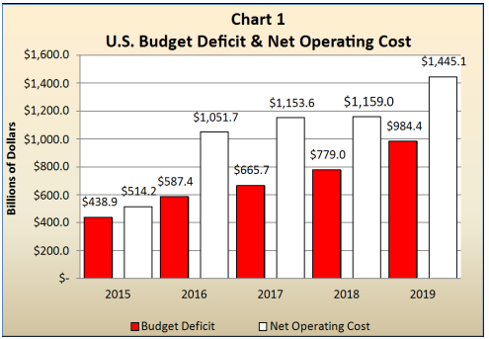
Since 2015 …

Slide 25
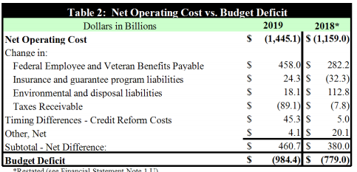
Budget Deficit vs. Net Operating Cost

Slide 26
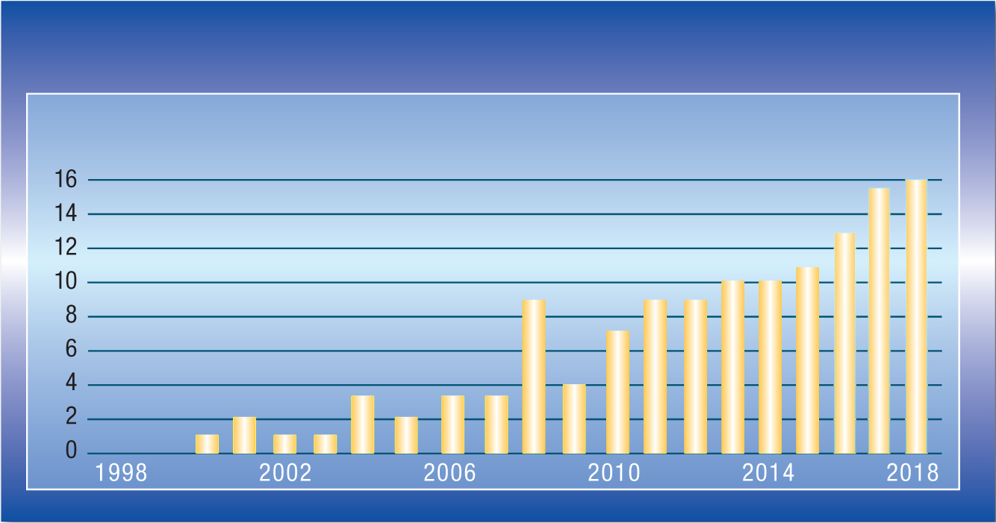
Financial State of the Union / Sustainability
Frequency of the word “unsustainable” in FRUSG since 1998
From “A True Portrait of America’s Finances,” The CPA Journal (May 2019)

Slide 27
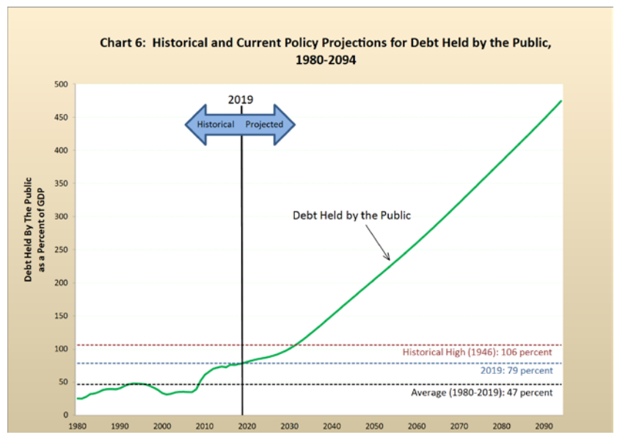

Slide 28
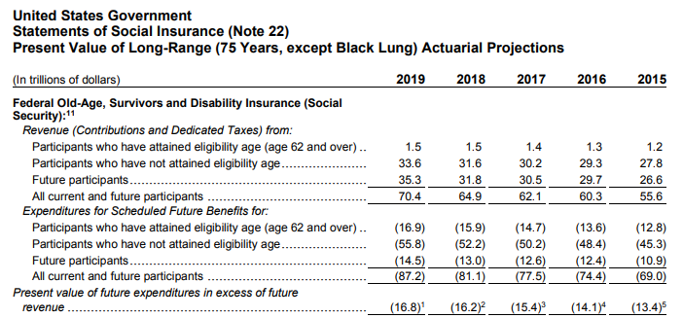
Social Security – not on Balance Sheet, but …

Slide 29
Social Security – What, Me Worry?

Slide 30
Social Security – What, Me Worry?

Slide 31
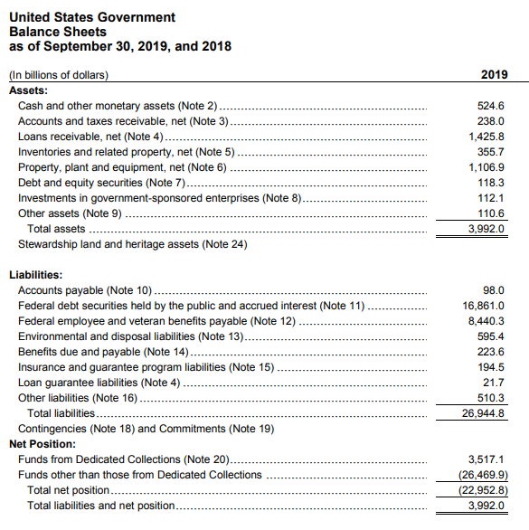

Slide 32
Bottom Line(s)
Financial Report U.S. Government, introduction to balance sheet:
“There are, however, other significant resources available to the government that extend beyond the assets presented in these Balance Sheets. Those resources include Stewardship Land and Heritage Assets in addition to the government’s sovereign powers to tax and set monetary policy.”

Slide 33
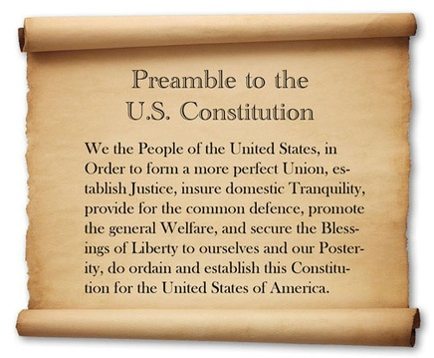
Government Accounting – and our Republic

Slide 34
Paul Douglas, as recalled by Milton & Rose Friedman
“Rose remembers Douglas as an extremely colorful teacher. In the Principles of Economics course she took with him her first year at the university, he arrived in class one day with a bag of oranges to demonstrate diminishing marginal utility. He proceeded to toss oranges to the students one by one until they yelled “no more.” After this demonstration, how could anyone forget diminishing marginal utility?”

