Slide 1
Bidenomics The President’s Plan for the Economy
Scott Baier
Clemson University
Foundation for Teaching Economics

Slide 2
Outline
Where we have been and where we are.
The American Recovery Plan
The American Jobs Plan
The American Family Plan
The Debt and Deficit

Slide 3
Spending
Health and
Social Services
Retail
18.9%
1.6%
-4.5%
-37.3%
Arts & Entertainment
Source: Opportunity Insights

Slide 4
Total Consumption was down 2.6 percent (-2.6%)
Source: Furman and Powell

Slide 5
Hours Worked
11%
18%
23%
25%
41%

Slide 6
Hours Worked by Income Group
“Stimulus Checks”
???

Slide 7
Weekly Initial Unemployment Claims
Weekly Claims (in 1,000)
200
Source: U.S. Employment and Training Administration

Slide 8
Weekly Initial Unemployment Claims
Weekly Claims (in 1,000)
200
Source: U.S. Employment and Training Administration

Slide 9
Employment: Nonfarm Payroll
Source: Bureau of Labor Statistics

Slide 10
March and April Job Loss (2020) (in 1,000)
Source: BLS

Slide 11
Job Loss and Job Gains (in 1,000)
Employment is still about 8 million below where it was in February 2020
Source: BLS

Slide 12
Unemployment Rate
14.8
6.0

Slide 13
Unemployment by Income and Age
Ages 21-35
Ages 36-55
Ages 56-70
Source: Wharton / CPS

Slide 14
Employment to Population Ratio

Slide 15
Unemployment
Benefits
Aid to State and
Local Gov’t
Direct Pandemic
Response
$289 Billion
$350 Billion
$100-$160 Billion
American Rescue Plan Act of 2021
Direct Payments
Stimulus Checks
Expanded and Refundable
Child Tax Credit
School
Support
$410 Billion
$135 Billion
$129 Billion
Source: Tax Foundation

Slide 16
American Recovery Plan Act of 2021
Emergency Relief for
Individuals and Families
Economic Assistance for
Communities and Businesses
Vaccine Distribution
and Health
Transportation
State and Local
Recovery Fund
$1,400 payments
$300 Unemployment
CTC $3,000 ($3,600)
EITC $1,000
TANF
Housing
Education Stabilization Funds
Child Care Tax Credit
PPP $7.25 billion
Economic Injury Disaster Loan
$15 billion
Public Transport $30B
Airports $8B
Amtrack $2B
Vaccine Distribution $20B
Medicaid Support
Testing
Mental Health
State Recovery $220B
Local Recovery $130B
COVID Capital Projects $10B
Notes:
CARES Act Coronavirus Aid, Relief, and Economic Security Act

Slide 17
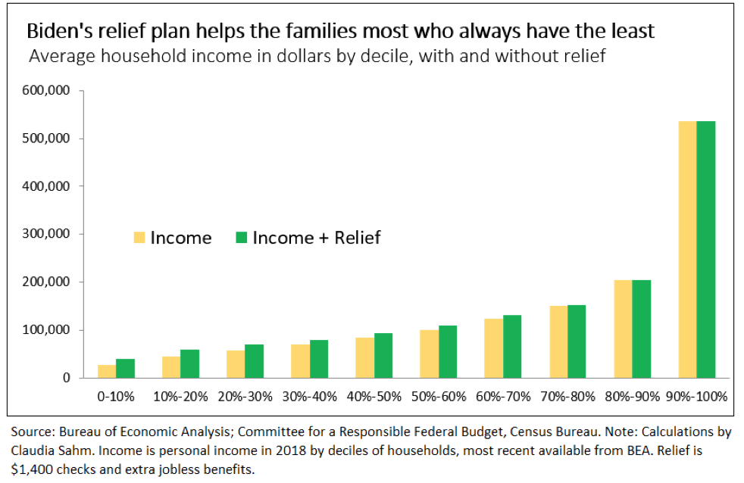

Slide 18
Economic Recovery
Without American Recovery Plan (2021)
Depends on how quickly people get vaccinated,
The number of daily cases.

Slide 19
Retail Sales (excluding Food)

Slide 20
Percent Vaccinated

Slide 21
Spending and Number of New COVID19 Cases
Stimulus, the decline
in cases, and private
and public adjustments
resulted in improvements
in the second and third
quarter.

Slide 22
Mobility
137%
136%
67%

Slide 23
Job Loss and Job Gains (in 1,000)
Source: BLS

Slide 24
Economic Recovery
Without American Recovery Plan (2021)
Depends on how quickly people get vaccinated,
The number of daily cases.
With the Recovery Plan (2021)

Slide 25
Economic Recovery
Without American Recovery Plan (2021)
Depends on how quickly people get vaccinated,
The number of daily cases.
With the Recovery Plan (2021)
Are the payments to households stimulus?

Slide 26
Economic Recovery
Without American Recovery Plan (2021)
Depends on how quickly people get vaccinated,
The number of daily cases.
With the Recovery Plan (2021)
Are the payments to households stimulus?
Is this “additional income” for people and will the spend it.
Are these payments primarily going to be used to pay down debt or save, or
Are the payments primarily going used to cover for lost income.

Slide 27
Economic Recovery
Without American Recovery Plan (2021)
Depends on how quickly people get vaccinated,
The number of daily cases.
With the Recovery Plan (2021)
Are the payments to households stimulus?
Is this “additional income” for people and will the spend it.
Are these payments primarily going to be used to pay down debt or save, or
Are the payments primarily going used to cover for lost income.

Slide 28
Economic Recovery
Without American Recovery Plan (2021)
Depends on how quickly people get vaccinated,
The number of daily cases.
With the Recovery Plan (2021)
Are the payments to households stimulus?
Is this “additional income” for people and will the spend it.
Are these payments primarily going to be used to pay down debt or save, or
Are the payments primarily going used to cover for lost income.
What becomes permanent?
Do the monthly checks (CTC) that begin in the summer for children become permanent?

Slide 29
Economic Outlays and Impact
Category | Outlays | Impact
Funding for Schools & Reopening | $170
Develop a COVID vaccination program | $160
$1,400 per person "Recovery Rebates" | $465
Increase and extend unemployment insurance | $350
Support for small landlords and renters | $30
Childcare provider support | $25
Expand the Child Tax Credit to $3,000 per child, $3,600 for children under 6 | $120
Aid for state and local governments | $350
Other policy provisions** | $200
Total

Slide 30
Economic Outlays and Impact
Category | Outlays | Impact
Funding for Schools & Reopening | $170 | $35
Develop a COVID vaccination program | $160 | $45
$1,400 per person "Recovery Rebates" | $465 | $130
Increase and extend unemployment insurance | $350 | $100
Support for small landlords and renters | $30 | $10
Childcare provider support | $25 | $10
Expand the Child Tax Credit to $3,000 per child, $3,600 for children under 6 | $120 | $40
Aid for state and local governments | $350 | $100
Other policy provisions** | $200 | $20
Total | $1,870 | $490

Slide 31
GDP Effects of the American Rescue Plan

Slide 32
GDP Effects of the American Rescue Plan

Slide 33
Employment: Nonfarm Payroll
1 million per month
At 1 million jobs per month, we are back on trend by April 1, 2022
Source; BLS

Slide 34
Employment: Nonfarm Payroll
1.5 mill. per month
At 1 million jobs per month, we are back on trend by November 1, 2021
Source: BLS

Slide 35
Employment: Nonfarm Payroll
0.50 mill per month
At 0.50 mill. jobs per month, we are back on trend 2024
Source: BLS

Slide 36
Overheating or Overreacting
Some economists worry that the stimulus along with a bounce-back from the vaccination efforts and the “opening” back up of the economy the economy will overheat
The (pent-up) private demand, the public push, and the amount of monetary stimulus will increase demand so much that we will quickly reach production capacity.
If this occurs, this may lead inflationary pressures.
Other economists argue that with more than 8.5 million people unemployed and the economy “far below” the natural rate of unemployment, the risks associated with overheating are low.
If the Federal Reserve sees signs of inflation in the financial markets or in the goods market, they will have time to take action to reduce inflation.

Slide 37
American Jobs Plan
Transportation
Climate Resilience
Energy Efficient
Buildup
R&D Training and
Manufacturing
$590B
School and
Human Services
Traditional Infrastructure
$621B
Roads, Highways,
Bridges, Mass Transit
Airport
EV
Modernize Drinking Water,
Storm Water,
Improve Broadband
Mitigate Floods and Wildfire
Electric Grid
Public Housing and
Energy Efficiency
$300B
Child and Elder Care
$600
Upgrading Research
Infrastructure in AI,
biotech, and computing,
Notes:
CARES Act Coronavirus Aid, Relief, and Economic Security Act

Slide 38
American Jobs Plan: Infrastructure Investment
Objective is to invest in the infrastructure and make the economy more productive.
In the 1950s and 1960s, we were investing about 5% of GDP on public infrastructure over the last few decades it has been about 2% per year.
Investments in Transportation infrastructure accounts for about a 25% of the total.
Economic questions:
Is the infrastructure productive?
Will it make workers more productive?
Will it make capital more productive?
Is the infrastructure a complement or a substitute for private capital?
How is paid for?
Efficiency: The one’s who benefit from it should be the one’s who pay the cost.
Equity: The infrastructure will be financed largely by higher income (wealth) inviduals
Deficit spending.

Slide 39
American Jobs Plan: Revenues/Taxes
Increase the corporate tax rate back to 28 percent.
Impose a 21 percent minimum tax on US corporations to prevent offshoring.
Limit the ability of corporations to obtain a tax break from shifting assets abroad by eliminating.
Enact 15 percent minimum tax on book income the largest corporations use to report profits to investors.
Eliminate loopholes, subsidies, and foreign tax credits for fossil fuel industry.

Slide 40
Combined Corporate Tax Rate
Source: OECD Tax Base

Slide 41
Combined Corporate Tax Rate
Source: OECD Tax Base

Slide 42
American Jobs Plan: Revenues/Taxes
Pro: Lower Corporate Tax Rates
If the tax rate is too high corporations will move overseas.
High corporate tax rates will cause companies to keep earnings overseas.
Lower corporate tax rates increases international investment in the United States.
Lower corporate tax rates leads to additional capital accumulation which typically results in higher worker salaries.
Con: Lower Corporate Tax Rates
In the 1950s and 1960s, US unemployment was lower when we had higher corporate tax rate.
Low corporate tax rates can lead to larger deficits which can lead to higher interest rates and slower job creations
In 2017-2018 the lower corporate taxes did not benefit workers it resulted in more stock buybacks

Slide 43
American Families Plan
Child Care
Universal Kindergarten ( for three-and four-year-olds)
Paid Family Leave (12 weeks of paid family leaveo
Free Community College

Slide 44
ARP and the Debt and Deficit

Slide 45
Why worry about the Debt and Deficit?
Traditional View: Higher debts will push up interest and the higher interest rates will “crowd out” private consumption and investment.
We have been in a relatively low interest rate environment for more than a decade even with rising deficits.
Will this persist?
Part of the government budget includes interest payments on the debt and higher interest payments on the debt can reduce spending in other areas.

Slide 46
Three Views on the Debt
In the coming years, the debt and deficit will likely take center stage.
Optimistic View: Modern Monetary Theory
Somewhat Optimistic View: The costs of a higher debt may not be that large.
Pessimistic View: The debt higher debt results in a fiscal crisis.

Slide 47
Three Views on the Debt: MMT -- No Worries
The United States Treasury borrows in dollars and therefore cannot default (just print more currency).
Example: How did the we find the money for the $4.2T increased deficit last year?
Answer: The Fed increased its holding of treasuries by $3.3T.
More generally, MMT argues that you can always find the money to increase federal spending -- if needed just go to the Fed.

Slide 48
Three Views on the Debt: MMT -- No Worries
Stephanie Kelton: ““An understanding of Modern Monetary Theory matters greatly now. It could free policymakers not only to act boldly amid crises but also to invest boldly in times of more stability.”

Slide 49
Three Views on the Debt: Cautiously Optimistic
Olivier Blanchard has argued that the low interest rate environment makes it less costly to increase the debt, because debt financing is less costly at low interest rates.
While Blanchard argues that a higher debt has lower costs in low interest rate environments, he does not subscribe to MMT.
If anything, he worries about too much stimulus and overheating.
Overheating and higher inflation will lead to higher interest rates.

Slide 50
Three Views on the Debt: Pessimistic View
“Debt that is high and rising as a percentage of GDP boosts federal and private borrowing costs, slows the growth of economic output, and increases interest payments abroad. A growing debt burden could increase the risk of a fiscal crisis and higher inflation as well as undermine confidence in the U.S. dollar, making it more costly to finance public and private activity in international markets.”

Slide 51
Three Views on the Debt: Pessimistic View
“Debt that is high and rising as a percentage of GDP boosts federal and private borrowing costs, slows the growth of economic output, and increases interest payments abroad. A growing debt burden could increase the risk of a fiscal crisis and higher inflation as well as undermine confidence in the U.S. dollar, making it more costly to finance public and private activity in international markets.”
– Congressional Budget Office (March 2021)

Slide 52
Conclusion
There are several parts to the Biden economic plan.
The American Recovery Act is primarily designed to help boost the economy out of a recession.
The American Jobs Act is an “infrastructure” plan that is designed to upgrade our roads, highways, bridges as well as other areas.
The American Families Plan is likely going to be another $2T package.

Slide 53
Employment: Nonfarm Payroll
1 million per month
At 1 million jobs per month, we are back on trend by April 1, 2022
Source: BLS

Slide 54
Employment: Nonfarm Payroll
1.5 mill. per month
At 1 million jobs per month, we are back on trend by November 1, 2021
Source: BLS

Slide 55
Employment: Nonfarm Payroll
0.50 mill per month
At 0.50 mill. jobs per month, we are back on trend 2024
Source: BLS

Slide 56
Pro Act
Would repeal right to work laws
Independent contractor
Limits ability of franchise owner to use discretion in operating her business
Strike and picket businesses that are not in labor diputes
Take away some options for workers and firms to settle out of court

