Slide 1
Spending My Money or Your Money: How the Incentives Change
Jayme Lemke
Senior Fellow, F. A. Hayek Program for Advanced Study
in Philosophy, Politics, and Economics
Mercatus Center at George Mason University

Slide 2
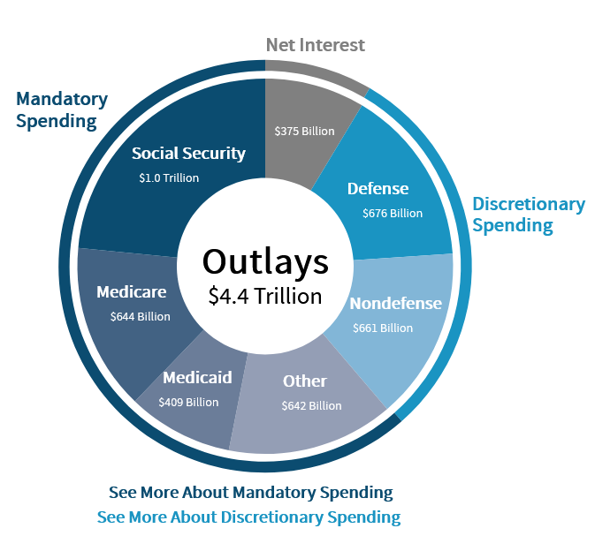
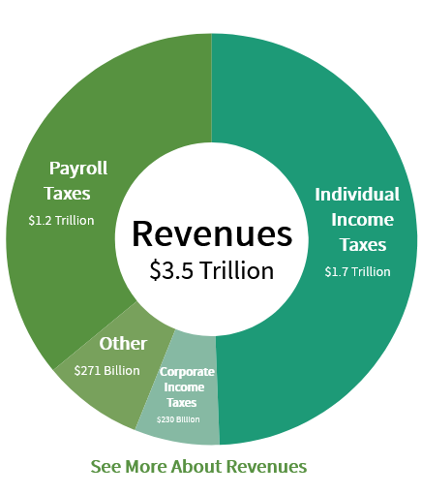
Congressional Budget Office 2019

Slide 3
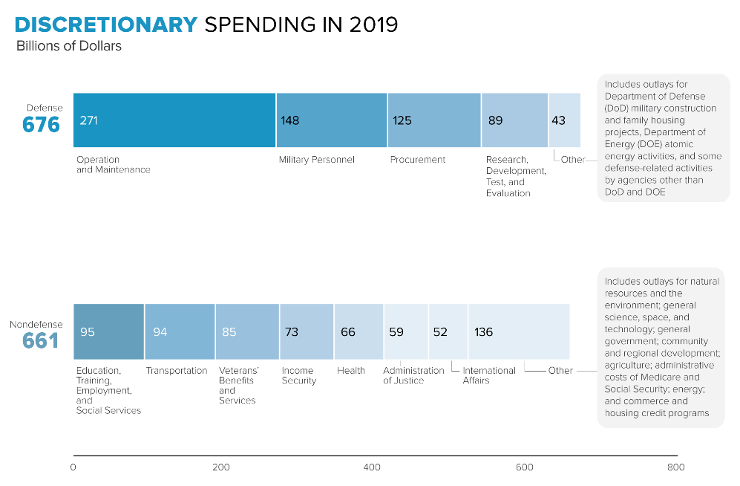

Slide 4
Urban Institute 2020

Slide 5
Making Sense of Scale
From betterexplained.com:
1 second is 1 second
1 million seconds is 12 days (a vacation)
1 billion seconds is 30 years (a career)
1 trillion seconds is 30,000 years (longer than human civilization)
Total Federal, State, and Local Spending in 2017 was roughly $7.2 trillion
Tax Freedom Day in 2019 was April 16
At the end of 2019, Federal debt was $22.8 trillion.

Slide 6
Making Sense of Government Spending
Individual and collective choice operate differently
The dinner party and the social dilemma
Politics without romance--looking at people, institutions, and practices as they are, not as we wish them to be

Slide 7
Public Choice Economics
The positive analysis of political institutions and the behaviors and consequences that result
Counterpart to public interest theory, which focuses on figuring out which outcome would be best
Focus in public choice is instead on which outcomes are feasible given constraints and most likely given the incentives currently in place
Includes recognition of unintended consequences—intention is not enough to guarantee results

Slide 8
The Constitutional Dilemma

Slide 9
Public Choice Economics: two levels of analysis
Constitutional level—the rules of the game that determine how we make rules and set the foundational terms for the exercise of power
Federalist #1: “…it seems to have been reserved to the people of this country, by their conduct and example, to decide the important question, whether societies of men are really capable or not of establishing good government from reflection and choice, or whether they are forever destined to depend for their political constitutions on accident and force.”
Can we use reflection and choice to design rules that will peacefully reconcile differences while limiting principle-agent problems in representative government?
Can we hold power with each other rather than power over each other?

Slide 10
Public Choice Economics: two levels of analysis
Postconstitutional—realm of everyday politics
What are the capabilities and motivations of the ordinary men and women tasked with carrying out the activities of government within the established constitutional rules?
Incentives—Are the rewards of politics consistent with acting in the interest of the whole public?
Knowledge—If incentives were set to reward the ‘right’ behaviors, do representatives and administrators have the knowledge to figure out what the ‘right’ choice is?

Slide 11
Deficits, debt, and debasement
Constitutional space for special interests was designed as an important protection against the tyranny of the majority
This protection created the space for the possibility of logrolling and excessive spending
Particularly when governments are able to run deficits, they are able to satisfy more interest groups, which has the long term effect of contributing to debt

Slide 12
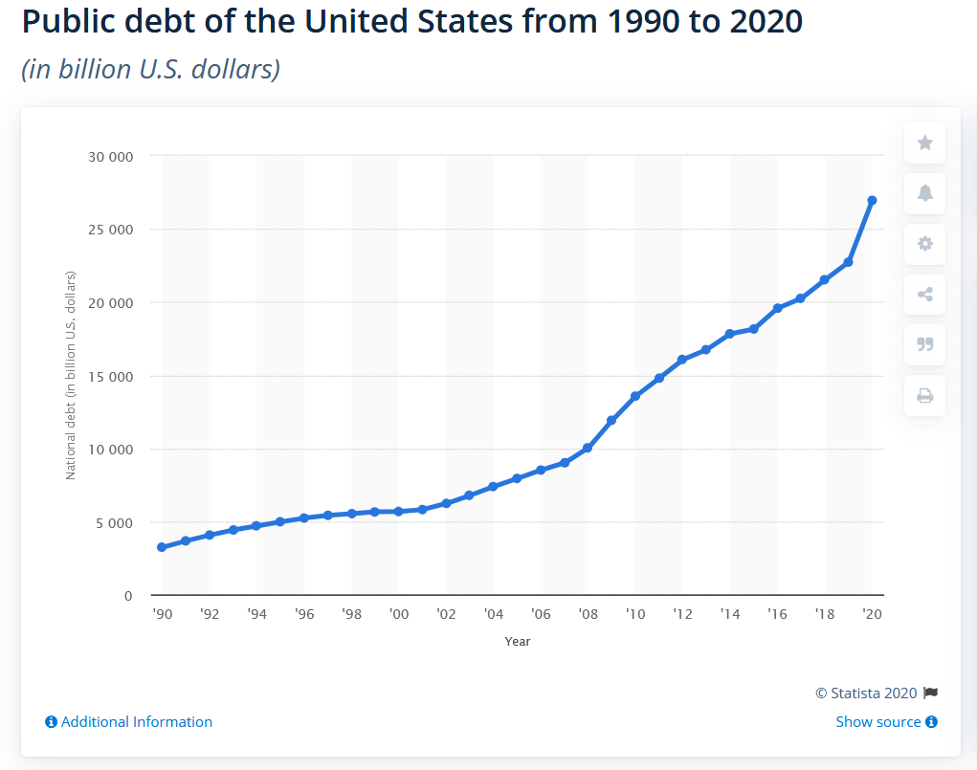

Slide 13
Deficits, debt, and debasement
Options once debt is accumulated are:
(1) paying off debt with further debt, pushing the problem forward onto future generations (the least well organized interest group) or
(2) paying off debt by printing money, which lowers the value of existing dollars (debasement) and risks hyperinflation
(3) tightening the public debt until debt is paid down—but that’s generally inconsistent with reelection

Slide 14
Deficits, debt, and debasement
Constitutional political economy suggests the only way out is radical reform in the rules by which governments are allowed to make spending decisions
A return to the classical fiscal principle of balanced budgets
Sunset clauses to address the problem of the accumulation of financial commitments
Stricter limits on scope of political authority, especially at the highest levels that are going to be more prone to the pathologies that cause over-spending.

Slide 15
Implications
The goal of the public choice research program is to remove the romantic blinders so we can better understand the real functioning of political institutions.
This is our best hope to be able to use reflection and choice to devise better constitutional rules and better post-constitutional practices that could help people engage in cooperative projects together, but within reasonable boundaries that take scarcity seriously.

Slide 16
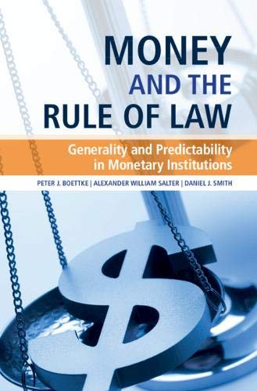
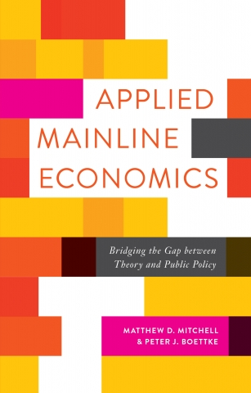
Further Reading
Boettke, Peter J. and Coyne, Christopher J., The Debt-Inflation Cycle and the Global Financial Crisis (February 1, 2011). Global Policy, Vol. 2, No. 2, pp. 184-189

