Slide 1
Fiscal Policy Response to COVID and the Long Term Outlook for the Federal Budget
Louise Sheiner
The Hutchins Center on Fiscal and Monetary Policy
The Brookings Institution
lsheiner@brookings.edu
October 2020

Slide 2
The Economic Consequences of the Pandemic
Employment and output (GDP) decline caused by lockdowns/social distancing.
GDP is production. With people not working, production falls.
Economic policy not able to do much about this
Public health policy (testing, tracing, encouraging masks, keeping certain places closed) to minimize the need for lockdowns/social distancing could.
GDP fell about 9% in the second quarter (Q2=April, May, June). At an annual rate, that’s 31.4%.
Unemployment rate averaged 13% in Q2.
Big bounceback in Q3. Unemployment rate fell to 7.9% by September.

Slide 3
What can fiscal policy do in a pandemic?
Fund public health: Invest in testing, tracing, research. Best thing for the economy is to limit the need for social distancing.
Provide sick leave: Make sure people have the ability to self-quarantine if sick.
Relief: Make sure people have enough income to eat, pay bills, etc. while unable to work.
Help create a strong recovery: Try to limit the GDP effects to those necessitated by the response to the virus, rather than having additional knock-on effects.
What’s a knock-on effect? If people don’t have income, then they can’t buy things that are NOT affected by social distancing, like goods they purchase online. That weakens the economy beyond the weakness due directly to social distancing.
Similarly, if businesses fail might cause some damage to the economy that lasts beyond the end of social distancing.

Slide 4
The Fiscal Response Thus Far
Cares Act and other legislation:
$1200 rebate checks for most adults
Unprecedented expansion of unemployment insurance:
Additional $600 per week through July.
Eligibility for previously ineligible (gig workers and others) until end of December.
Paycheck Protection Act: $550 billion in forgivable loans to businesses who kept workers on their payrolls.
$150 billion coronavirus relief fund to states.
On the whole—surprisingly good and quick response.
Clearly motivated by desire to set stage for strong recovery.
Tried to get money out fast. Tried to get out in various ways (UI, PPP, checks) to limit the amount of falling through the cracks.
UI very progressive.

Slide 5
Did it work? Mostly yes, but we need more.
UI benefits took a long time to get out—because state UI systems were overwhelmed with the volume of claims—but eventually the $ did go out.
Income actually rose in Q2 because of the checks and UI, despite the high unemployment rate.
Because spending fell a lot because of the pandemic, saving also increased sharply. This will help set the stage for a stronger recovery once the risk of the virus has subsided.
But now, the extra $600 is gone. Replacement rates in general are quite low—only 40%-45%--meaning people’s income goes way down when they become unemployed.
Some people will be running out of unemployment benefits soon (limited to about 39 weeks, depending on the state.)
Small businesses still not getting customers have spent their PPP money.
State and local governments will need more help soon.
Need more $ to provide relief to unemployed people and to minimize long-term costs of the pandemic on the macroeconomy.

Slide 6
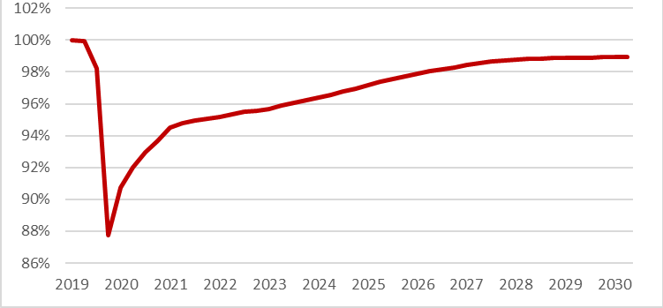
CBO Projects Very Weak Recovery under Current Law
Projection assumes no new legislation.
Economy never fully recovers—GDP still down 1% in 2030.
With more fiscal stimulus, could fully recover and recover much sooner. (Say, by 2022 if vaccine widely disseminated by then.)
CBO Projections of Real GDP: July 2020 relative to January (pre-pandemic) 2020

Slide 7
Pre-Pandemic Economy
Unemployment rate was 3.5% in February, and there were no signs of inflation increasing.
We were learning that the economy had the capacity to operate at a much lower unemployment rate than we thought.
Low unemployment rate was bringing marginalized people back into the labor force, and starting to result in some real wage growth.
We need to get back to THAT economy, and not settle for a so-so recovery.

Slide 8
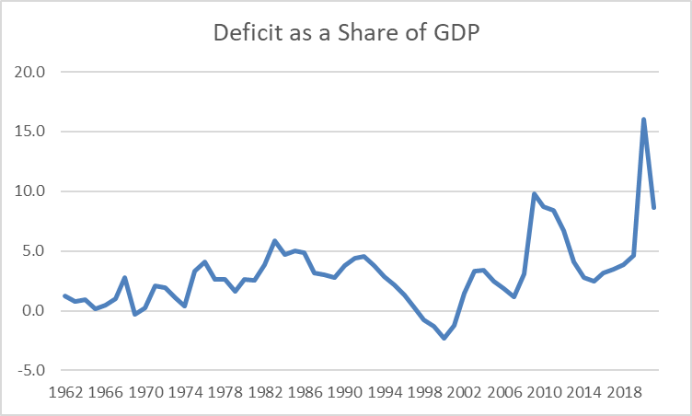
But What About the Federal Deficit?
What is the federal deficit? The amount that the government borrows.
The legislation already enacted increased deficit by $2.3 trillion in FY 2020.
Good to think about it relative to size of economy.
Deficit 16% of GDP in 2020 and projected to be 8.6% in 2021.
These are huge #s. Bigger than any time other than during WWII.

Slide 9
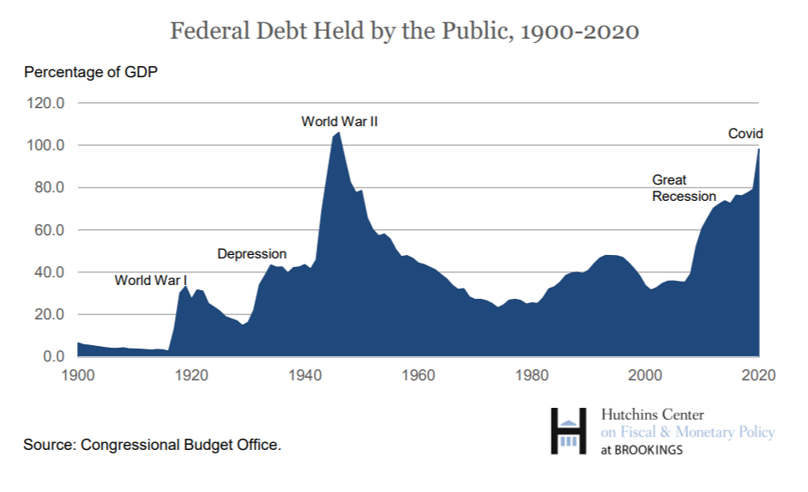
What about the Debt?
Debt in FY 2020 98% of GDP.
Higher than at any time other than WWII.

Slide 10
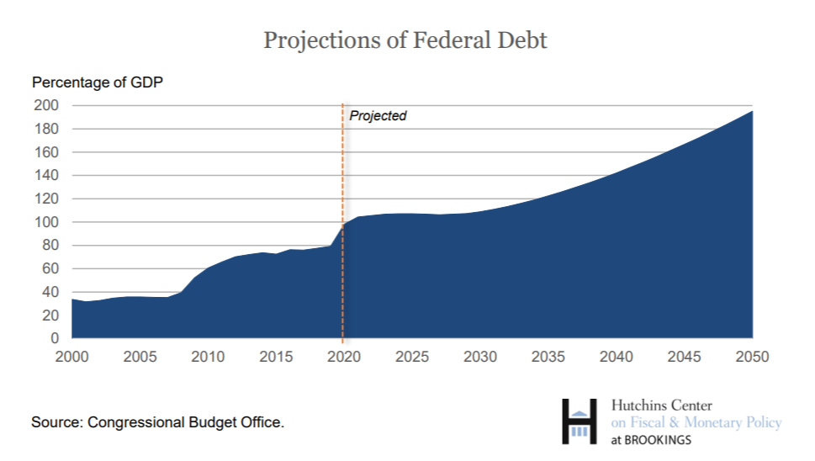
And Debt to GDP Projected to Keep on Increasing
Recent increases in debt due to GR and COVID.
Future increases reflect population aging and continued rising health care spending.
Debt is projected to reach levels never seen before.

Slide 11
Is this a huge problem?
Traditional—probably dated—view:
Why do we worry about debt?
Crowds out private investment:
Savers lend to U.S. government, making less $ available to fund private investment
Less investment -> less growth in GDP. We are poorer in the future.
Requires increases in future taxes/cuts to future spending to pay interest on the debt
Borrowing to finance current consumption lowers future living standards
Borrowing to finance investment (e.g. infrastructure, education) does not
If we keep increasing borrowing (to finance consumption), interest rates will rise, crowding out lots of future consumption. Eventually no one will lend to us because we won’t be able to credibly repay.
This view doesn’t account for the very low interest rates we now see.

Slide 12
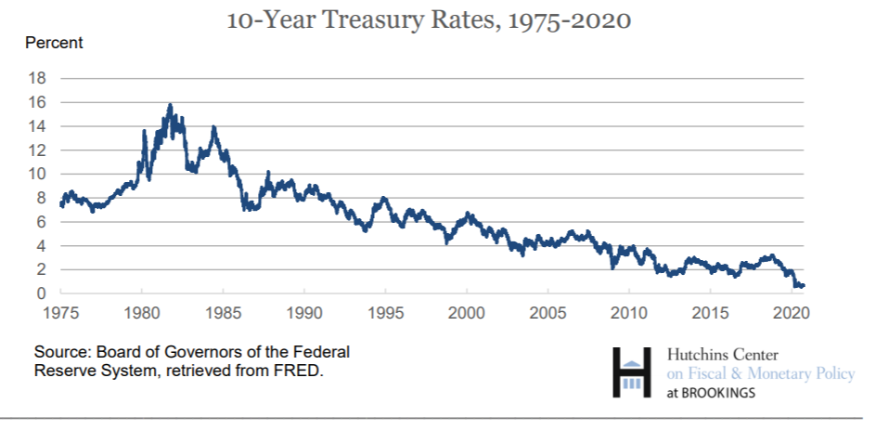
Interest rates have been falling for 30 years.

Slide 13
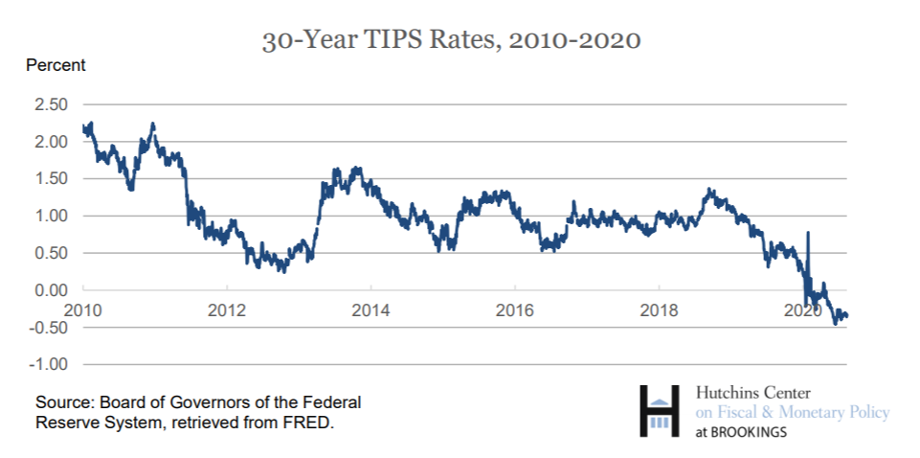
Real rates for 30-year bonds are negative! While this may not last, government could lock in low rates for a long time

Slide 14
Debt Sustainability in a World of Persistently Low Interest Rates
Debt is sustainable when it is a constant share of GDP
What is required for debt to be constant as a share of GDP?
Primary Surplus (revenues – non-interest spending)
must equal (r-g)*Debt,
where r is the interest rate and g is the growth rate of GDP.
Intuition? If economy is growing, debt can grow too and still be stable. How much can debt grow? g*Debt.

Slide 15
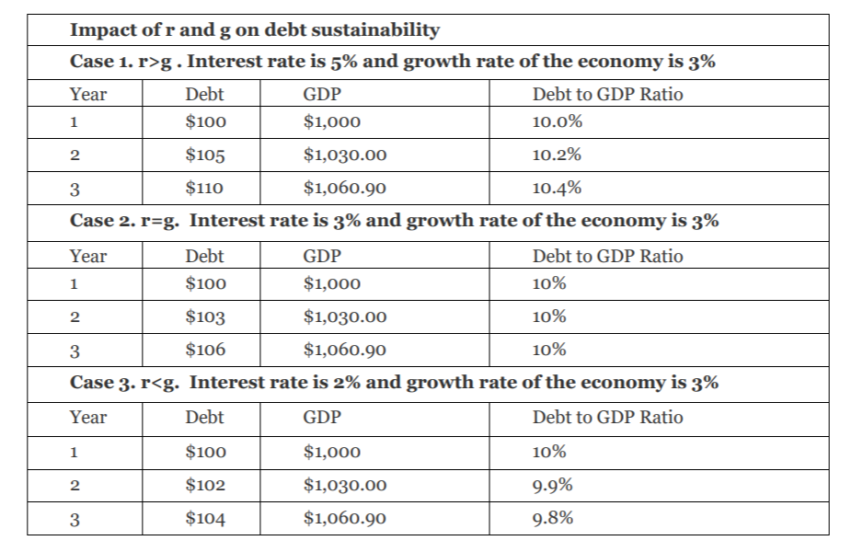
When r<g, any given level of debt declines without the government making any payments on it

Slide 16
CBO projects interest rates to be at or below GDP growth for the next 17 years.

Slide 17
Low interest rates relative to GDP growth means debt is not costly
If r-g <0, can rollover debt indefinitely by borrowing more to pay the interest, and debt won’t rise.
In this sense, debt is “free.”
Of course, at some point, increased debt will lead to higher interest rates.
But note CBO projections assume current debt projections—debt rising indefinitely.
Also, interest rates hard to project. Don’t want to go all in on low interest rates and debt because rates could increase sharply and then debt would be hard to service.

Slide 18
Why is r so low?
Glut of savings relative to demand for investment – so return on savings very low.
Why?
Not well understood, but some of the proposed reasons:
Demographic change: lowers demand for investment, increases supply of savings possibly
Move away from capital-intensive industries
Increased social insurance lowers need for precautionary savings
Increasing inequality raises saving rate.
Note that these reasons suggest r will mostly remain low.

Slide 19
Improving Future Living Standards
To try to improve future living standards, rather than cutting back on spending or raising taxes, one should:
Do everything possible to get economy back to potential as soon as possible.
Improve education, health, housing, especially for poor families.
Improve infrastructure, invest in clean air.
Invest in climate change resilience.
These are all investments that are likely to yield much higher returns than the cost of debt
So future is better off if borrow and invest than if we don’t, even though debt would increase.
Doesn’t make sense to not invest because “can’t afford it” .e.g. removing lead from drinking water.
Lot of evidence in recent years that many of these programs have very high rates of return.

Slide 20
Conclusions
Fiscal response to COVID has raised debt to GDP sharply, and debt projected to continue rising over foreseeable future
Despite this rise in debt (here and around the world), interest rates have continued to plummet, and real interest rates now negative
Looking forward, we expect interest rates to remain low and to remain below the growth rate of the economy for some time
This is the time to invest in our economy
Not only will this improve future living standards, but it also can make help address some of our other major challenges: rising inequality, falling mobility, climate change

Slide 21
Thank you!

