Slide 1
Sound Money, Freedom, and Prosperity
Prepared by J. A. Dorn
Senior Fellow, Cato Institute
Washington, DC, April 25, 2015
02:30

Slide 2
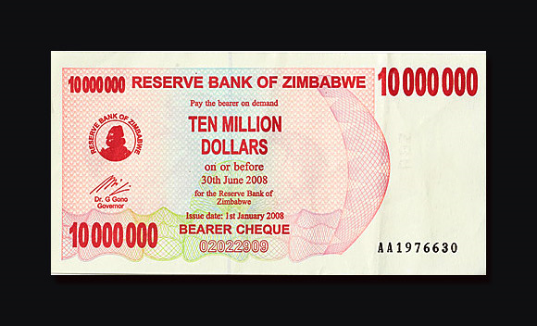
A Bad Central Bank (1)
05:50
Notes:
02:30

Slide 3
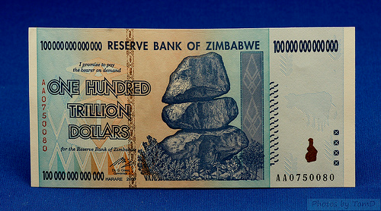
A Bad Central Bank (2)
07:10
Notes:
05:50

Slide 4
Money and Prices
“Inflation is always and everywhere a monetary phenomenon.”
—Milton Friedman (1963)
08:11
Notes:
07:10

Slide 5
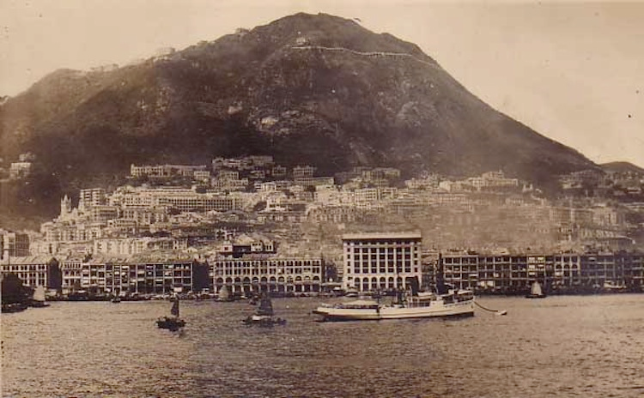
Hong Kong 1920
08:27
Notes:
08:11

Slide 6
Hong Kong Today
10:00
Notes:
08:27

Slide 7
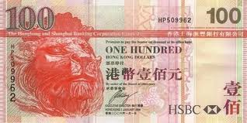
Hong Kong’s Stable Dollar
10:40
Notes:
10:00 1 USD = 7.75 USD. Pegged exchange rate under currency board.

Slide 8
Overall Economic Freedom Index and the Top 10 (EFW Report 2014)
10:54
Source: The Fraser Institute.
Notes:
10:40

Slide 9
Overall Economic Freedom Index and the Bottom Ten (EFW Report 2014)
11:36
Source: The Fraser Institute.
Notes:
10:54

Slide 10
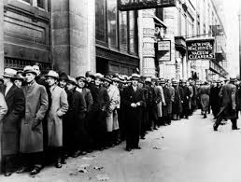
U.S. Unemployed Workers in 1930s
11:55
Notes:
11:36

Slide 11
Bad U.S. Monetary Policy Caused the Great Depression
“The [1929]recession was an ordinary business cycle. We had repeated recessions over hundreds of years, but what converted [this one] into a major depression was bad monetary policy.”
—Milton Friedman (Oct. 1, 2000, PBS)
14:05
Notes:
11:55

Slide 12
Ben Bernanke Agrees
“I would like to say to Milton and Anna: Regarding the Great Depression. You’re right, we did it. We’re very sorry. But thanks to you, we won’t do it again.”
—Ben Bernanke (Nov. 8, 2002)
Chairman, Federal Reserve System
15:05
Notes:
14:05

Slide 13
A Monetary Constitution
“Congress shall have Power To coin Money [and] regulate the Value thereof.”
—Art. 1, Sec. 8
15:10
Notes:
15:05

Slide 14
What Monetary Policy Can and Can’t Do
Prepared by J. A. Dorn
Senior Fellow, Cato Institute
Washington, DC, April 25, 2015
24:45
Notes:
15:13

Slide 15
What the Fed Can Do
Create base money (C+R) out of thin air
Prevent liquidity crises (LLR)
Affect the level and growth rate of nominal variables
Influence expectations about future inflation and nominal interest rates
29:25
Notes:
24:45

Slide 16
What the Fed Can’t Do
Target real variables to permanently reduce the rate of unemployment or increase economic growth
Determine real interest rates
Fine-tune the economy
Make accurate macroeconomic forecasts
34:05
Notes:
29:25

Slide 17
The Fed’s Risky Policy and the Case for Constitutional Money
Fed Policy in a Pure Fiat Money World
Impact on U.S. and Global Economy
Exit Problem
Alternatives to Pure Discretionary Government Fiat Money
The Case for a Centennial Monetary Commission
41:30
Notes:
34:05

Slide 18
Unconventional Monetary Policy and Asset Bubbles
“A risk of remaining at the zero lower bound too long is that a significant asset market bubble will develop.”
“A gradual normalization would help to mitigate this risk.”
—James Bullard
President and CEO, FRB-St. Louis
April 15, 2015
42:20
Notes:
41:30

Slide 19
U.S. Consumer Price Index, 1774–2011
Av. 1982–84 = 100
43:25
Source: Officer and Williams (www.measuringworth.com).
Notes:
42:20

Slide 20
No Price-Level Anchor under Pure Fiat Money
Nixon closes gold window August 1971
43:50
Notes:
43:25

Slide 21
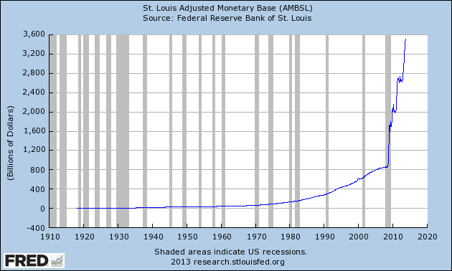
Monetary Base
44:25
Notes:
43:50

Slide 22
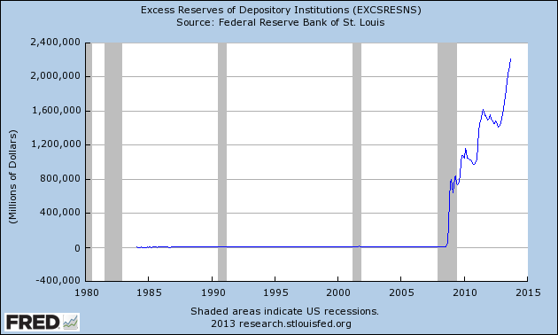
Excess Reserves
Fed starts paying interest on ER, October 2008
44:40
Notes:
44:25

Slide 23
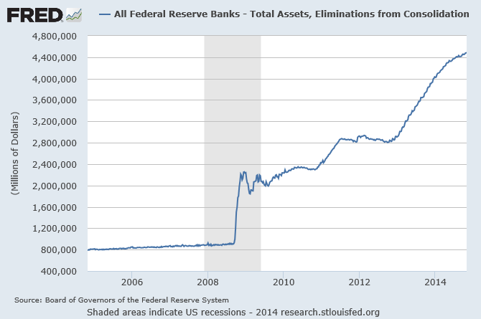
Growth of Fed Balance Sheet
45:30
Notes:
44:40

Slide 24
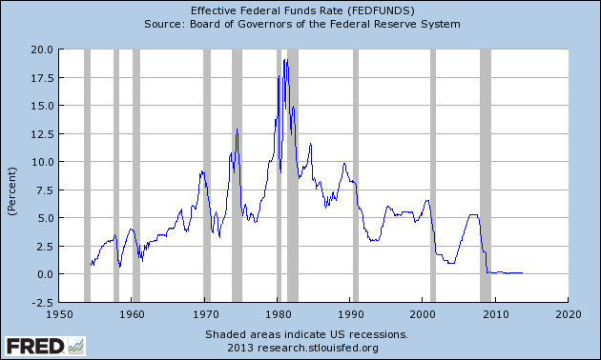
Fed Funds Rate
46:30
Notes:
45:30

Slide 25
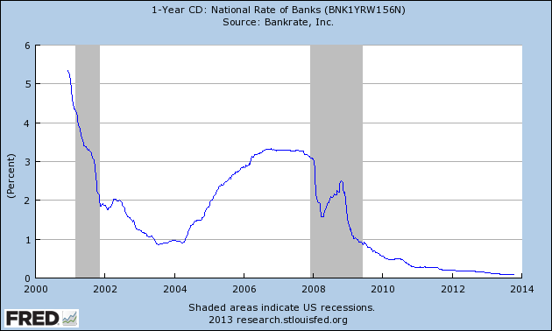
Interest on Savings
47:00
Notes:
46:30

Slide 26
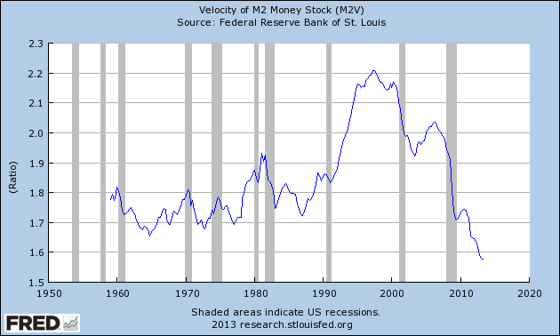
M2 Velocity
48:00
Notes:
47:00

Slide 27
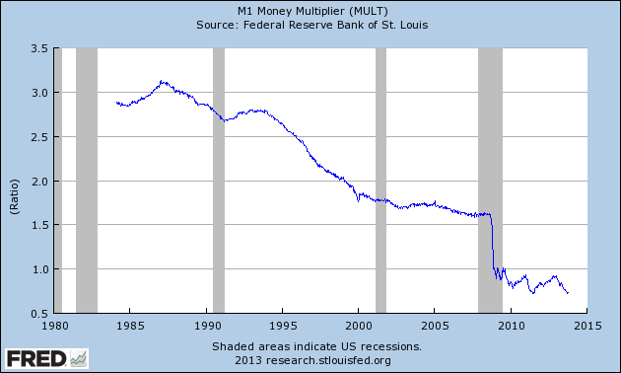
M1 Money Multiplier
49:05
Notes:
48:00

Slide 28
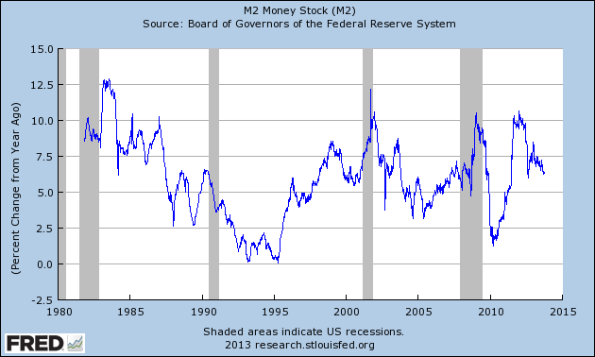
M2 Growth (Annual, %)
49:30
Notes:
49:05

Slide 29
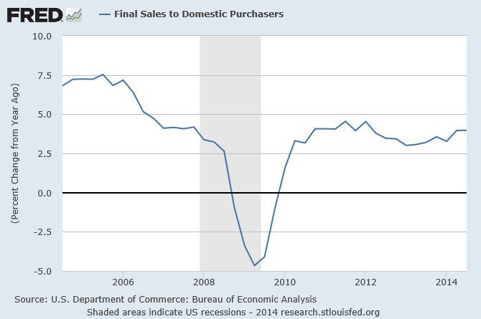
Growth of Domestic Final Sales
Notes:
49:30

