Slide 1
This is Your Brain on Numbers: Data, Statistics and COVID-19
Presenter: Dr. Russell Roberts, host of EconTalk, co-creator of the Keynes-Hayek rap videos and noted author.
May 27, 2020
Webinar will begin at 3:00 pm PDT/6:00 pm EDT

Slide 2
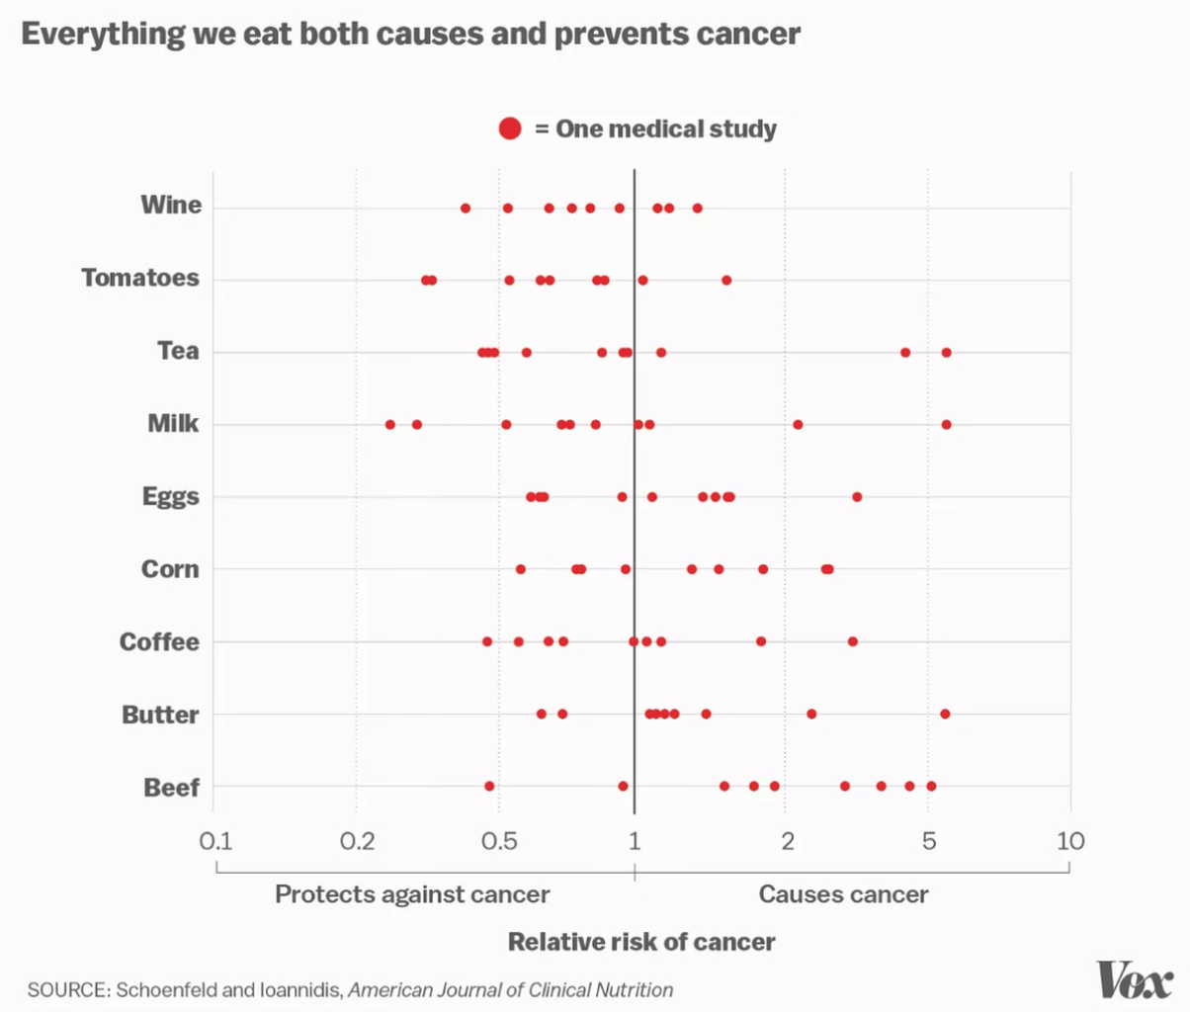

Slide 3
