Slide 1

Foundation for Teaching Economics
Promoting excellence in economic education

Slide 2
GDP 2020:Q1

Slide 3
Early COVID-19 Timeline
Dec 31
Jan 20
Jan 31
Feb 9
Feb 11
First case detected
In Hubei Province
First case outside
China (Thailand,
Japan, and South Korea)
White House limits
International travel
Death toll in Mainland
China exceeds SARS
WHO names
new coronavirus
COVID-19
At this point, most believed that the coronavirus would largely be contained within a few countries.

Slide 4
Coronavirus: Supply Chains
If contained, COVID-19 would mainly disrupt manufacturing supply chains.
The more a country’s manufacturing
relied on these supply chains the
bigger the impact on GDP.
Countries | Share of World GDP | Manufacturing as a Share of GDP | Services as a Share of GDP
United States | 24% | 11% | 77.4%
Canada | 2% | 10% | 66.7%
UK | 3% | 9% | 71.0%
Germany | 5% | 20% | 61.8%
France | 3% | 10% | 70.3%
Italy | 2% | 15% | 66.3%
Spain | 2% | 11% | 67.7%
Japan | 6% | 21% | 69.1%
China | 16% | 29% | 52.2%

Slide 5
Coronavirus: Supply Chains
Countries | Share of World GDP | Manufacturing as a Share of GDP | Services as a Share of GDP
United States | 24% | 11% | 77.4%
Canada | 2% | 10% | 66.7%
UK | 3% | 9% | 71.0%
Germany | 5% | 20% | 61.8%
France | 3% | 10% | 70.3%
Italy | 2% | 15% | 66.3%
Spain | 2% | 11% | 67.7%
Japan | 6% | 21% | 69.1%
China | 16% | 29% | 52.2%
If contained, COVID-19 would mainly disrupt manufacturing supply chains.
The more a country’s manufacturing
relied on these supply chains the
bigger the impact on GDP.
If limited to supply chain effects,
COVID-19 was likely to be
to slow GDP by 0.25 to 0.50 from its
baseline prediction – say from 2.5 to 2%

Slide 6
Dow Jones and S&P 500
COVID cases in US
Exceed 500 (3/9)
Largest DJIA fall in
two years on fears of COVID-19
and a weak retail sales report
(2/24)
White House and
Congress independently
discuss fiscal policy (3/13)
Day after NBA, MLB
and NCAA postpone
games (3/12)
Epidemiology

Slide 7
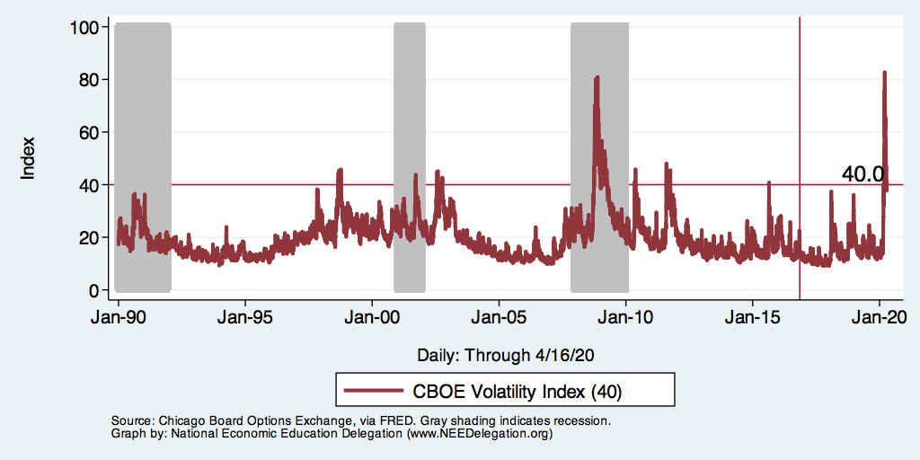
Market Risk and Stress: CBOE VIX

Slide 8
Epidemiology and Flattening the Curve
The importance of testing and social distancing on containment.
Vaccines &
Prophylaxis
Social Distancing

Slide 9
Flattening the Curve
Number or Cases
Health Care
Capacity
Time

Slide 10
Flattening the Curve May Deepen and Lengthen the Recession
Health Care
Capacity
Number or Cases
Time
GDP (Recession)

Slide 11
Flattening the Curve May Deepen and Lengthen the Recession
Health Care
Capacity
Number or Cases
z
Time
GDP (Recession)

Slide 12
GDP and Sudden Demand Stops
Countries | Share of World GDP | Manufacturing as a Share of GDP | Services as a Share of GDP
United States | 24% | 11% | 77.4%
Canada | 2% | 10% | 66.7%
UK | 3% | 9% | 71.0%
Germany | 5% | 20% | 61.8%
France | 3% | 10% | 70.3%
Italy | 2% | 15% | 66.3%
Spain | 2% | 11% | 67.7%
Japan | 6% | 21% | 69.1%
China | 16% | 29% | 52.2%
The most vulnerable industries include entertainment, food, recreation, health and beauty, education, social assistance and manufacturing. These industries account for more than 50% of GDP.

Slide 13
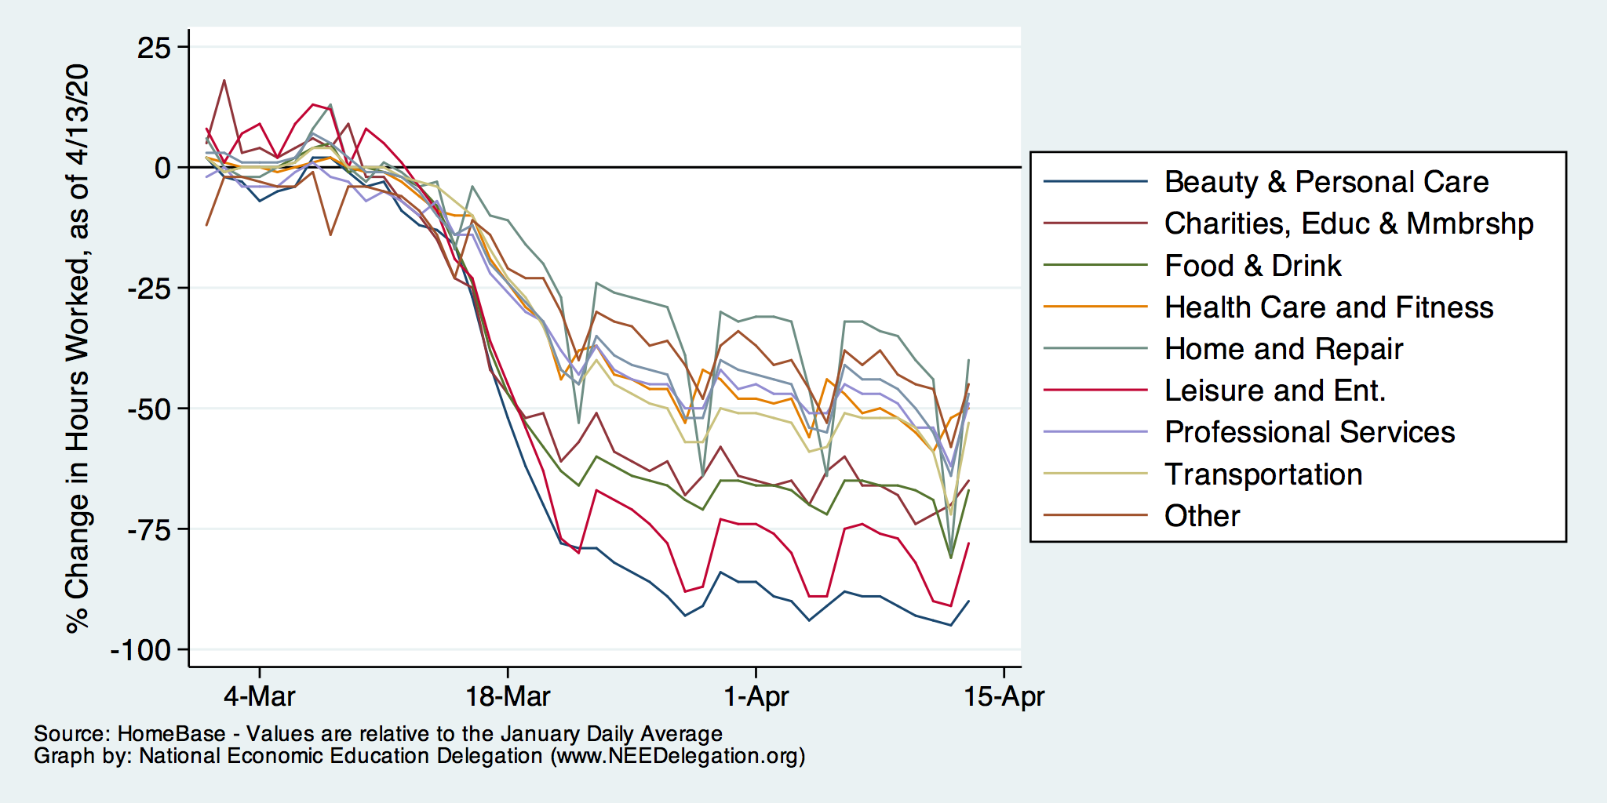
Percent Change Hours Worked
Data Source: Homebase

Slide 14
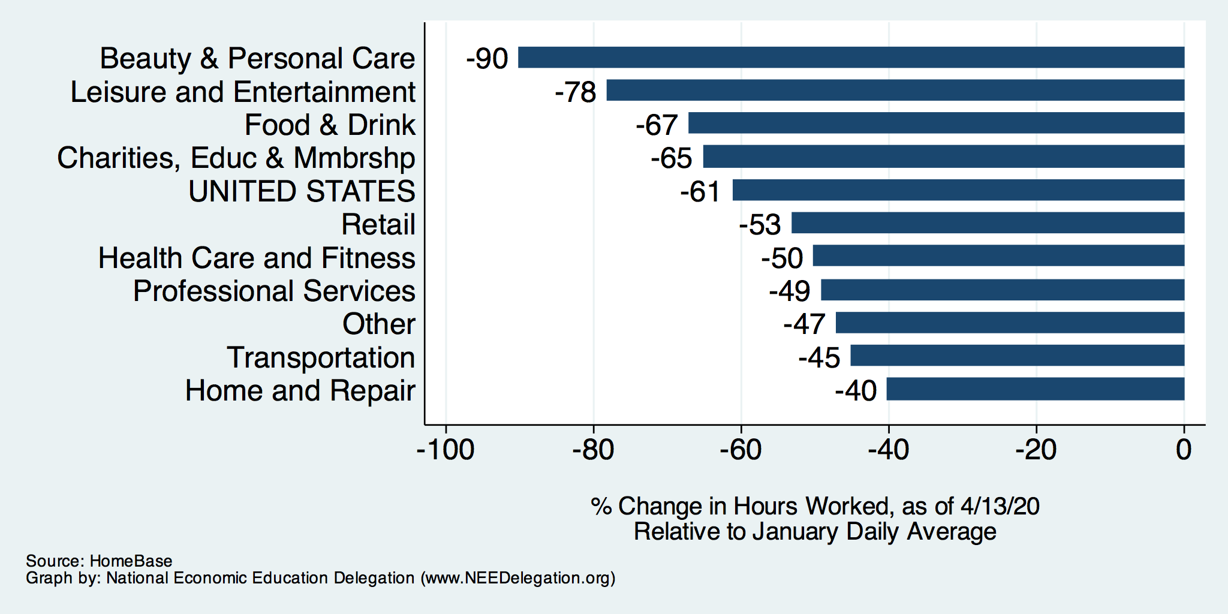
Percent Change Hours Worked

Slide 15
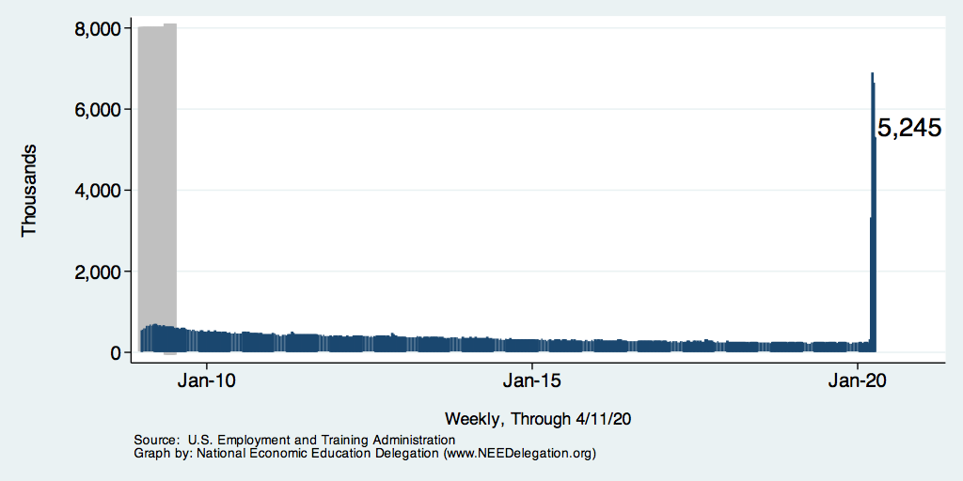
Weekly New Unemployment Claims
Over 4 weeks,
3/21 3.3 mill
3/28 6.8 mill
4/4 6.6 mill
4/11 5.2 mill
Total 22 mill
665K

Slide 16
GDP Shares and Impact of COVID-19
Countries | Share of World GDP | Manufacturing as a Share of GDP | Services as a Share of GDP | Confirmed Cases | Deaths
United States | 24% | 11% | 77.4% | 1,054,166 | 61,009
Canada | 2% | 10% | 66.7% | 51,231 | 2,984
UK | 3% | 9% | 71.0% | 165,221 | 26,097
Germany | 5% | 20% | 61.8% | 161,173 | 6,399
France | 3% | 10% | 70.3% | 167,518 | 24,087
Italy | 2% | 15% | 66.3% | 203,591 | 27,682
Spain | 2% | 11% | 67.7% | 236,899 | 24,275
Japan | 6% | 21% | 69.1% | 13,736 | 394
China | 16% | 29% | 52.2% | 82,858 | 4,633
Source: World Bank, Johns Hopkins Coronavirus Resource Center, Worldometer

Slide 17
GDP Shares and Impact of COVID-19
Countries | Share of World GDP | Manufacturing as a Share of GDP | Services as a Share of GDP | Confirmed Cases | Deaths | GSP Growth
United States | 24% | 11% | 77.4% | 1,054,166 | 61,009 | -5.9
Canada | 2% | 10% | 66.7% | 51,231 | 2,984 | -6.2
UK | 3% | 9% | 71.0% | 165,221 | 26,097 | -6.5
Germany | 5% | 20% | 61.8% | 161,173 | 6,399 | -7.0
France | 3% | 10% | 70.3% | 167,518 | 24,087 | -7.2
Italy | 2% | 15% | 66.3% | 203,591 | 27,682 | -9.1
Spain | 2% | 11% | 67.7% | 236,899 | 24,275 | -8.0
Japan | 6% | 21% | 69.1% | 13,736 | 394 | -5.2
China | 16% | 29% | 52.2% | 82,858 | 4,633 | 1.2
US GDP growth in
2009 -2.54%
Source: World Bank, Johns Hopkins Coronavirus Resource Center, Worldometer

Slide 18
Cost Benefit Analysis: Tradeoffs
Stringent containment policies
  Dramatically reduced economic activity
  Fewer coronavirus deaths
  Non-coronavirus deaths(?)
No containment policies
  Reduced economic activity
  More coronavirus deaths
  Non-coronavirus deaths
???
Analysis of Containment Policies
Reduced economic activity < value of additional deaths
Complicated equation – both numerically and philosophically

Slide 19
BOTE: Cost – Benefit Analysis
BOTE: Back Of The Envelope
BENEFITS of social distancing:
  $5 million/life and 600,000 lives saved ($3.0 trillion)
  Long term health issues avoided: 2 million at $500,000 ($1 trillion)
  Total Benefit of Social Distancing: $4.0 Trillion
COSTS of “Shelter in Place” or “Lockdown”
  There are about 70+ workdays in a quarter (plus March).
  The cost of a “lockdown” is roughly $1.3 Trillion
Benefit: $4.0 trillion > Cost: $1.3 trillion

Slide 20
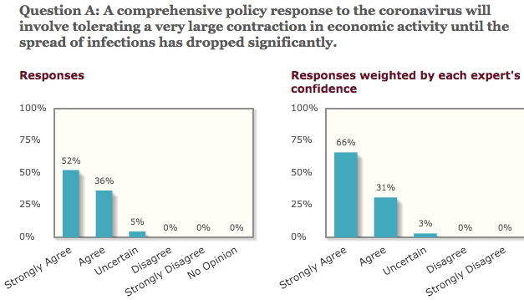
University of Chicago – Experts Poll

Slide 21
This Time Its Different
Great Depression and Recession (Demand Shocks)
  A Financial Crisis which led to
  A Collapse of demand with persistent high unemployment
Oils Crisis of 1975 due to a sharp rise in the price of oil (Supply Shocks)
Prior to the pandemic none of the above:
  Financial markets were not in trouble.
  Real GDP growth was strong buoyed by strong consumer spending.
  Unemployment and inflation were both low.
  Oil prices were falling.
“Health Shock” public health requires cessation of economic activity

Slide 22
Government Response: Fiscal Response
Respond to the impacted sector(s) – health crisis,
Provide income support for the lower income and most vulnerable,
Provide support to maintain employer - employee matches, and
Provide support for the sectors that are most exposed to the shock.

Slide 23
Fiscal Policy Timeline
Phase I: H.R. 6074
3/6
Phase II: Family First
3/14
Phase IIIa: CARES
3/18
Phase III b
4/24
R&D
Public Health
Medical Supplies
Other
Paid Sick Leave
Family Medical Leave
Covid-19 Testing
Unemployment Expansion
HHLD Payments
Support for Small Firms
Support for Medium Sized Firms
Unemployment Insurance
Aid to States
(More) Support for Small Firms
COVID-19 Testing
Hospitals
Notes:
CARES Act Coronavirus Aid, Relief, and Economic Security Act

Slide 24
Government Response (Phase II): Family First (H.R. 6201)
Free testing for anyone whose doctor recommends testing.
Expand family and medical leave.
Paid emergency sick leave.
Additional unemployment benefits.
Food assistance: Supplemental Nutrition Assistance Program (SNAP) and Home-Delivered.

Slide 25
Fiscal Response (Phase III a-b): CARES Act
Direct payment to households $1,200 for every adult and $500 for every child – similar to the 2008 rebate but purpose is different.
Small business loans (Paycheck Protection Program)-- $350 billion
  <500 employees and designed to cover six (6) weeks of payroll.
Economic Stabilization Fund (Main Street Lending Program) – $500bn
  for medium sized firms,
  state and local municipalities, and
  passenger and cargo air carriers, and firms maintaining national security.
Expand unemployment benefits

Slide 26
Federal Reserve Timeline
March 3
March 15
March 17/18
March 23
April 9
Primary Dealer Credit Facility
(PDCF)
Commercial Paper Funding Funding Facility (CPFF)
Money Market Mutual Fund Facility (MMLF)
Primary Market Corporate Credit Facility
(PMCCF)
Secondary Market Corporate Credit Facility
(CMCCF)
Term Asset-Backed Securities Loan Facility
(TALF)
Paycheck Protection Program Liquidity Facility (PPPLF)
Main Street Business Lending Program
Municipal Liquidity Facility
Federal Funds Rate
Federal Funds Rate
Discount Window Lending
Quantitative Easing
Forward Guidance

Slide 27
Federal Reserve: Standard Operations
Federal Funds Rate: The Federal Reserve lowered the targeted Federal funds rate on March 3 and again on March 15 moving the targeted Federal Funds rate to zero.
Discount Window Lending: Lowered the interest rate it charges banks to borrow from 1.75% to 0.25%.
Reserve Requirement: Lowered the reserve requirement to zero.
Forward Guidance: Honed during the Great Recession the Fed tries to set market expectations on the time path of interest rates over time.

Slide 28
US Treasury Rates: A Safe Haven?

Slide 29
Federal Reserve: Ensure Financial Market Stability
Securities Purchases (Quantitative Easing): Fed Response -- purchase treasuries and mortgage backed securities (3/15).
Re-launched the Primary Dealer Credit Facility (PDCF) in order “smooth market functioning and facilitate the availability of credit to businesses and households (3/17).
Re-instituted the Money Market Mutual Fund Liquidity Facility (MMLF) to “assist money market mutual funds in meeting demands for redemptions by households and investors enhancing overall market function and credit provision to the broader economy.”
Increased liquidity in the repo market. The repo market is where firms borrow and lend cash and short-term securities. The Fed was offering $100 billion in overnight loans and $20 billion in two-week loans.
    The Fed increased the offerings to $1 trillion (from $100 bn) in overnight repos, and
    $500 billion in one month and three-month repos (from $20bn 2/wks).
Notes:
The MMMF funds were experiencing heavy outflows from large corporate and institutional depositors that are desperate to raise cash as the COVID-19 coronavirus rattles the economy and the markets.

Slide 30
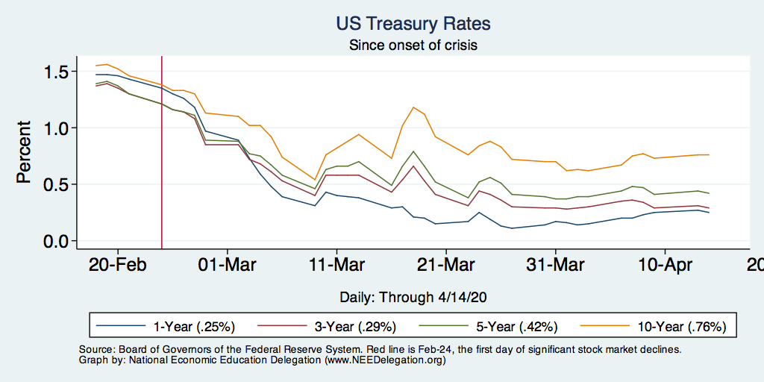
US Treasury Rates: A Safe Haven?
Run to Safety
Cash Grab
Liquidity Working

Slide 31
Federal Reserve: Support Corporations and Business
Created the Primary Market Corporate Credit Facility (PMCF) allows the Fed to lend directly to corporations by buying new bond issuances and providing loans (3/17).
Instituted the Commercial Paper Funding Facility (CPFF) the Fed can purchase commercial paper from firms at a given interest rate – effectively, the Fed is lending directly to firms. (3/17)
Main Street (Expanded) Loan Facility: Through the CARES Act these two programs offer four-year loans to US businesses with up to 10,000 employees or revenues less than $2.5 billion. (4/9)
Paycheck Protection Program Facility: Facilitates loans under the Small Business Administration Paycheck Protection Program
Notes:
In 1932 section 13(3) was added to the Federal Reserve Act, which has permitted emergency lending to bank and nonbank companies by the Board of Governors of the Federal Reserve System (the Federal Reserve).

Slide 32
Federal Reserve: Other Support
Support for Households and Consumers:
  Re-instituted Term Asset-Backed Securities Loan Facility (TALF) by which the Fed lends to holders of asset backed securities that are collateralized by new loans. Extended this program to include existing commercial mortgage-backed securities and newly issued collateralized debt obligations.
Support for States and Municipalities
  The municipal bond market exhibited signs of stress in March it was becoming increasingly hard to borrow in the Muni-market. The Fed created the Municipal Lending Facility to lend directly to state and local governments.
  Also expanded eligible collateral to include municipal debt in the MMLF and CPFF market.

Slide 33
How Do We Pay for This?
Deficit was forecast at 4.9% of GDP – likely to exceed 10% of GDP
Good News: Treasury Interest Rates are Near Zero
Bad News: The Long-term Budget Outlook was already a Mess

Slide 34
Economic Forecast
Most economic forecasts have GDP in the United States contracting by 5.0% for 2020.
Most economic forecasts have world GDP falling in by about -3.0%
The consensus is that that real GDP will start to recover in the third or fourth quarter.

Slide 35

Public Policy: Shelter in Place
We do not know much about the transmission mechanism – differing views of health risks by the general population.
Acts as a coordination policy between owners and employees.
Recovery may be quicker when the SIP are lifted.

Slide 36
Shelter in Place
Early March: Clemson University began discussions of our contingency plans and canceling “non-essential” events that could potentially put individuals at risk.
March 6 — SXSW canceled
March 10 — Ivy League cancels its basketball tournament
March 11 — March Madness will be played without fans
March 12 — March Madness canceled
March 12 — Cato Institute and Brookings Institution shift to mandatory telework
March 13 — Masters and Boston Marathon postponed
March 15 — CDC recommends cancellation of events involving 50+ people
March 16 — Kentucky Derby postponed
March 19 — California becomes the first state to issue a stay‐​home and business‐​closing order

Slide 37
Shelter in Place

Slide 38
Question: Recovery
What sectors are likely to recover the fastest?
  Expect that offices and factories would be the first to open back up.
  Small retailers with limited customers
  Barbershops and beauty salons / Eye doctors and Dentists
  Restaurants
  Lastly: events with large crowds.
Winners:
  Technology,
  Industries that can adapt the fastest
Negatively Impacted
  Individuals with lower educational attainment or those working in sectors where automation can replace face-to-face contact.
  Energy markets
Structural Change:
  More investment in (public) health
  Airlines (teleconferencing)
  Telemedicine, telecommuting, education

Slide 39
Question: Health of the Economy
Safe and Effective Tests are a Prerequisite:
  Quick tests for who may have the virus.
  Ability to random test a fraction of the population.
  Tests for who has antibodies against the virus.
  Better tracking and containment of outbreaks
Without these prerequisites, the “Costs” of reopening are high.
Reopen slowly and strategically -- be prepared to reimpose stay at home:
Full reopening and consumer confidence will depend on the availability of a vaccine and/or effective therapy

Slide 40
What Have We Learned? Positive Take-Aways
May improve and enhance the delivery of some services
Encourage firms, households, governments to have a business continuity plan.
In an integrated world, this will likely not be the last pandemic…
  Improve social insurance for these types of events
  Allow more flexibility to governments and firms to respond

