Slide 1

Foundation for Teaching Economics
Promoting excellence in economic education

Slide 2
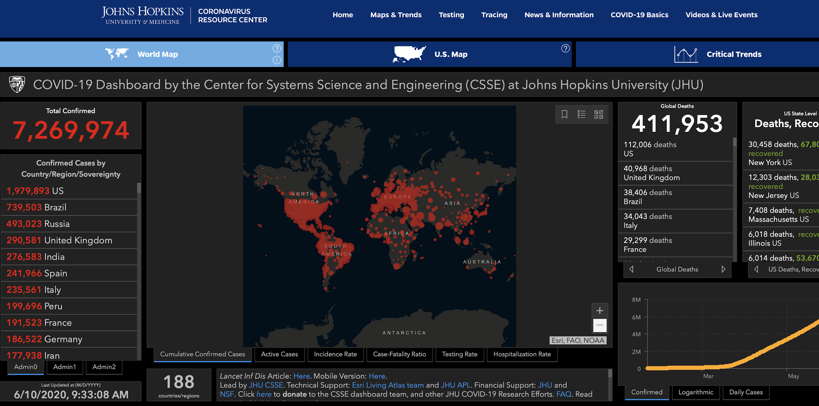

Slide 3
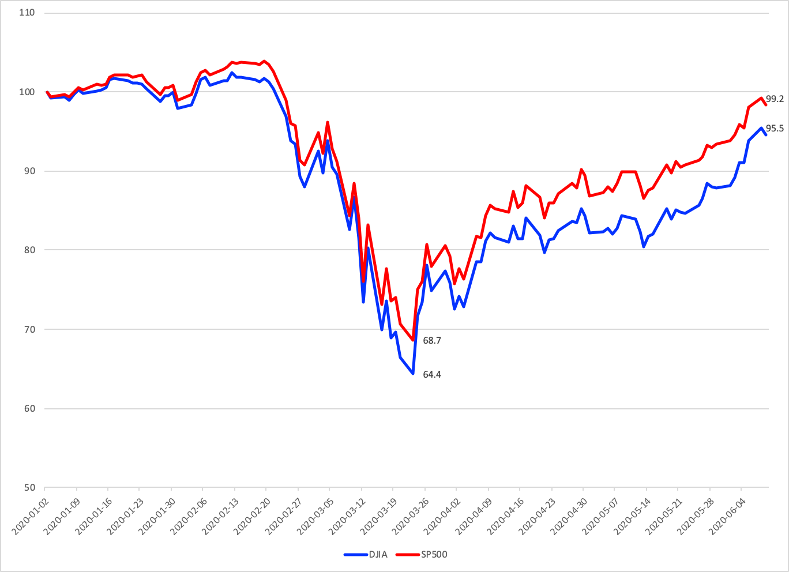
Dow Jones and S&P 500
Day after NBA, MLB
and NCAA postpone
games (3/12)
Largest DJIA fall in
two years on fears of COVID-19
and a weak retail sales report
(2/24)
Passage of the CARES Act (3/18)

Slide 4
Flattening the Curve
Number or Cases
Health Care
Capacity
Time

Slide 5
Flattening the Curve May Deepen and Lengthen the Recession
Health Care
Capacity
Number or Cases
z
Time
GDP (Recession)

Slide 6
Apple Mobility Trends

Slide 7
Plunge in Consumer Spending
Total
Grocery
Transportation
Apparel & Gen Merch
Health
Entertainment
Restaurants

Slide 8
Percent Change in Hours Worked
Source: Homebase

Slide 9
Employment Changes by Firm Size
Source: Cajner, Crain, Dexter, Grigsby, Hamins-Puertolas, Hurst, Kurtz, and Yidirmaz

Slide 10
Businesses Open

Slide 11
Weekly Unemployment Claims: 1/1990 – 3/2020
When the economy is
doing well, initial claims
for unemployment average
about 280,000 to 340,000.
During recessions,
initial claims typically
increase to about 400,000
--the biggest increase had
665,000.

Slide 12
Weekly Unemployment Claims
1/6/190 – 6/9/2020
Weekly average is nearly 4 million per week

Slide 13
March and April: Job Losses

Slide 14
Unemployment Rate
14.7
10.88
9.9
7.9%

Slide 15
JOLTS: Hires and Separations
Separations
Hires

Slide 16
JOLTS: Hires and Separations
Hires fell be roughly 650,000
Separations increased by nearly 9 million

Slide 17
Separations: Quits and Layoffs
Quits
Layoffs

Slide 18
Separations: Quits and Layoffs
Quits fell be roughly 650,000
Layoffs increased by more than 9.5 million

Slide 19
This Time is Different
Great Depression
  A Financial Crisis which and (initial) flawed policy response
  that resulted in persistent high unemployment
Great Recession
  A Financial Crisis
Oil Crisis of 1975 : Supply Shock due to a sharp rise in the price of oil
Prior to the pandemic none of the above:
  Financial markets were not in trouble.
  Real GDP growth was strong buoyed by strong consumer spending.
  Unemployment and inflation were both low.
  Oil prices were falling.
COVID-19 – “Health Shock”
  Supply Shocks: Disrupted supply chains
  Demand Shocks: Limit market transaction in order to reduce the spread
Spanish Flu (1918)
  Structure of production and consumption is notably different

Slide 20
Government Response: Fiscal Response
Respond to the impacted sector(s) – health crisis,
Provide income support for the lower income and most vulnerable,
Provide support to maintain employer - employee matches, and
Provide support for the sectors that are most exposed to the shock.

Slide 21

Fiscal Policy Timeline
Phase I: H.R. 6074
3/6
Phase II: Family First
3/14
Phase IIIa: CARES
3/18
Phase III b
4/24
R&D
Public Health
Medical Supplies
Other
Paid Sick Leave
Family Medical Leave
Covid-19 Testing
Unemployment Expansion
HHLD Payments
Support for Small Firms
Support for Medium Sized Firms
Unemployment Insurance
Aid to States
(More) Support for Small Firms
COVID-19 Testing
Hospitals
Notes:
CARES Act Coronavirus Aid, Relief, and Economic Security Act

Slide 22
Government Response (Phase II): Family First (H.R. 6201)
Free testing for anyone whose doctor recommends testing.
Expand family and medical leave.
Paid emergency sick leave.
Additional unemployment benefits.
Food assistance: Supplemental Nutrition Assistance Program (SNAP) and Home-Delivered.

Slide 23
Fiscal Response (Phase III a-b): CARES Act
Direct payment to households $1,200 for every adult and $500 for every child – similar to the 2008 rebate but purpose is different.
Small business loans (Paycheck Protection Program)-- $350 billion
  <500 employees and designed to cover six (6) weeks of payroll.
Economic Stabilization Fund (Main Street Lending Program) – $500bn
  for medium sized firms,
  state and local municipalities, and
  passenger and cargo air carriers, and firms maintaining national security.
Expand unemployment benefits

Slide 24

Federal Reserve Timeline
March 3
March 15
March 17/18
March 23
April 9
Primary Dealer Credit Facility
(PDCF)
Commercial Paper Funding Funding Facility (CPFF)
Money Market Mutual Fund Facility (MMLF)
Primary Market Corporate Credit Facility
(PMCCF)
Secondary Market Corporate Credit Facility
(CMCCF)
Term Asset-Backed Securities Loan Facility
(TALF)
Paycheck Protection Program Liquidity Facility (PPPLF)
Main Street Business Lending Program
Municipal Liquidity Facility
Federal Funds Rate
Federal Funds Rate
Discount Window Lending
Quantitative Easing
Forward Guidance

Slide 25
Federal Reserve: Standard Operations
Federal Funds Rate: The Federal Reserve lowered the targeted Federal funds rate on March 3 and again on March 15 moving the targeted Federal Funds rate to zero.
Discount Window Lending: Lowered the interest rate it charges banks to borrow from 1.75% to 0.25%.
Reserve Requirement: Lowered the reserve requirement to zero.
Forward Guidance: Honed during the Great Recession the Fed tries to set market expectations on the time path of interest rates over time.

Slide 26
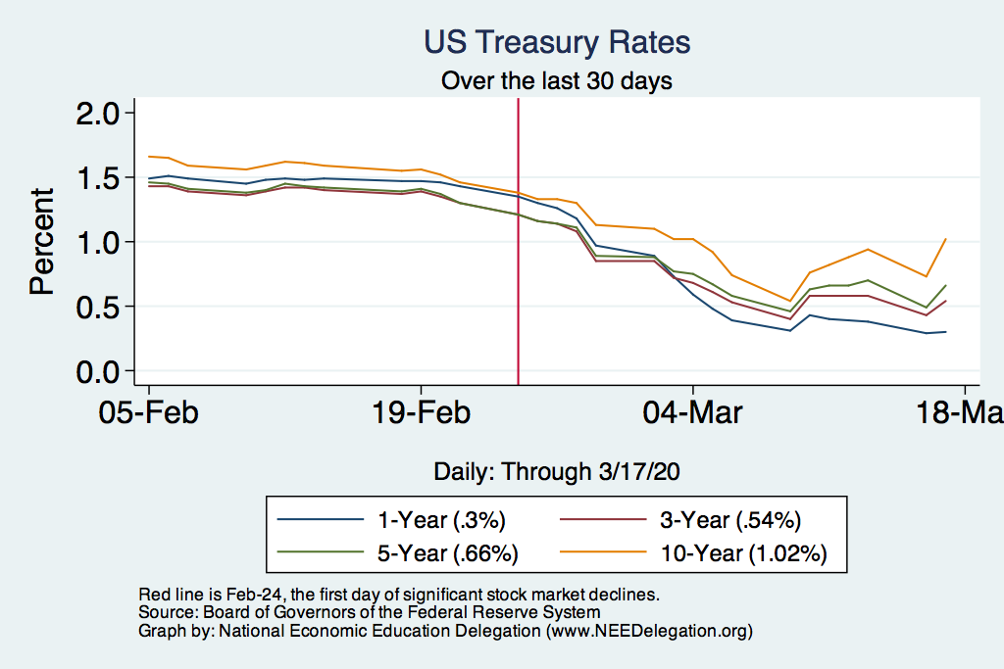
US Treasury Rates: A Safe Haven?

Slide 27
Federal Reserve: Ensure Financial Market Stability
Securities Purchases (Quantitative Easing): Fed Response -- purchase treasuries and mortgage backed securities (3/15).
Re-launched the Primary Dealer Credit Facility (PDCF) in order “smooth market functioning and facilitate the availability of credit to businesses and households (3/17).
Re-instituted the Money Market Mutual Fund Liquidity Facility (MMLF) to “assist money market mutual funds in meeting demands for redemptions by households and investors enhancing overall market function and credit provision to the broader economy.”
Increased liquidity in the repo market. The repo market is where firms borrow and lend cash and short-term securities. The Fed was offering $100 billion in overnight loans and $20 billion in two-week loans.
    The Fed increased the offerings to $1 trillion (from $100 bn) in overnight repos, and
    $500 billion in one month and three-month repos (from $20bn 2/wks).
Notes:
The MMMF funds were experiencing heavy outflows from large corporate and institutional depositors that are desperate to raise cash as the COVID-19 coronavirus rattles the economy and the markets.

Slide 28
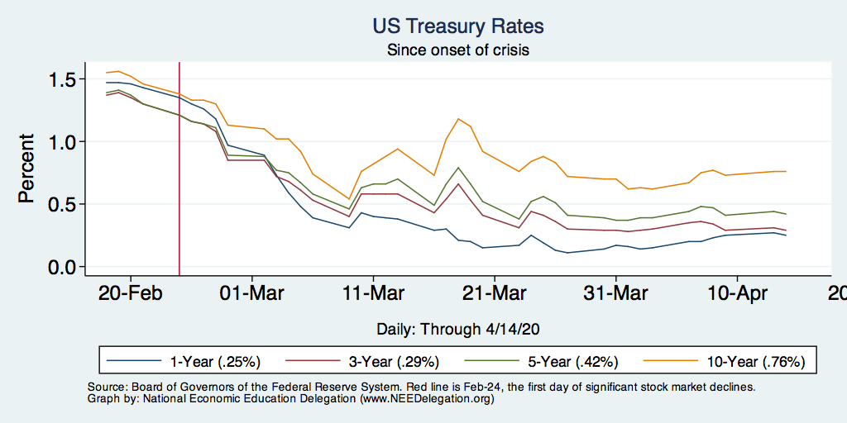
US Treasury Rates: A Safe Haven?
Run to Safety
Cash Grab
Liquidity Working

Slide 29
Federal Reserve: Support Corporations and Business
Created the Primary Market Corporate Credit Facility (PMCF) allows the Fed to lend directly to corporations by buying new bond issuances and providing loans (3/17).
Instituted the Commercial Paper Funding Facility (CPFF) the Fed can purchase commercial paper from firms at a given interest rate – effectively, the Fed is lending directly to firms. (3/17)
Main Street (Expanded) Loan Facility: Through the CARES Act these two programs offer four-year loans to US businesses with up to 10,000 employees or revenues less than $2.5 billion. (4/9)
Paycheck Protection Program Facility: Facilitates loans under the Small Business Administration Paycheck Protection Program
Notes:
In 1932 section 13(3) was added to the Federal Reserve Act, which has permitted emergency lending to bank and nonbank companies by the Board of Governors of the Federal Reserve System (the Federal Reserve).

Slide 30
SBLA Distribution
 | Distribution of PPP Eligible Firms
Firm Size | Percent of Firms | Percent of. Employment | PPP Loan Size (est)
Under 5 | 61.9% | 9.8% | $16,985
5 to 9 | 16.9% | 11.0% | $57,239
10 to 19 | 10.6% | 14.0% | $121,470
20 to 99 | 9.1% | 35.3% | $387,137
100 to 499 | 1.5% | 29.9% | $2,248,253

Slide 31
PPP Loan Major Recipients By Industry
Industry | Amount (Billions) | Percent of Loans
Construction | $44.9 | 13.1
Professional, Technical and Scientific, Services | $43.3 | 12.7
Manufacturing | $40.9 | 12.0
Health Care and Social Assistance | $39.9 | 11.7
Accommodation and Food Service | $30.5 | 8.9
Retail Trade | $29.4 | 8.6
Wholesale Trade | $19.5 | 5.7
These seven (7) industries account for nearly 75% of the PPP loans

Slide 32
Apple Mobility Trends

Slide 33
Businesses Open

Slide 34
Percent Change in Hours Worked

Slide 35
Hours Worked: 3/23 and 6/8

Slide 36
Change in Nonfarm Payrolls (May)

Slide 37
Unemployment Rate

Slide 38
Unemployment: By Gender

Slide 39
Unemployment: By Race

Slide 40
Alternative Measure of Unemployment

Slide 41
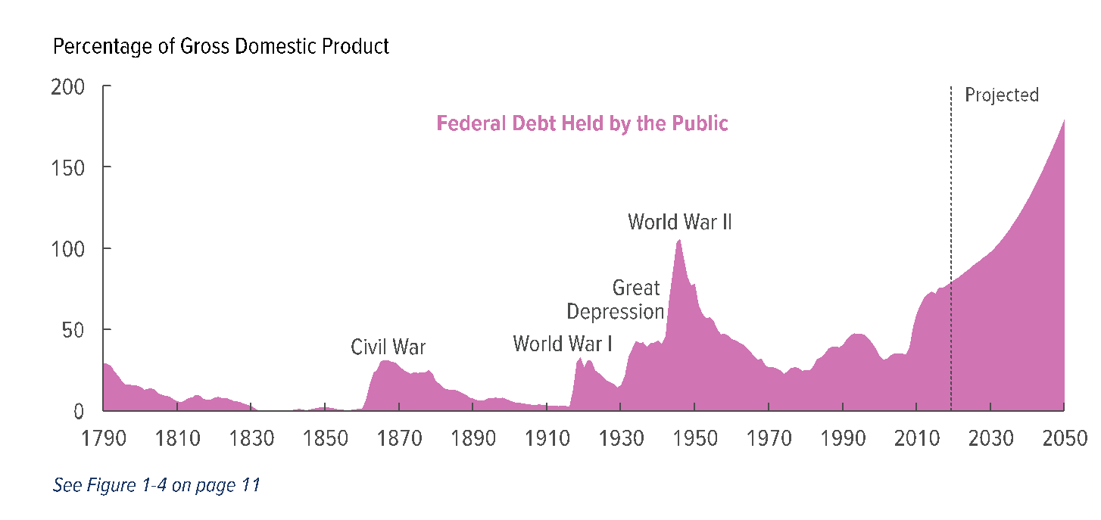
How Do We Pay for This?
Deficit was forecast at 4.9% of GDP – likely to exceed 10% of GDP
Good News: Treasury Interest Rates are Near Zero
Bad News: The Long-term Budget Outlook was already a Mess

Slide 42
Question: Recovery
What sectors are likely to recover the fastest?
  Expect that offices and factories would be the first to open back up.
  Small retailers with limited customers
  Barbershops and beauty salons / Eye doctors and Dentists
  Restaurants
  Lastly: events with large crowds.
Winners:
  Technology,
  Industries that can adapt the fastest
Negatively Impacted
  Individuals with lower educational attainment or those working in sectors where automation can replace face-to-face contact.
  Energy markets
Structural Change:
  More investment in (public) health
  Airlines (teleconferencing)
  Telemedicine, telecommuting, education

Slide 43
Comparison of COVID-19: Fatality an R0
Fatality Rate
100%
(log scale)
Average # of People Infected by Each Sick Person (R₀)

Slide 44
Economic Forecast
Most economic forecasts have GDP in the United States contracting by 5.0%-6.0% for 2020.
Most economic forecasts have world GDP falling in by about -3.0%
The consensus is that that real GDP will start to recover in the third or fourth quarter.

Slide 45
Question: Health of the Economy
Safe and Effective Tests are a Prerequisite:
  Quick tests for who may have the virus.
  Ability to random test a fraction of the population.
  Tests for who has antibodies against the virus.
  Better tracking and containment of outbreaks
Without these prerequisites, the “Costs” of reopening may be high.
Reopen slowly and strategically
Full reopening and consumer confidence will depend on the availability of a vaccine and/or effective therapy

Slide 46

Public Policy: Shelter in Place
We do not know much about the transmission mechanism – differing views of health risks by the general population.
Acts as a coordination policy between owners and employees.
Recovery may be quicker when the SIP are lifted.

Slide 47
Shelter in Place
Early March: Clemson University began discussions of our contingency plans and canceling “non-essential” events that could potentially put individuals at risk.
March 6 — SXSW canceled
March 10 — Ivy League cancels its basketball tournament
March 11 — March Madness will be played without fans
March 12 — March Madness canceled
March 12 — Cato Institute and Brookings Institution shift to mandatory telework
March 13 — Masters and Boston Marathon postponed
March 15 — CDC recommends cancellation of events involving 50+ people
March 16 — Kentucky Derby postponed
March 19 — California becomes the first state to issue a stay‐​home and business‐​closing order

Slide 48
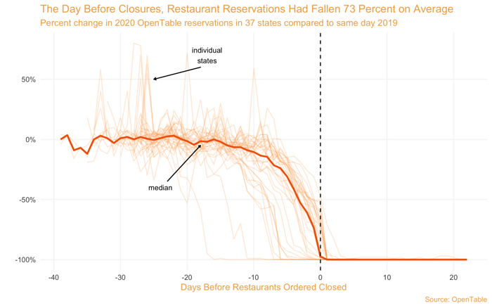
Shelter in Place

Slide 49
What Have We Learned? Positive Take-Aways
May improve and enhance the delivery of some services
Encourage firms, households, governments to have a business continuity plan.
In an integrated world, this will likely not be the last pandemic…
  Improve social insurance for these types of events
  Allow more flexibility to governments and firms to respond

Slide 51

Early COVID-19 Timeline
Dec 31
Jan 20
Jan 31
Feb 9
Feb 11
First case detected
In Hubei Province
First case outside
China (Thailand,
Japan, and South Korea)
White House limits
International travel
Death toll in Mainland
China exceeds SARS
WHO names
new coronavirus
COVID-19
At this point, most believed that the coronavirus would largely be contained within a few countries.

Slide 52
Coronavirus: Supply Chains
If contained, COVID-19 would mainly disrupt manufacturing supply chains.
The more a country’s manufacturing
relied on these supply chains the
bigger the impact on GDP.
Countries | Share of World GDP | Manufacturing as a Share of GDP | Services as a Share of GDP
United States | 24% | 11% | 77.4%
Canada | 2% | 10% | 66.7%
UK | 3% | 9% | 71.0%
Germany | 5% | 20% | 61.8%
France | 3% | 10% | 70.3%
Italy | 2% | 15% | 66.3%
Spain | 2% | 11% | 67.7%
Japan | 6% | 21% | 69.1%
China | 16% | 29% | 52.2%

Slide 53
Coronavirus: Supply Chains
Countries | Share of World GDP | Manufacturing as a Share of GDP | Services as a Share of GDP
United States | 24% | 11% | 77.4%
Canada | 2% | 10% | 66.7%
UK | 3% | 9% | 71.0%
Germany | 5% | 20% | 61.8%
France | 3% | 10% | 70.3%
Italy | 2% | 15% | 66.3%
Spain | 2% | 11% | 67.7%
Japan | 6% | 21% | 69.1%
China | 16% | 29% | 52.2%
If contained, COVID-19 would mainly disrupt manufacturing supply chains.
The more a country’s manufacturing
relied on these supply chains the
bigger the impact on GDP.
If limited to supply chain effects,
COVID-19 was likely to be
to slow GDP by 0.25 to 0.50 from its
baseline prediction – say from 2.5 to 2%

Slide 54
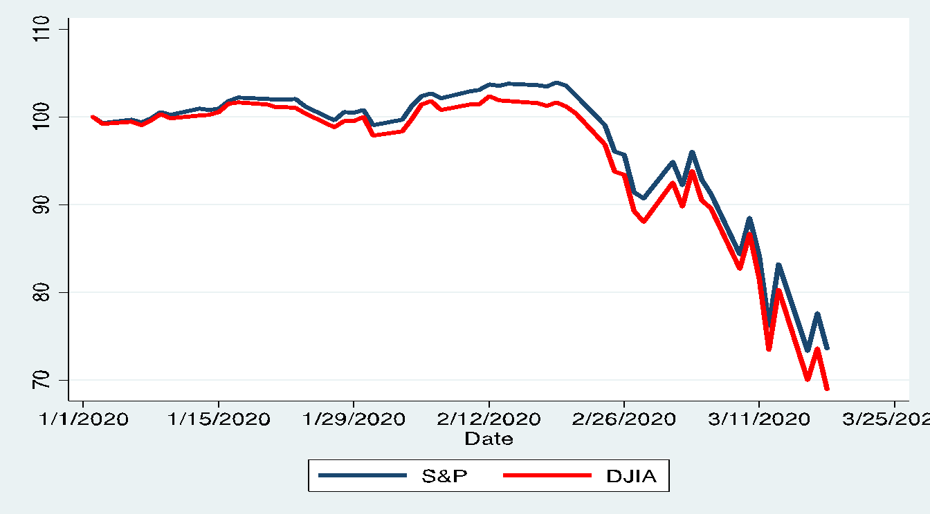
Dow Jones and S&P 500
COVID cases in US
Exceed 500 (3/9)
Largest DJIA fall in
two years on fears of COVID-19
and a weak retail sales report
(2/24)
White House and
Congress independently
discuss fiscal policy (3/13)
Day after NBA, MLB
and NCAA postpone
games (3/12)
Epidemiology

Slide 55
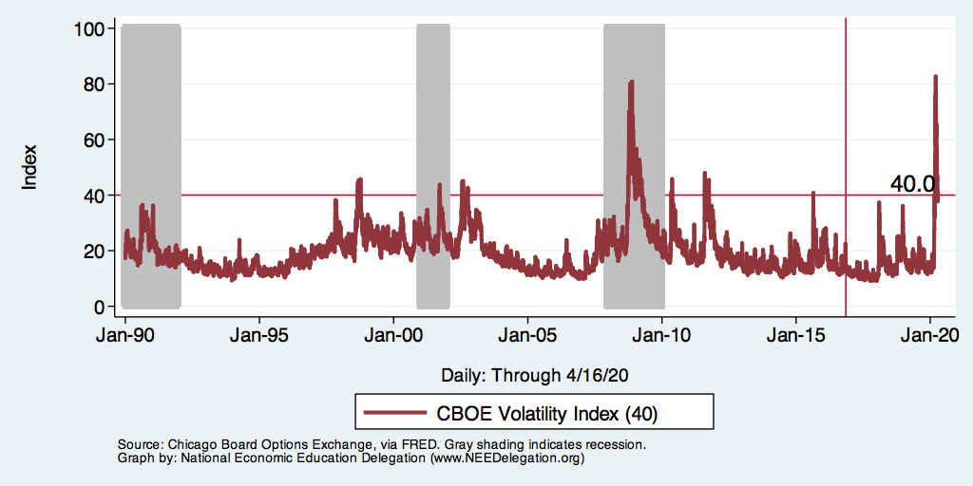
Market Risk and Stress: CBOE VIX

Slide 56
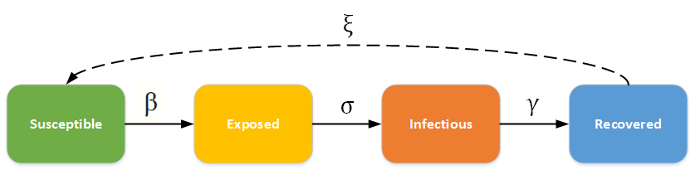
Epidemiology and Flattening the Curve
The importance of testing and social distancing on containment.
Vaccines &
Prophylaxis
Social Distancing

