Slide 1
Enter the url for the collection in your browser. Here’s what you’ll see for Immigration.
Notice the features on the first screen:
Meet Econ Eddie.
He’s your guide through the collection.
Click here when you’re ready to start.

Slide 2
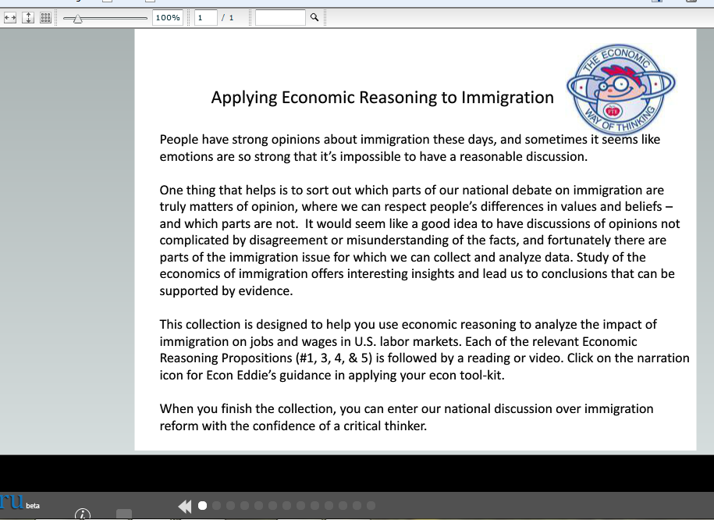
Here’s the first resource in the immigration collection. Take a moment to familiarize yourself with some of the features that you’ll use as you go through the collection.
Use these controls to change the size of the resource on your screen.
Use these controls to move back and forth through the resources.

Slide 3
Econ Eddie’s narration is designed to help you focus on the important features of each resource. He may ask questions, offer background, or emphasize key points.
Another way to size the screen
When this call-out icon is yellow, it means Econ Eddie has narration for this resource. To see the narration, click the icon.

Slide 4
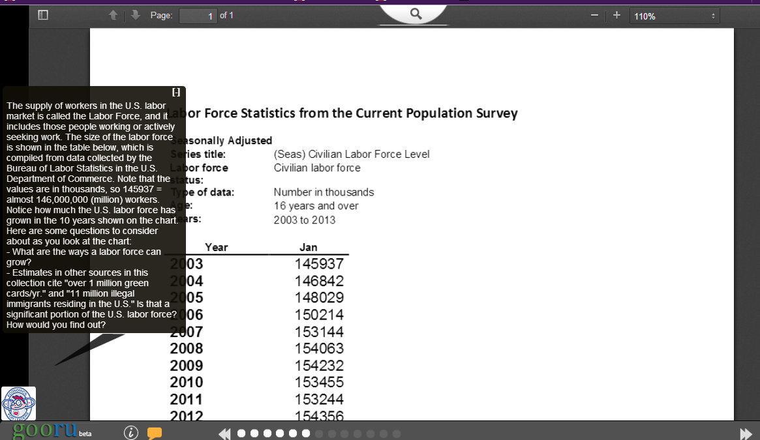
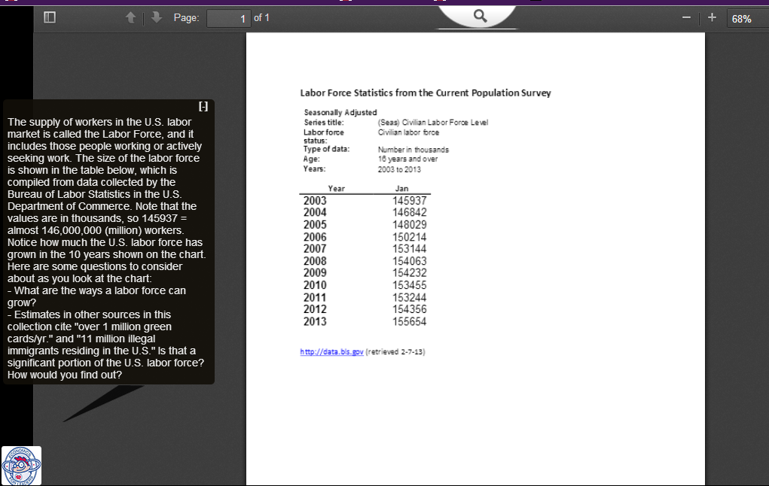
If the narration is in the way, check to see if you can re-size the resource so that it moves out from under the narration.

Slide 5
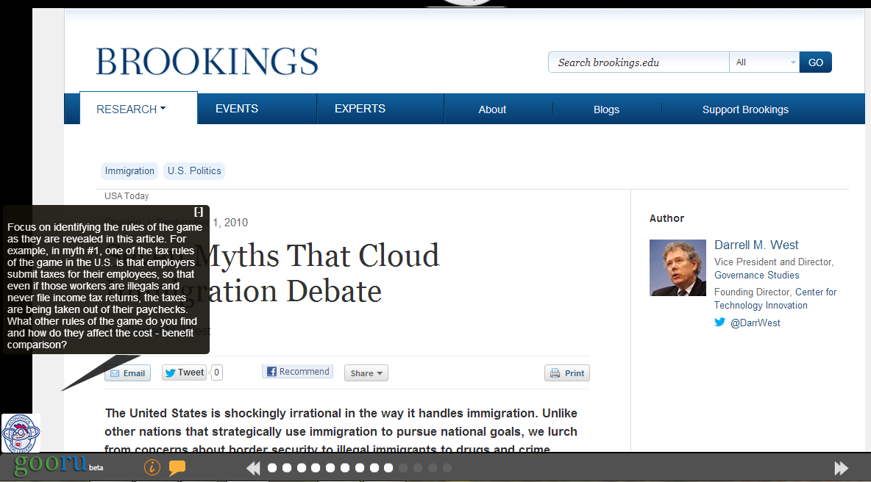
If Econ Eddie is in the way and you cannot re-size the resource to move it out of the way, you can close the narration by clicking here or here, and then re-open it on the next resource.

Slide 6
Controls for video and audio resources appear on the screen between the resource screen and the collection navigation buttons.

Slide 7
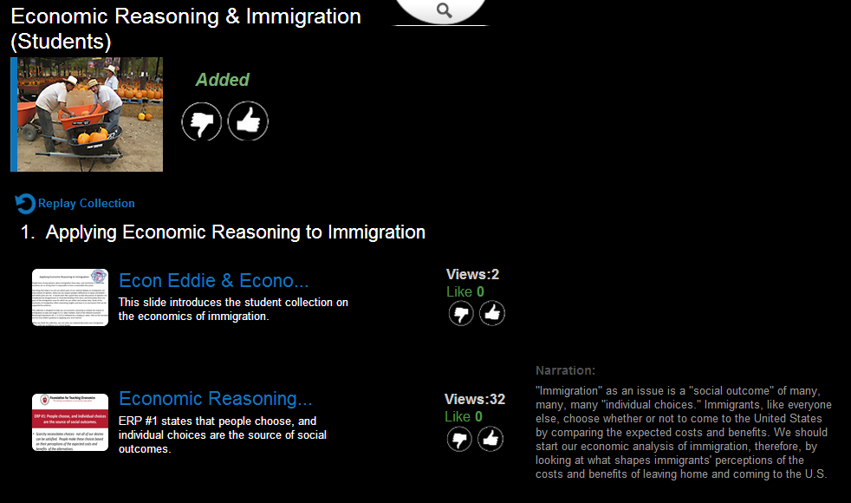
The very last screen in each collection shows all the resources (and any narrations) in the entire collection. You can use this to go back to a particular resource without going through all of them or to re-read the narration.
This feature is for people with their own Gooru accounts. If they want to keep a collection handy for further use, they can add it to their “shelf”
You can weigh-in on how valuable each resource was to you.
(This screen is also useful if you want to see an overview of a collection to get a sense of the steps you’ll be taking or the time required. See the next slide for instructions about how to get here without going through the entire collection.)

Slide 8
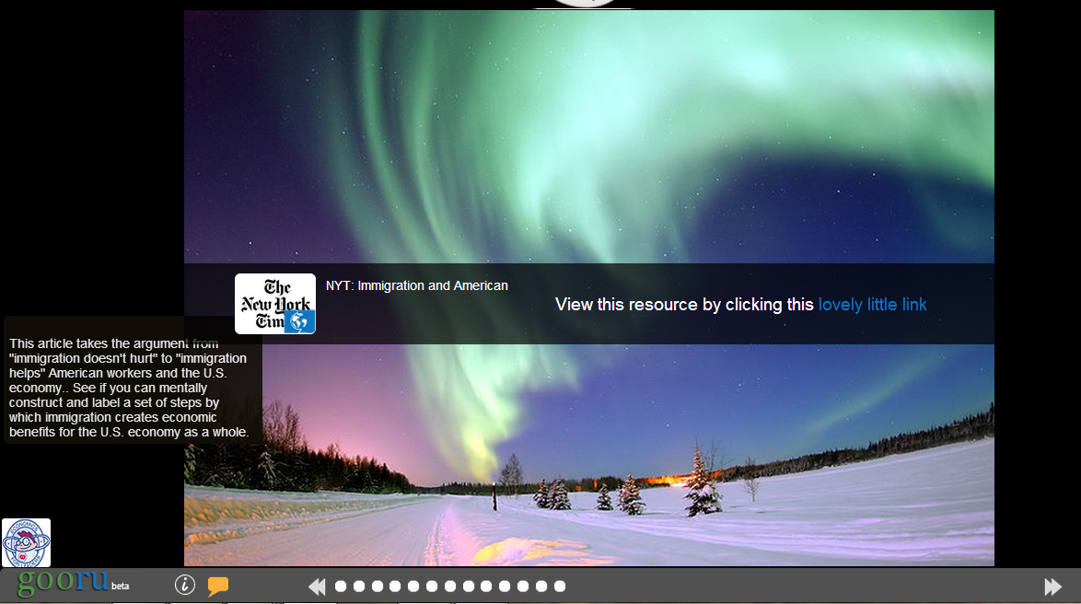
This is the last resource slide in the Immigration collection.
Remember that Gooru is a search engine that links you to resources on the Internet; the resources aren’t “in” Gooru. Sometimes the picture will take you to a new url outside your Gooru collection. When you’ve finished viewing and close the resource, you’ll be right back in your Gooru collection and ready to go to the next resource.
To get to the summary/overview slide without going through the entire collection, click on the last white dot (which will take you to the last resource in the collection), and then click the double arrow on the right.

