Slide 1
State of the Economy What does the data say?
Scott Baier
Clemson University
Foundation for Teaching Economics

Slide 2
Real Gross Domestic Product
Source: Bureau of Economic Analysis

Slide 3
Real Gross Domestic Product
Source: Bureau of Economic Analysis

Slide 4
Real Gross Domestic Product
Two-quarters of negative growth
Source: Bureau of Economic Analysis

Slide 5
NBER Definition of Recessions
The NBER's traditional definition of a recession is that it is a significant decline in economic activity that is spread across the economy and that lasts more than a few months.

Slide 6
NBER Definition of Recessions
The NBER's traditional definition of a recession is that it is a significant decline in economic activity that is spread across the economy and that lasts more than a few months.
The criterion need to be met in some ways and some factors may offset others
depth,
diffusion, and
duration
Employment and changes in employment are indicators used by the NBER in dating business cycles.

Slide 7
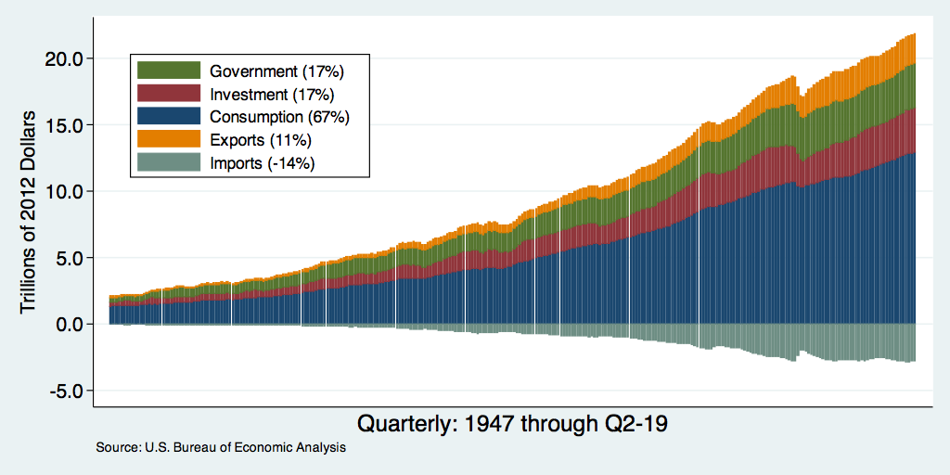
Composition of Real GDP
Notes:
Components sum to GDP
Average % of GDP for each component from 1960-Present: C = 64%, I=15%, G=24%, NX = 2% (X = 7%, M=9%)
Net Exports as a % of GDP has increased over the sample period, but it’s contribution to GDP is relatively small

Slide 8
Understanding Contributions to GDP Growth
GDP Growth is a combination of the growth in its components:
Consumption, Investment, Government, and Net Exports
It’s a weighted average of these components
For example: Consumption
If consumption accounts for 2/3 of the economy,
If consumption grew by 3%,
It implies that consumption growth accounts for 2 percentage points of GDP growth; that is, $2\%=\left(\frac{2}{3}\right)∗3\%$.

Slide 9
Real Gross Domestic Product
Source: Bureau of Economic Analysis

Slide 10
Personal Consumption Expenditures

Slide 11
Consumption’s Contribution to GDP Growth
Generally, speaking consumption accounts for about two-thirds of GDP growth
Source: Bureau of Economic Analysis

Slide 12
Consumption’s Contribution to GDP Growth
Source: Bureau of Economic Analysis

Slide 13
Personal Income and Expenditures
Personal Income
Personal Expenditures
Source: Bureau of Economic Analysis

Slide 14
Excess Savings
Source: Bureau of Economic Analysis and author’s calculations

Slide 15
PCE Goods and Service Expenditures
Services
Goods
Source: Bureau of Economic Analysis

Slide 16
PCE Goods and Service Expenditures
Goods
100
Services

Slide 17
PCE Goods and Service Expenditures
100
Source: Bureau of Economic Analysis

Slide 18
PCE Goods and Service Expenditures
100
Source: Bureau of Economic Analysis

Slide 19
Investment Spending and GDP Growth
Source: Bureau of Economic Analysis

Slide 20
Mortgage Rates
Source: Bureau of Economic Analysis

Slide 21
Government Spending and GDP Growth
Source: Bureau of Economic Analysis

Slide 22
Net Exports and GDP Growth
Source: Bureau of Economic Analysis

Slide 23
Takeaways from GDP and Components
GDP growth has been supported by relatively strong consumption growth.
Consumption remains “tilted” toward goods rather than services
Consumers are spending through the excess savings that accumulated during the pandemic.
Investment spending
Higher mortgage rates will likely slow residential investment.
Fixed investment remains uncertain.
Net Exports
Exports will depend on world GDP growth– if the GDP growth slows globally it will likely reduce exports.

Slide 24
Why was GDP Growth So Low in 2022 Q 1& Q2?
First quarter, Omicron Variant impacted GDP growth
Changes in Business Inventories (part of Investment) has less persistence than other components of GDP.
In 2021:Q4 Changes in business industry were one of the main reasons GDP growth was so in at the end of the year (5%)
It seemed likely that this would slow in 2022:Q1 and they did (1%)
It fell even more in 2022:Q2 (-2%)
Net Exports also were one of the reasons that GDP growth was slow.
Much of this had to to with increased processing of imports at the ports (-3%)
Source: Bureau of Economic Analysis

Slide 25
What is the Data Telling Us Now?
The Atlanta Fed’s predictor of GDP growth in 2022:Q3 is 3.1!
Driven by two factors Consumption Spending (1%) and Net Exports (2.25%)
Investment spending growth is expected to fall (-0.60%) mostly driven by the decline in residential investment.
Government expenditures are expected to add about 0.60% to GDP
Going forward
Depends on how difficult it is for the Federal Reserve to bring inflation down.
Also depends on supply-side factors like productivity growth and innovation
In the long-run, economic growth is driven by productivity growth, but it is difficult to project where and when the productivity growth is going to come from.

Slide 26
Unemployment
Source: Bureau of Labor Statistics

Slide 27
Employment
Source: Bureau of Labor Statistics

Slide 28
Employment Changes
Source: Bureau of Labor Statistics

Slide 29
Job Losses: February and May 2020
Source: Bureau of Labor Statistics

Slide 30
Job Losses and Gains: February and September 2022
Source: Bureau of Labor Statistics

Slide 31
Job Openings and Hires
Job Openings
Job Hires
Source: Bureau of Labor Statistics

Slide 32
Employment Changes by Age Group

Slide 33
Wage Growth by Industry
Inflation Rate

Slide 34
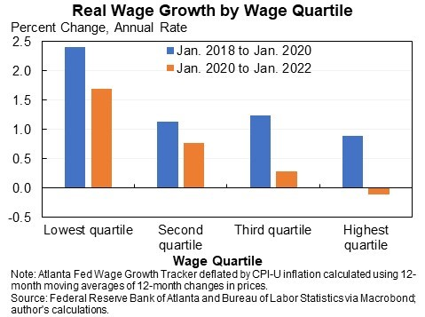
Wage Growth Adjusted for Inflation

Slide 35
Employment Situation
Employment: Economy continues to add jobs
The challenge has been for employers to fill vacancies.
Why?
Extended (or expected continuation) unemployment benefits and other stimulus payments
Workers reluctant to work in certain industries and occupations
Workers looking for different career opportunities.
Workers looking for better employment opportunities withing their industry/occupation – non-pecuniary benefits
Increased desire to have the option to work from home.
Better working conditions
Recognition of accomplishments

Slide 36
Inflation
Source: Bureau of Labor Statistics

Slide 37
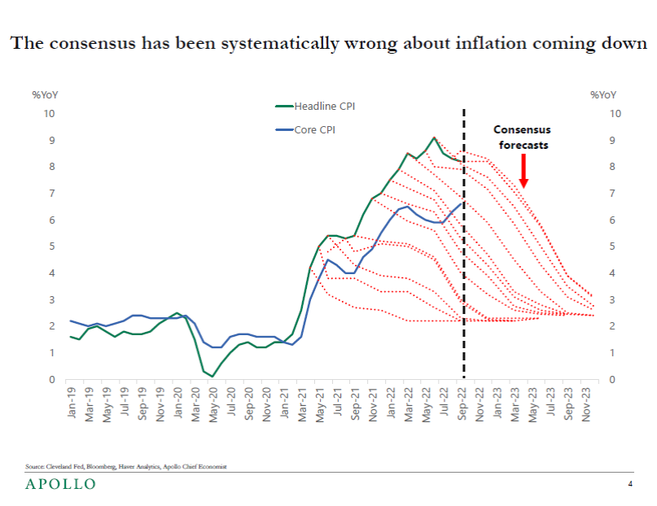
Transitory Inflation?

Slide 38
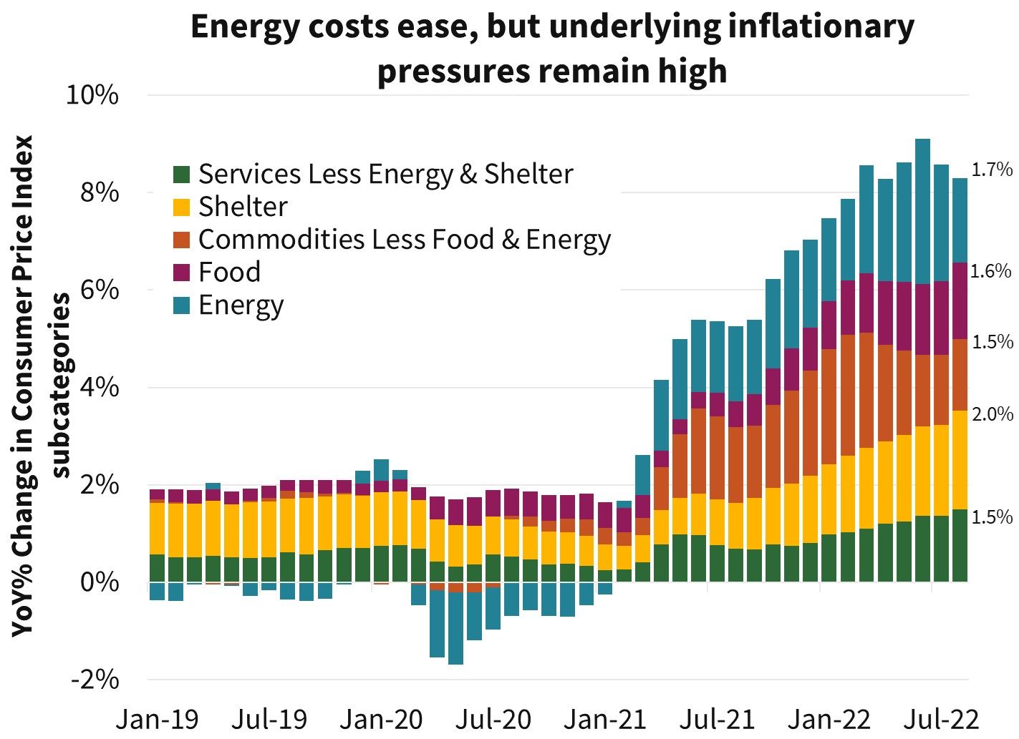
Source: BLS and Jason Furman

Slide 39
Global Supply (and Demand) Chains
Pressure seems to be easing but it is still above pre-pandemic levels
Source: New York Federal Reserve

Slide 40
PCE Goods and Service Expenditures
100
Source: Bureau of Labor Statistics

Slide 41
Percent Change in Goods and Service Prices

Slide 42
Is Inflation a Global Phenomenon?
Yes, but the sources may be different.
In terms of basic supply and demand …..
the price increases are supply-driven, we will see higher prices and lower quantities – negative supply shocks --> real GDP below trend.
If the price increases are demand-driven, we will see higher prices and higher quantities – positive demand shocks -> higher nominal GDP.
We can look at real GDP and Nominal GDP
If real GDP is at or above trend, demand shocks are likely to be more important.
If nominal and real GDP are above trend, it is likely the case that demand shocks are also more important.

Slide 43
Is Inflation a Global Phenomenon?
It looks like Supply shocks are more important in the EURO area
Source: BLS / FRED

Slide 44
Is Inflation a Global Phenomenon?
For the US it looks like demand shocks are more important

Slide 45
Is Inflation a Global Phenomenon?
Why do we care?
If the shocks are demand-driven, it means that the government response (stimulus) to the pandemic is, at least, partially responsible for the higher inflation.
If the inflation is demand-driven, the Central Bank is better equipped to respond to higher demand than supply-side shocks.

Slide 46
Money Growth: M2 (Transactions Money)
6 percent

Slide 47
Annualized Money Growth
Growth Rate of Money Stock (percent per year) | Beginning of Period | End of Period
6.15 | January 2000 | March 2020
37.3 | March 2020 | July 2020
12.44 | July 2020 | December 2021

Slide 48
Federal Funds Rate
The Federal Reserve will likely
increase the Federal Funds Target Rate
by 75 basis points next week.
In December, t he Federal Reserve may
increase the Federal Funds Target Rate
by 50-75 basis points next week.

Slide 49
Money Growth: M2 (Transactions Money)
6 percent

Slide 50
Takeaways
Economic Growth: The recovery has been a V-shaped recovery
The economic recovery should continue through 2022.
Atlanta Fed predicts US growth to be 3.1% in 2022:Q3
Economic growth in 2022:Q1 was muted for the reasons discussed below.
Tailwinds: Strong consumer demand
Headwinds: Inflation, supply chain disruptions (?), rising commodity prices, labor market challenges
The labor market still faces some challenges
The unemployment rate is low.
We have just recently reached the pre-pandemic levels of employment.
In some (service) sectors, we have not reached pre-pandemic employment levels
Inflation: Can the Fed bring down inflation without sending the economy into a recession.
Political Uncertainty

