Slide 1
A CENTURY of The federal reserve: success or failure?
Lawrence H. White
George Mason U.
Foundation for Teaching Economics
23 April 2015
00:50

Slide 2
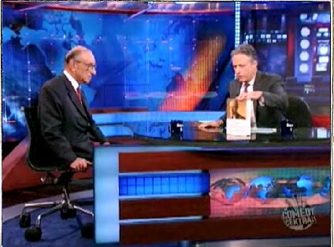
Why was the federal reserve established?
“Many people are free-market capitalists, and they always talk about free-market capitalism, and that is our economic theory. So why do we have a Fed? Is the free market – wouldn’t the market take care of interest rates and all that?”
Daily Show, 18 Sept. 2007
01:04
Notes:
00.50

Slide 3
Why was the federal reserve established?
“You’re raising a very fundamental question. … You didn’t need a central bank when we were on the gold standard, which was back in the nineteenth century. And all of the automatic things occurred because people would buy and sell gold, and the market would do what the Fed does now.”
  Note: Because the US was on the gold std. in 1913 when the Fed Reserve Act was passed.
Daily Show, 18 Sept. 2007
03:00
Notes:
01:04

Slide 4
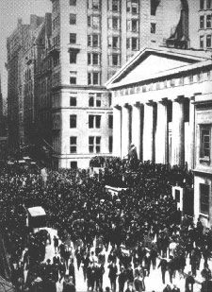
Panics of the pre-fed era
Milder in 1884, 1890
More severe in 1873, 1893, and 1907
  widespread suspensions, runs
  “currency famine”
Run- and panic-proneness of US banks not natural, but due to policies that weakened US banks
  No such problems in Canada
Panic of 1907, NYC
03:40
Notes:
03:00

Slide 5
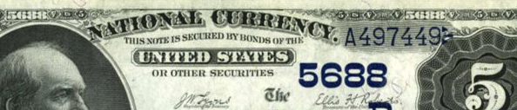
Policies that weakened National Banks
restrictions on branching (contrast Canada)
  poorly diversified banks→ failure-prone → run-prone
collateral restrictions on note-issue (contrast Canada)
  seasonal demands led to reserve drains
  banks couldn’t issue more notes to swap for deposits even in a currency famine
06:20
Notes:
03:38

Slide 6
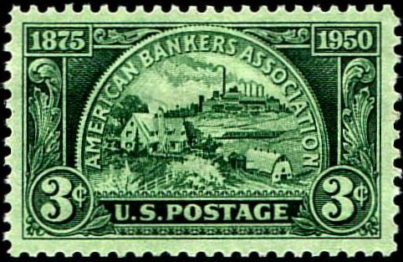
Reform discussed but not adopted
Deregulation a la Canada: ABA’s 1894 “Baltimore Plan”
  end bond-collateral restriction on note-issue
  branch banking to provide speedier drain for excess notes
  opposed by small banks
07:30
Notes:
06:18

Slide 7
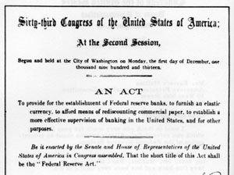
Instead of deregulation: The Federal Reserve Act, 1913
To provide for the establishment of Federal reserve banks, to furnish an elastic currency, to afford means of rediscounting commercial paper, to establish a more effective supervision of banking in the United States, and for other purposes.
08:40
Notes:
07:30

Slide 8
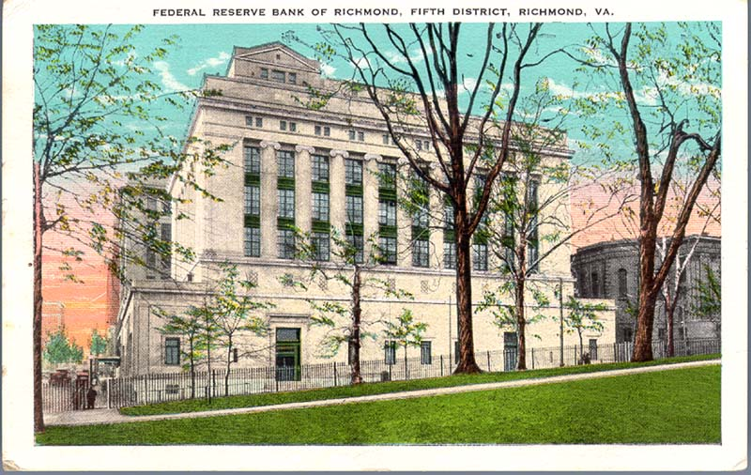
Federal Reserve act “nationalized” 3 key clearinghouse roles
bankers’ banks
  for interbank payments: check clearing and settlement
lender of last resort
  seasonal and emergency elasticity to currency, reserves
supervision of member banks
10:50
Notes:
08:39

Slide 9
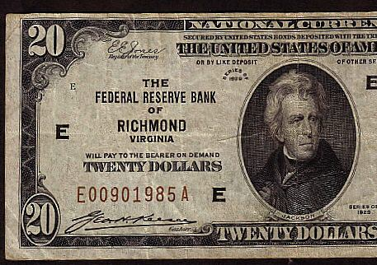
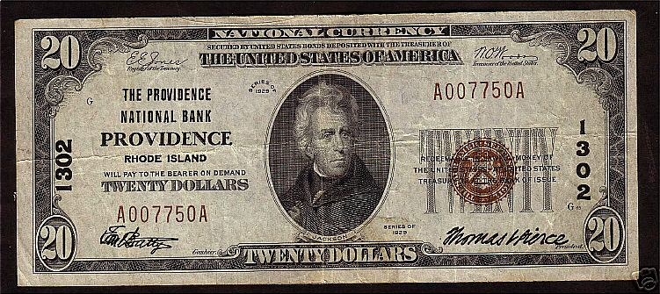
The fed assumed two additional key roles
  Conducting an active monetary policy (during WWI)
    FR Act assumed that gold standard will determine money supply
  Monopoly of paper currency issue (during the 1930s)
    National Banks continued to issue notes until then
12:10
1929 notes
Notes:
10:50

Slide 10
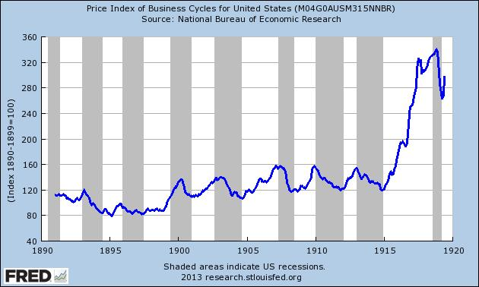
Pre-Fed period vs. Fed during WWI: price index for 10 industrial and agricultural commodities
13:10
Notes:
12:08

Slide 11
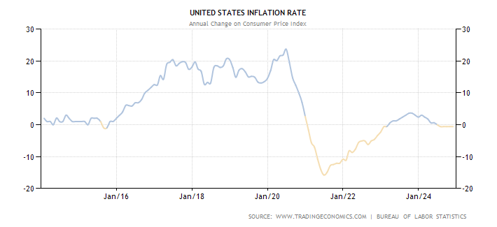
The Fed’ 1st decade, 1914-24: 20+% inflation, then sharp (partial) correction
WWI
14:10
Notes:
13:10

Slide 12
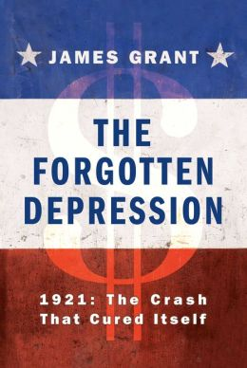
(Recommended)
14:40
Notes:
14:07

Slide 13
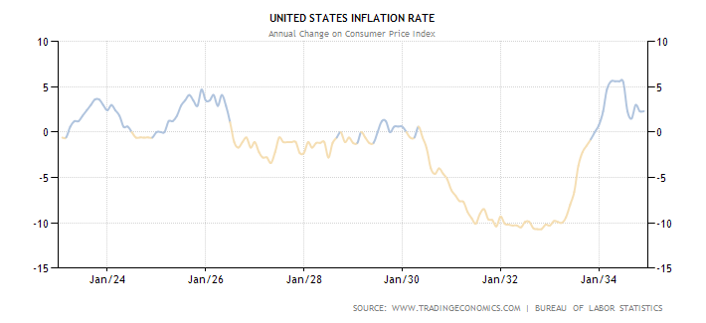
The Fed’ 2nd decade, 1924-34: boom, bust,
Great Contraction with 10% deflation
Great Contraction
Boom ends
Gold confiscation, devaluation
19:55
Notes:
14:40

Slide 14
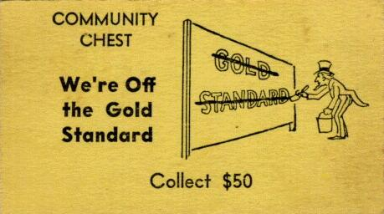
20:20
Notes:
19:55

Slide 15
Why did the fed fail so badly to prevent the great contraction?
Bordo and Wheelock (2010): The Federal Reserve Act
    failed to spell out the Fed’s duty in a panic
    created a system that depended on the competence of authorities currently in charge, rather than on a set of rules
    failed to reform the crisis-prone U.S. banking system to allow a more stable branch banking system, such as Canada’s
Friedman and Schwartz (1963):
The Fed took over the roles of the private clearinghouses, then did less than they had done in 1907 to stem panics
23:00
Notes:
20:18

Slide 16
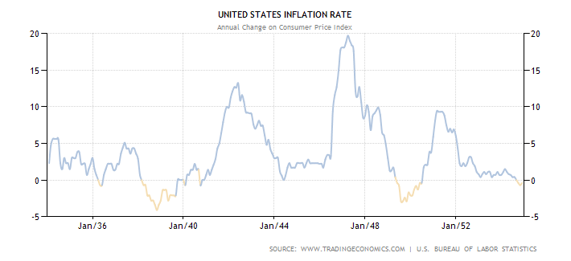
1934-54: deflation, 20% inflation, The Accord
WWII
The Accord
25:30
Notes:
23:00

Slide 17
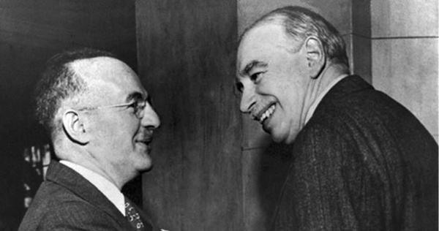
1944: Bretton Woods begins
1 oz. Au = $35
Harry Dexter White, John Maynard Keynes: Bretton Woods, NH, July 1944
27:50
Notes:
25:30

Slide 18
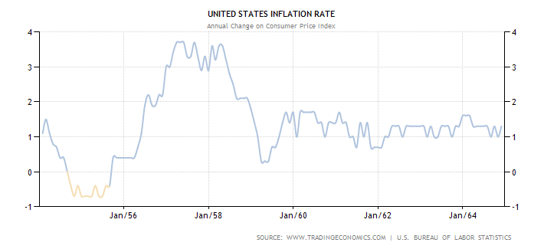
1954-64: not so bad! the most successful period for the Fed: due to Bretton woods constraint?
28:30
Notes:
27:50

Slide 19
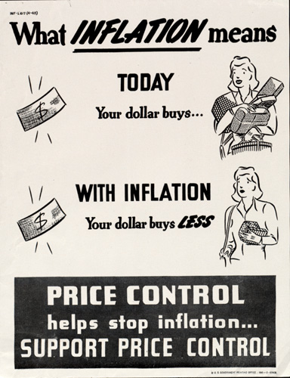
28:50
Notes:
28:30

Slide 20

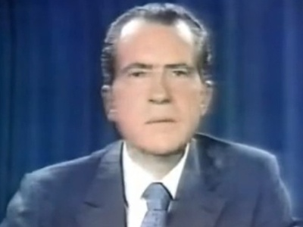
1971: Bretton Woods ends
Pres. Richard Nixon, 8 August 1971
29:20
Notes:
28:50

Slide 21
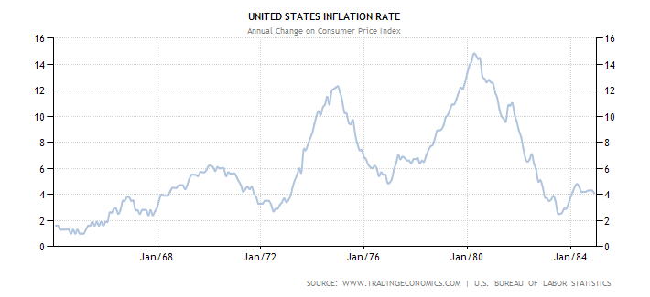
1964-84: the peacetime Great Inflation the second-greatest failure of the Fed
BW ends
Volcker appt.
30:40
Notes:
29:20

Slide 22
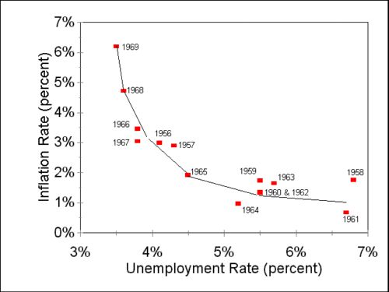
Playing the Phillips Curve, 1964-69
31:45
Notes:
30:40

Slide 23
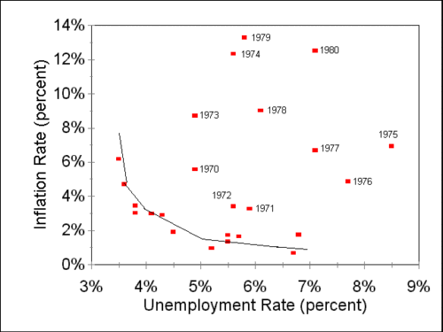
After 1969: where did the Phillips Curve go?
32:00
Notes:
31:45

Slide 24
After 1969: where did the Phillips Curve go?
34:35
Notes:
32:00

Slide 25
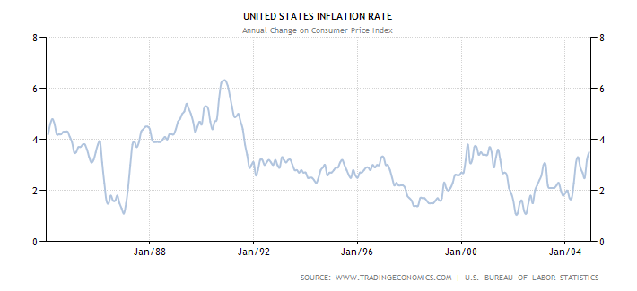
1984-2004: the Great Moderation
35:15
Notes:
34:35

Slide 26

The Taylor Rule
R_{t} = 1 + 2.5π_{t} - 0.5y_{t}, where
  R_{t} is current Federal Funds Rate target
  π_{t} is current inflation rate
  y_{t} is current “output gap” (estimated potential real GDP minus actual real GDP, in %)
A description of Fed policy 1987-2002
A norm for policy: Great Moderation while the Fed followed it
  Housing bubble when the Fed held R below Taylor Rule target (next slides)
36:50
Notes:
35:15

Slide 27
R “too low too long”
Note: In the lecture, White mis-identifies the colors of the two lines on this graph. The gray, “spikey” line IS the Taylor rule projection.
38:10
Source: L. H. White in Beckworth, ed., Boom and Bust Banking (2012)
Notes:
36:50 says these backwards – Fed Funds rate is black

Slide 28
38:40
Source: L. H. White in Beckworth, ed., Boom and Bust Banking (2012)
Notes:
38:10

Slide 29
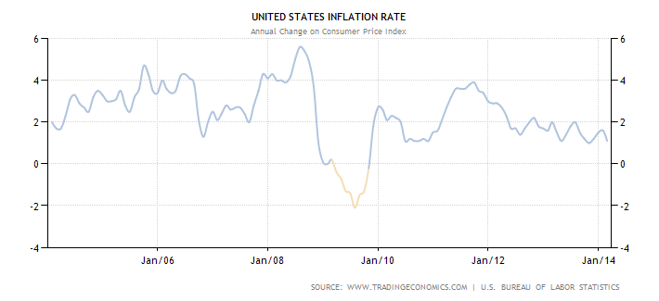
2004-14: housing boom, great recession
Bernanke era
39:25
Notes:
38:40

Slide 30
2004-14: housing boom, great recession
2009 a year of deflation
Bernanke era
40:05
Notes:
39:25

Slide 31
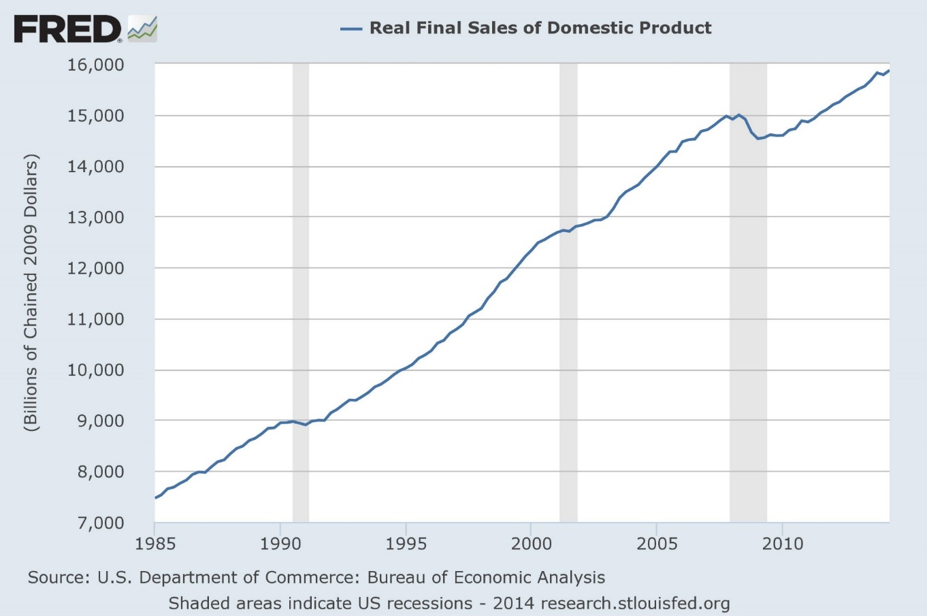
Boom gives way to bust, 2008
40:25
Notes:
40:05

Slide 32
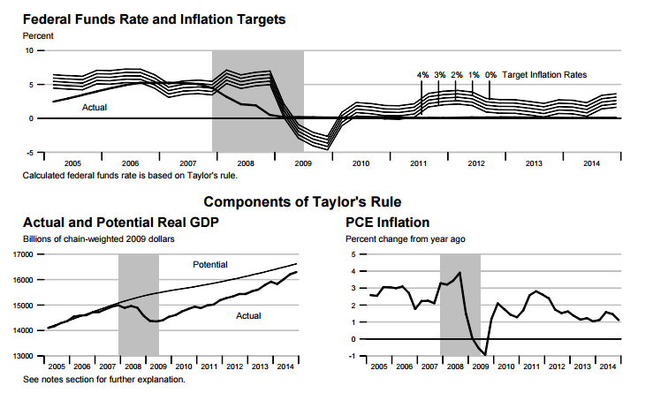
Zero interest rate policy + QE
43:10
Source: St. Louis Fed Monetary Trends, 14 April 2015
Notes:
40:25

Slide 33
Dangers of interest rates too low for too long
Failure to clear out dead wood → “Zombie” finance, slow growth
  Zombie banks stay open at ultralow interest rates
  Zombie banks finance Zombie business firms that “basically drag [other firms] into the pit. Potential growth decreases. There are all kinds of evidence of this in Japan.” --William R. White, 21 July 2014
New asset-price/credit bubble, setting stage for next crisis
  Stock markets at record high levels
  W. R. White: “For the G-20, the total debt the non-financial private sector climbed about 30% since the crisis.”
Lax fiscal discipline
  At ultralow rates, spendthrift governments can pile up debt painlessly
  When rates return to normal, danger of Greek-style debt trap
46:25
Notes:
43:10

Slide 34
Interest on Excess Reserves + QE
BoG press release, 6 Oct. 2008: “The payment of interest on excess reserves will permit the Federal Reserve to expand its balance sheet as necessary”
  Between the lines: without corresponding expansion in M2 or the price level
  Not a coincidence that IOER and QE1 began together
If it didn’t raise the M2 path, because sterilized by IOER, what was the point of QE?
  Credit allocation -- to raise relative MBS prices
  Disguised fiscal policy: outside the debt ceiling limit, without Congressional vote
48:30
Notes:
46:25

Slide 35
Fed’s stabilization track record in sum
Success requires the Fed to stabilize aggregate spending, i.e. to vary M in response to money hoarding faster than market prices adjust
Limited ability to forecast hoarding has made changes in M growth in practice
  poorly timed
  the wrong size
  E.g. expansion too little, too late to stop 2009 deflation
Yellen Fed may tighten too little, too late to stop next upswing in inflation
y
steady M policy
poorly timed
stop-go policy
time
50:15
Notes:
48:30

Slide 36
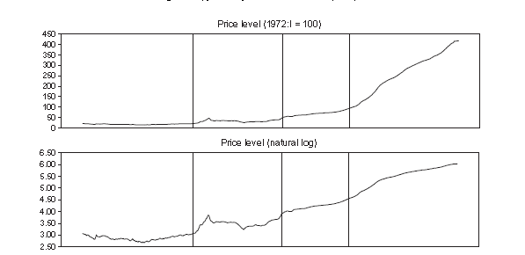
By contrast to classical gold standard,
The Fed has increased the avg. inflation rate
Pre-Fed gold std., 1879-1914: -0.05% Fed, 1971-2013: 4.25%
Source: Selgin, Lastrapes, White (2012)
52:00
Notes:
50:15

Slide 37
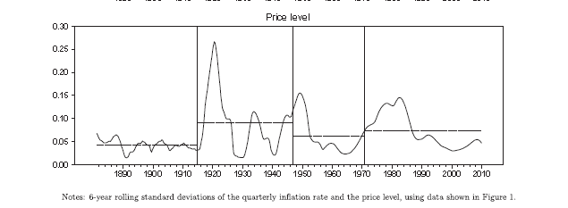
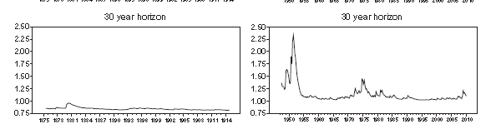
The Fed has increased price level uncertainty
Source: Selgin, Lastrapes, White (2012)
Price level uncertainty: 6-year rolling std. deviation of the quarterly price level
53:20
Conditional variance of price-level forecast errors, 30-year horizon
Pre-Fed
Post-WWII
Notes:
52:00

Slide 38
The Fed has not reduced output volatility
even though US output has become more diversified, with more fiscal “automatic stabilizers,” and smaller measured supply shocks
In response to aggregate demand shocks, Fed has tended to enlarge deviations of output by inappropriate monetary policy
Output volatility (% std. dev. from trend), Romer Quarterly GDP ests.
1869-1914 1915-2009 1915-1946 1947-2009
2.7 5.7 9.2 2.6
54:20
Notes:
53:20

Slide 39
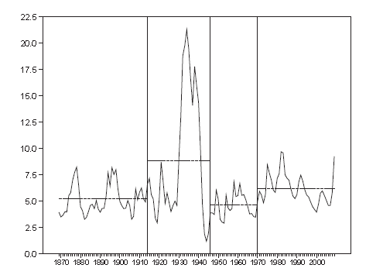
The Fed has not reduced unemployment
US Unemployment rate, 1869-2009
55:00
Notes:
54:20

Slide 40
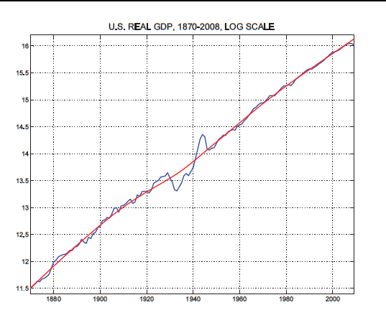
The Fed has not raised real growth
Source: Robert E. Lucas, Jr. (2011)
55:20
Notes:
55:00

Slide 41
How might we get better results?
Bind the Fed with a weighted dual mandate
  i.e. make it stick to a specified Taylor Rule
Bind the Fed with a single mandate
  Target the path of a price level exclusively
  Better: Target the path of nominal GDP
    Hayek (1931): stabilize “the money stream”
    Productivity norm: when surge in output reduces inflation, don’t offset with M injections, and vice-versa
End the Fed with a gold standard plus free banking
  If not politically feasible, at least a benchmark for Fed accountability
Notes:
55:20

